Slide 1



Slide 2


What are going to learn today?
Australia as a destination
Why study in Australia?
Understanding Australian Education System
Post study work permit? What is it? Duration?
Universities we represent
Application process
Admission requirement
GS process in Australia
Understanding part-time work opportunities

Slide 3

About Australia
Top study destination among international students.
Excellent education opportunities offered at world’s leading academic institution.
Education system is research based which makes the graduates highly sought after.
International students are allowed to work up to 48 hours per fortnight.
Graduates can stay back in the country for 2-5 years and work full-time.
Australia is a very safe and welcoming place to live and study, consistently ranking among the safest countries in the world.
94 per cent of international students rated their overall living experience in Australia positively.
Cultural diversity and inclusive environment
Favorable climatic conditions
Reasonable cost of living.

Slide 4
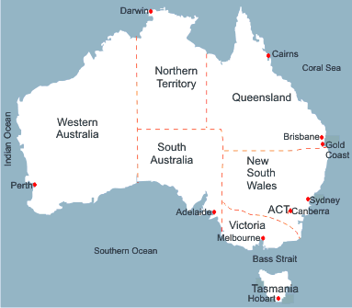
Australian States and Capitals

Slide 5
Intakes available with Australian Universities
Major Intakes
February and July
Offered by Universities and Private Colleges
Courses offered: All popular areas
Minor Intake
October/November
Offered by Private Colleges and some of the major universities
Courses offered: Business, Information Technology and Engineering

Slide 6
Programs offered by Australian Universities
Pharmacy
Business, Management & Accounting
IT & Computer Science
Architecture & Urban Planning
Hospitality & Tourism
Programs offered by Universities
Media & Communication
Engineering & Project Management
Biotechnology & Biomedical Sciences
MBBS, Nursing & Public Health
Education & Teaching

Slide 7
Understanding Australian Education System.
Australia's education system is considered one of the best in the world. The system is known for its focus on practical learning and independent thinking.
Levels of the Australian Qualification Framework (AQF)
AQF Level | Qualifications
10 | Doctoral Degree
9 | Masters Degree
8 | Graduate Diploma Graduate Certificate Bachelors Honors Degree
7 | Bachelors Degree
6 | Associate Degree Advanced Diploma
5 | Diploma
4 | Certificate IV
3 | Certificate III
2 | Certificate II
1 | Certificate II

Slide 8
Admissions Requirement
Bachelors
Criteria | Undergraduate Courses
Percentage | The student must have 4 major components. National Board – 60% State Board – 70-75%
English language proficiency | IELTS and PTE are majorly recognized. IELTS – overall 6.0 with no band less than 6.0 PTE – 50 with no band less than 50
Gap | Only 2023 pass-outs accepted. No gaps accepted for undergraduate courses. 1-year diploma NOT accepted after year 12.

Slide 9
Admissions Requirement
Masters
Criteria | Postgraduate Courses
Percentage | Section 1 & 2 University – 50% to 60% (depending upon the institute) Section 3 University – 70% Other countries – 50-55%
English language proficiency | IELTS and PTE are majorly recognized. IELTS – overall 6.5 with no band less than 6.0 PTE – 58 with no band less than 50
Gap | 5 to 6 years of work experience is accepted with proper justification.
Salary | Cash salary NOT accepted
Marriage | Minimum 1 year old marriage is acceptable

Slide 10
Admissions Requirement
Masters
Follow NOOSR Guidelines
(National Office of Overseas Skills Recognition – An Australian
Government Agency assessing level of overseas qualifications)
Note: Entry requirements may vary depending on the university and programs

Slide 11

Application Process Australia
Application Process
Conditional Offer Letter
GS Process
Unconditional Offer Letter
Make Payment
Get eCOE
Visa Process
Notes:
3rd most popular international students’ educational destination.
Moderate climate
As per the QS Best Student Cities Rankings 2023, seven Australian cities are ranked in the top 100 best student cities. Here are the seven best cities to study in Australia for international students. SYDNEY, MELBOURNE, ADLEAIDE, GOLD COAST, BRISBANE, PERTH, CANBERRA.

Slide 12
Course Relevancy
Picking the right course is the most important for you student visa in Australia.
For Arts students:
For Commerce students:
For Science students:
*these are some instances, for better understanding about what course relevancy is.

Slide 13

GS – Genuine Student Criteria
“GTE – Genuine Temporary Entrant ”
GS Parameters
Overall profile of the applicant (academic scores, IELTS score and work experience)
Student’s financial documents – 1 Year tuition fee + Living Expense AUD 29710 + Travel cost AUD 2200
Relevance of the program to student’s educational background
Students’ awareness of the program structure, costs, units, etc.
Gaps in the student’s profile and the evidence he can furnish to explain the reasons
Student’s reasons for choosing not to study in India

Slide 14

GS – Genuine Student Criteria
Acceptable Funds
Australian Universities accept following types of funds
Education Loans
Balance in Savings Bank Accounts
Fixed Deposits

Slide 15
GS – Genuine Student Criteria
Acceptable Sponsors
Parents
Grandparents (Maternal/Paternal)
Siblings (brother/sister)
Student himself
Uncle/Aunt (not more than 20%-25% of the total fund requirement)
Non-acceptable Sponsors
Cousins
Family Friends
Distant Relatives

Slide 16
GS – Genuine Student Criteria
EDUCATION Loan
Should be availed from an acceptable financial institution
Should not be ‘In-Principle’ or ‘Conditional’ and should be fully sanctioned
Valuation Report of the property
Collateral security can be asked for (immovable property/fixed deposits)
Security should belong to immediate family members

Slide 17
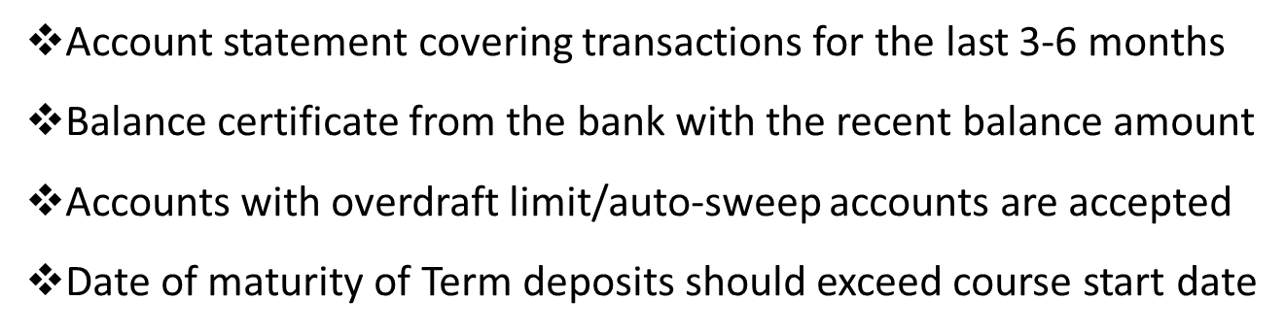

GS – Genuine Student Criteria
Savings Accounts and Term Deposits
Income Proofs

Slide 18
GS – Genuine Student Criteria (SOP)
“GTE – Genuine Temporary Entrant ”
Give details of the applicant’s current circumstances. This includes ties to family, community, employment and economic circumstances.
Explain why the applicant wishes to study this course in Australia with this particular education provider. This must also explain their understanding of the requirements of the intended course and studying and living in Australia.
Explain how completing the course will be of benefit to the applicant.
Give details of any other relevant information the applicant would like to include.
Answers must be written in English, with a maximum of 150 words per question.

Slide 19
What are the Work Rights of
International Students in Australia?
Students can work 48 hours/fortnight (part-time) when their course is in session
Students can work 40 hours/week (full time) during semester breaks and vacations
Students not having exhausted 20 hours of part time work in a week can work extra in the following week in such a manner that the total duration over two weeks should not exceed 40 hours
Students are usually paid between AUD 15 to AUD 20 per hour
Students are able to support their living expenses to a good extent by working part time in Australia
Note: Students are allowed to work full time even when their course is in session.

Slide 20

Support from Us…
Quick and easy admissions process with an interactive agent portal
View all your applications + Daily updates regarding your application
Fast offers
Visa support, accommodation support.
Support to convert students from application to visa stage.
Checklist of documents to maximize chances to obtain student visa

Slide 21

CANADA

Slide 22
Points for Today’s Discussion
Why Study in Canada
Key Facts Canada
Type of Universities in Canada
Level and Type of Courses in Canada
Intakes/ Time Schedule for Intakes
Our University Tie ups
Academic Entry Criteria
Documents Requirement
Average Cost to Study in Canada
Employment Rate by University/Course
Post Study Work Visa/Student Work Rights
Counselling Tips

Slide 23
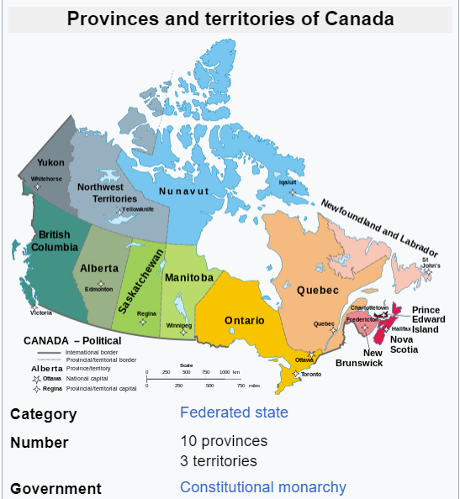

Canada is Divided into 10 Provinces; Province is a Political Boundary that divides Canada into different regions.
Canada Stretches from Pacific Ocean from West to the Atlantic Ocean on the East.
United Kingdom of great Britain & Northern Ireland
Top Provinces popular Cities :
Ontario: Toronto
British Columbia: Vancouver
Quebec: Montreal
Alberta: Calgery
Capital : Ottawa
Canada–United States border is the longest international border in the world
Currency: CAD ( Canadian Dollars )

Slide 24

Why Canada?
Post-Graduation Work Permits- PGWPs guarantees high-paying career opportunities for international students
Canada's exotic geography and climate- World 2nd Largest Country.
Every 1 out of 5 people in Canada is International.
Tuition & Cost of Living is Lower than its western Counterparts.
Canada’s VISA acceptance rate is 90% for Indian students.
One of the safest places in the world.
Tuition fee for 1 year diploma starts at 6 Lacs (10k CAD)

Slide 25
Our Partnered Universities
Crandall University
Cape Breton University
Seneca College
Canadore College (North Bay Campus)
University of Regina
Canadore College (Scarborough & Mississauga Campus)
Lakehead University
Niagara College
Mount Saint Vincent University
Great Plain College
Durham College
LaSalle College, Montreal
Fanshawe College
Georgian College
Adler University
University of Canada West
George Brown College
Royal Roads University
Cape Breton University
Mount Saint Vincent University
LaSalle College, Montreal
University of Canada West
Nipissing University
Selkirk College
Fraser International College (FIC)
Lakeland College
Toronto Metropolitan University International College(Ryerson University)
Saskatchewan Polytechnic
Trent University
Sault College
Fleming College- Toronto
Canadian College of Technology and Business
Northern Lights College
University of Northern British Columbia
Cambrian College
Acadia University and many more….

Slide 26
Our Featured Universities
1. University of Niagara Falls
2. University Canada West
3. Trinity Western University
4.Canadian College of Technology and Business.
5. Holmes Institute of Canada
6. Pacific Link College
7. Sprott Shaw College
8. Crandall University
9. Trinity Western University
10.Hermes College Network

Slide 27

GATEWAY TO CANADA

Slide 28





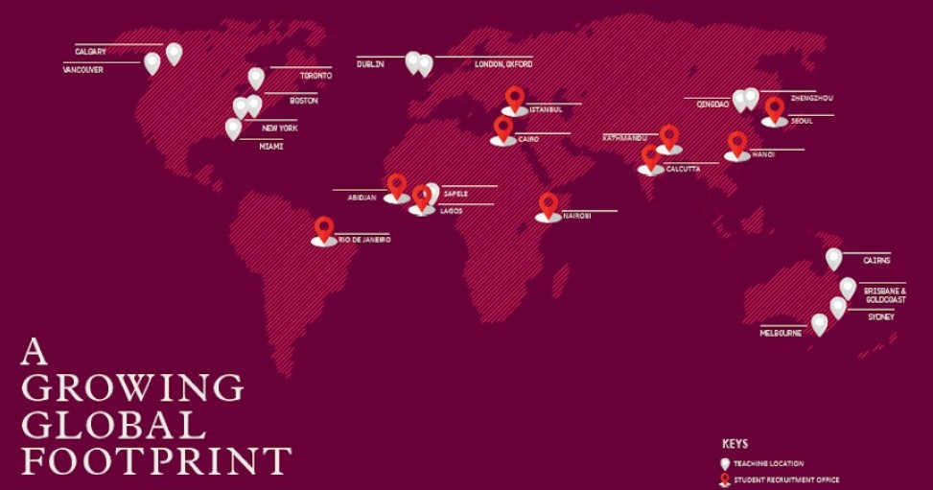


Why Holmes?
High Quality, Affordable Education
Strong Industry Partners for Jobs
20 Institutes, Schools, and Colleges across 4 Continents
85,000 successful graduates worldwide

Slide 29

Course- Diploma in Hospitality Operations CO-UP
There are eight core modules to complete:
Careers in Hospitality Operations
Food and Beverage Studies
Management and Leadership
Front Office Operations
Customer Service
Accounting and Finance
Human Resources
Marketing

Slide 30

Fees and Scholarship:
Requirements:
Tuition Fee : CAD $14000
Scholarship Up to CAD $5000
Tuition Fees after Scholarship is CAD $9700
Achieving Standard XII with average of 33% i.e. Just Pass Student.
IELTS 6 Overall and No less than 6 in each Band.
Microsoft Excel
Worksheet
Please Refer to the country wise
requirements here -

Slide 31
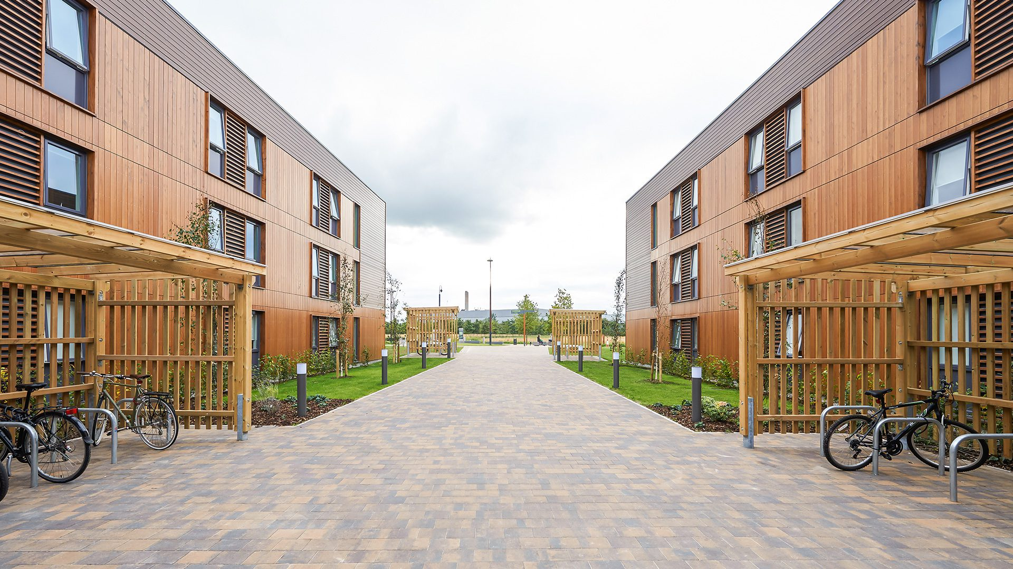


Accommodation
Host family
Student Residences
Shared House/Apartments

Slide 32


Slide 33

Location
16 Campuses
Across British
Columbia:
International Office
Vancouver Downtown
East Vancouver
Richmond
Burnaby
New Westminster
Surrey
Victoria
Abbotsford
Chilliwack
Kamloops
Kelowna
Nanaimo
Maple Ridge
Pentiction
Osoyoos

Slide 34






Key Faculties
Business
Post Graduate Diploma
Tourism / Hospitality
Health Care
Early Childhood Education
University Pathway CO-OP

Slide 35
Program – Overview
Intake Available:
For health care course only three intakes are available - January, May and September.
For Business and hospitality courses- Monthly Intakes
Masters / PG Courses – January / July.
Course fees: Price List
Scholarship: Guide Sheet
Programmes Offered
Application Fee: 0 CAD
Academic Requirement:
Sprott Shaw University Admission Requirements
English Requirement:
For Health care Assistant IELTS overall: 6.0
For Licensed Nursing- IELTS overall: 7.0
For PG : IELTS overall 6.0
( L:6.0,S : 6.0,R : 6,W: 6 )

Slide 36
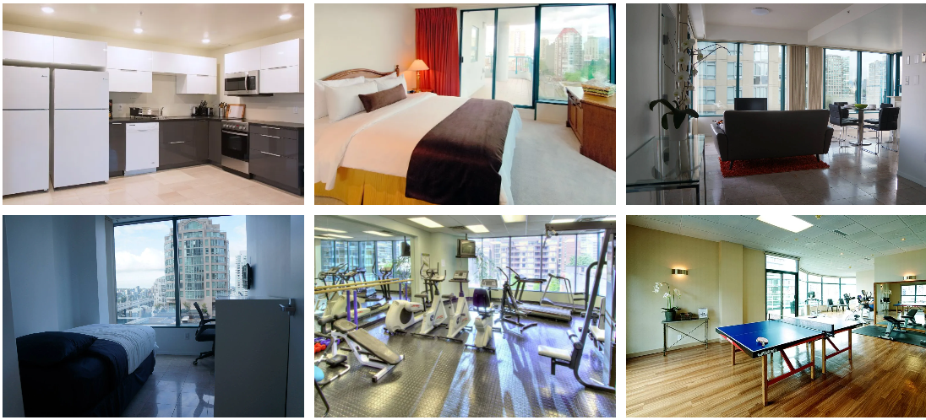
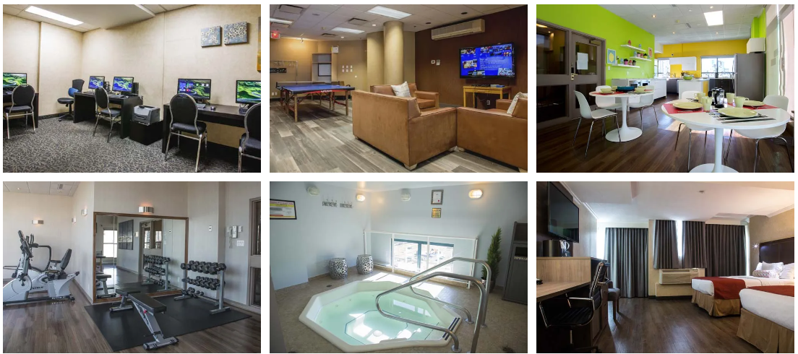
Accommodation
GEC VIV
Located in Downtown Vancouver
Room Types:
Economy: Shared room (2 twin beds)
Premium: Private Room (1 twin bed)
2. GEC GRANVILLE
Situated in Downtown Vancouver
Room Types:
Economy: Shared suit
1 double bed – 2 beds per room
Premium: Private suite – queen bed
Premium: Private suite – king bed with kitchenette
3. The average on-campus living expense at the Sprott Shaw College, Surrey College is 5400 annually.

Slide 37
Documents Required & Application Process
Copy of passport
Copy of transcript
Copy of credentials (diploma/degree)
Language proficiency (IELTS/TOEFL/CLBPT/CELPIP)
Essay
Course Specific Requirements
you can find in the Sheet.
Online Application
Online Entrance Assessment
Tuition Deposit
Invoice & Letter of Admission
Student Enrollment Contract
Letter of Acceptance

Slide 38



Job Opportunities
Health Care Assistant
Provincial Median Salary: $ 45,883.00
Licensed Practical Nurse
Provincial Median Salary: $ 58,397.00
Registered Nurse
Provincial Median Salary: $ 81,340.00
Can you work before getting the HCA registration number?
Yes, Students can work as an unregulated HCA in Canada before receiving HCA registration number.
Companions
Dietary Aide
Facilities’ Receptionist

Slide 39



Slide 40

Why Crandall University?
Average undergraduate class size – 19
Oxford Exchange Program
(Available for B.A. Eng. Literature Only)
A warm, welcoming community
85% Of faculty have a Ph.D
40% Of student body is made up of international students from 50+ countries
Championship Athletics:
- Varsity Soccer, Volleyball, Basketball, Cross-country, Boxing & Cricket.

Slide 41



Why Moncton, New Brunswick?
Greater Moncton International Airport (YQM)
Hub City of the Maritimes
Multi cuisine Restaurants
First Bilingual Province
The best place to live in Atlantic Canada
Moncton is the largest city in the Province.
Climate Fast Facts
Spring
Summer
Fall
Winter
4⁰ C
22⁰ C
15⁰ C
-4⁰ C
cool transition
from winter to summer
  warm and breezy sometimes
  reaching highs of 30⁰+ C
  rainy season
mild and brilliantly
vivid as the leaves
change colour
snowy from
December to April

Slide 42
Crandall Programs – UG
English
Psychology
Sociology
Kinesiology
Biblical Studies
History
Accounting
Economics & Finance
Management
Marketing
Biology
Chemistry
Environmental Science
Christian Studies
English
History
Psychology
Religious Studies
Sociology and
Biology in Science.
Bachelor of Arts
Bachelor of Business
Bachelor of Science
Bachelor of Arts & Science

Slide 43


Crandall Programs – PG
Master of Management
Master of Organizational Management
2 year program
3 year PGWP
Internship opportunity
12-month program
1 year PGWP

Slide 44
Program – Requirements
Intake :
MAY 2024 is Open till 10th Jan 2024
Closed for M. Org. M
Closed for MM
CLOSED for undergraduates
SEPT 2024 open till 20th May 2024
OPEN for M. Org. M
OPEN for MM
OPEN for Undergraduates
Crandall tuition + fees: https://www.crandallu.ca/money-matters/finance-international/
Scholarship
All Programmes at Crandall
Application Fee: CAD$100

Slide 45
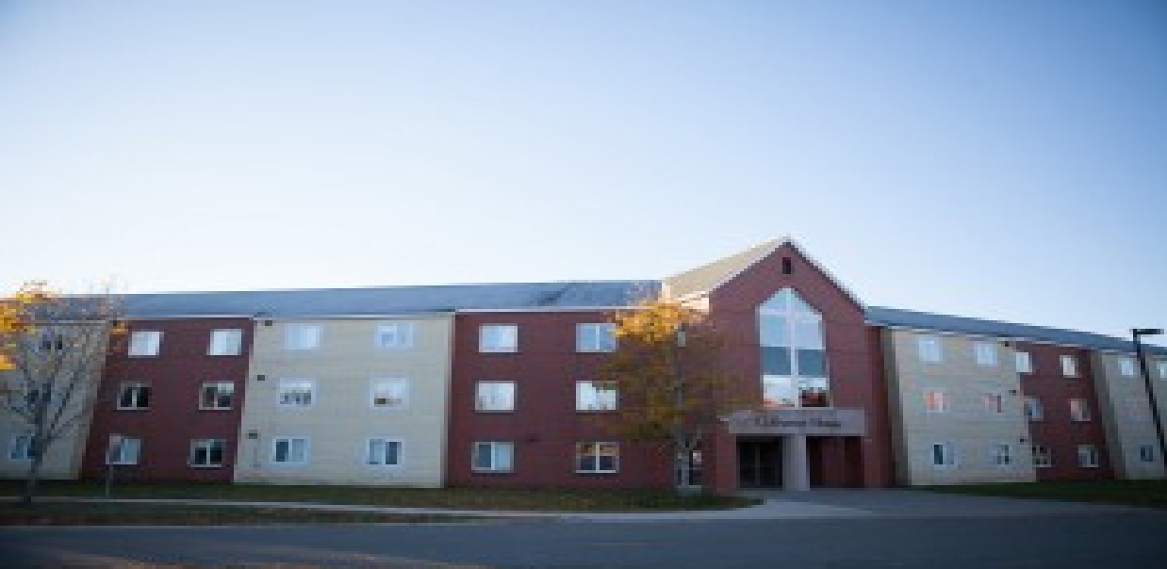

Accommodation Options - Campus Housing
COLBURNE HOUSE
This a traditional residence for undergraduate students designed with four-bedroom pods.
A team of Resident Assistants are waiting to meet you and are available to support and encourage you through the year.
MITTON COURT
Mitton Court is a spacious, fully furnished apartment style residence primarily for upper-level students.
There are two-bedroom, three bedroom and four-bedroom units to choose from.
Housing Dons support the students and help create community.

Slide 46

English Language Proficiency Requirements
Applicants whose first language is not English must provide documentation for one of the following as proof of English language proficiency
  IELTS Academic
    - Overall Score of 6.5, with no band less than 6.0
  TOEFL
    - Paper-based: 580
    - Computer-based: 236
    - Internet-based: 90
  CAEL
    - 70
  MELAB
    - 85
  PTE Academic
  - 58-65
Full list of alternate testing methods and acceptable results are here:
https://www.crandallu.ca/international-students/language-requirements/

Slide 47

11 Years of PLC
QUALITY | INNOVATIVE | CREATIVE | PRACTICAL

Slide 48
Why Pacific Link College?
2.5 Days
Classes Per
Week
Free Online
Language
Assessment
Co-op and
Work
Monthly
Intake
Simple
Requirements

Slide 49
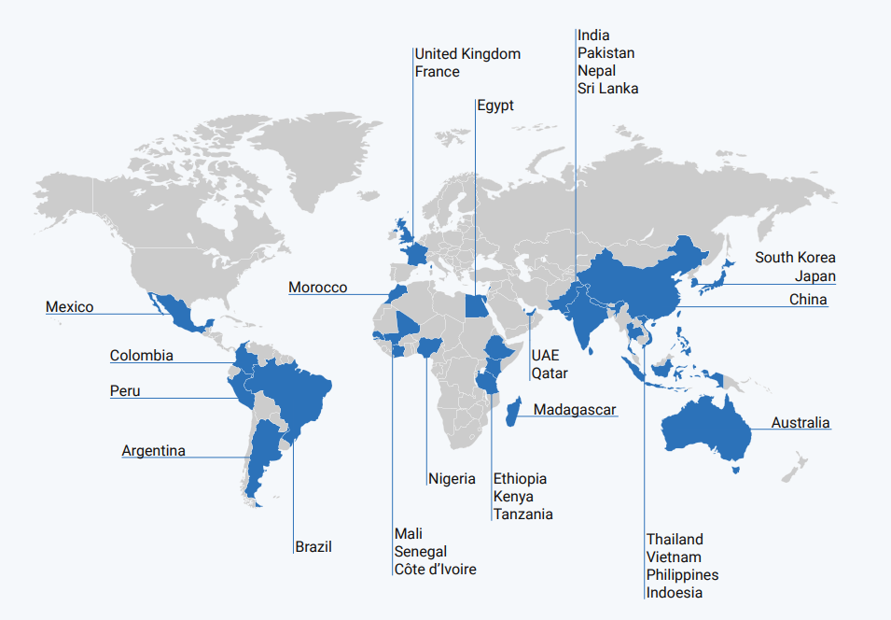
Pacific Link College, Location?
Two Location :
1. 4980 Kingsway, Unit 200, Burnaby, BC V5H 4K7, Canada
2. 201 – 10090 152 St. Surrey, BC, V3R 8X8
With hundreds of graduations every year and 600 new students joining us annually, PLC is one of the fastest-growing institutions in Canada.

Slide 50

PLC Programs
2-year programs
Business Hospitality Management(PG Diploma)
Digital Media Management Science (PG Diploma)
Digital Media Studies
Business Hospitality Management (Advance Diploma)
Information & Communication Technology in Business (Advanced Diploma)
Global Restaurant entrepreneurship (Diploma)
Business Leadership (University Transfer Advanced Diploma)
1-year programs
Business Fundamentals with Co-op
Childcare Language Assistance Program with Co-op
Information & Communication Technology with Co-op
Tourism Hospitality & Service with Co-op

Slide 51
Tuition & Intake
Tuition :
2-year programs regular tuition: 22,000CAD+ (total)
  2023 special: Right Now Fee CAD 15,900 total; 7,500CAD deposit
  But Regular fees are from 22500-29500 for these programs ( Offer is Going on )
1-year programs regular tuition: 14,000CAD+ (total)
  2023 special: 14,000CAD total; single payment
Intake: Every Month Intake :
Simple & Fast
Admission Requirement :
Ideally 60% but not less than 50%
19 years or older at start of program
English Requirement:
IELTS - Overall, 6 and above, No band Less than 6

Slide 52
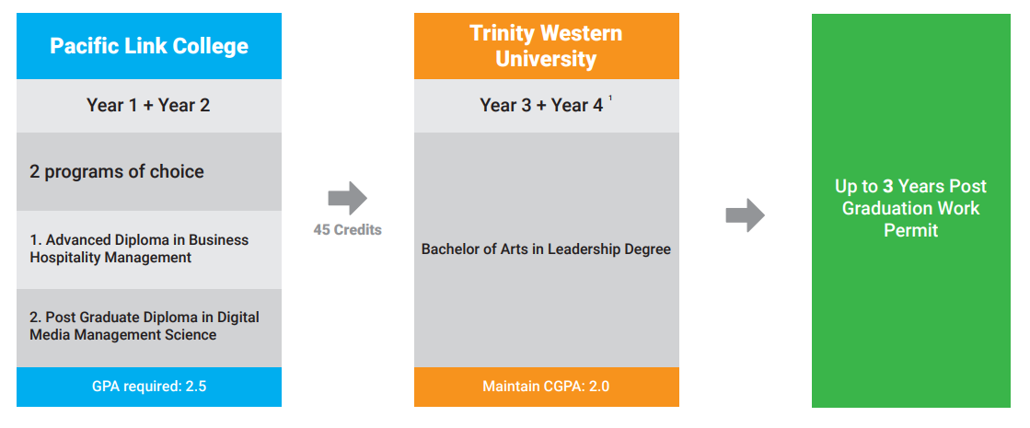
Pathways with TWU
01

Slide 53
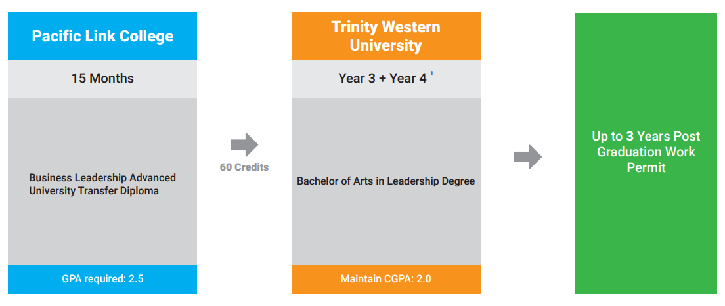
Pathways with TWU
02

Slide 54
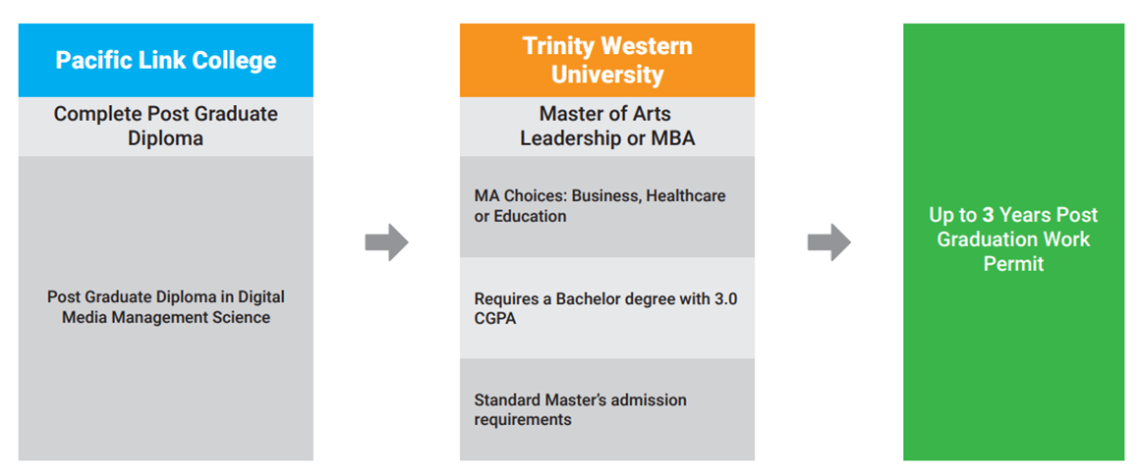
Continued……
03

Slide 55
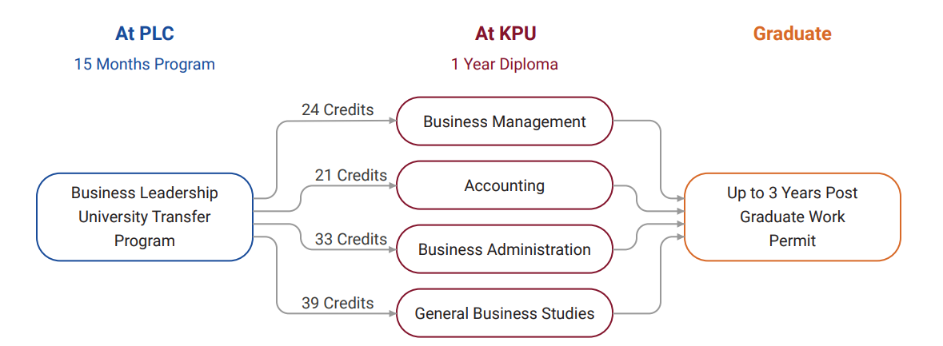
Pathways with KPU
01

Slide 56
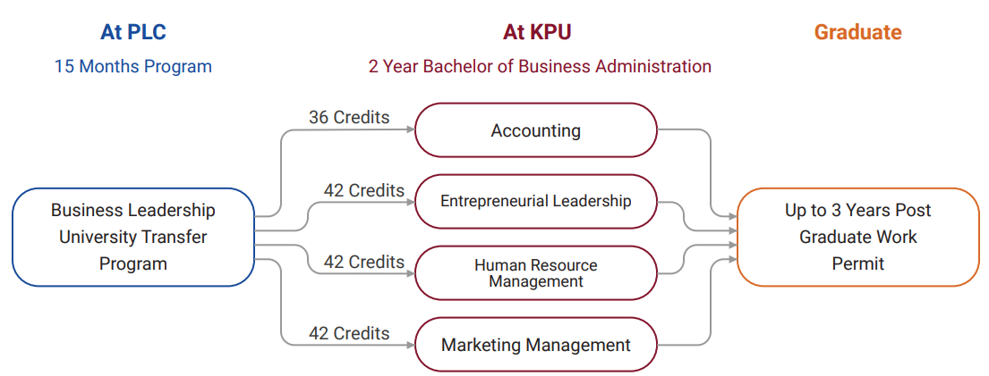
Pathways with KPU
02

Slide 57
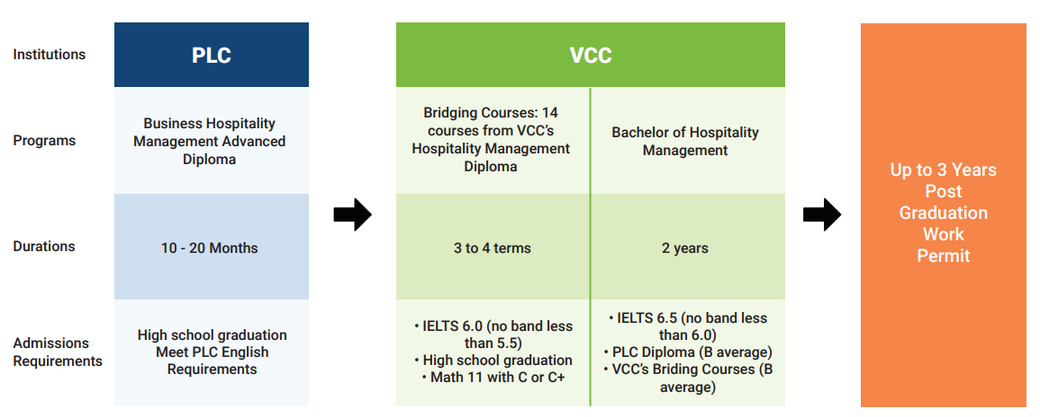
Pathways with VCC
01

Slide 58
Documents Required & Application Process
Document Required
Copy of passport
Copy of transcript
Copy of credentials
(diploma/degree)
Language proficiency (IELTS/TOEFL/CLBPT/CELPIP)
Course Specific Requirements
you can find in the Sheet.
Application Process
Complete and Submit the Application
Receive offer Within a Day
Submit the English
Unconditional Offer letter
Submit Fees
Letter of Acceptance you will receive
Return the Signed Student Contract

Slide 59
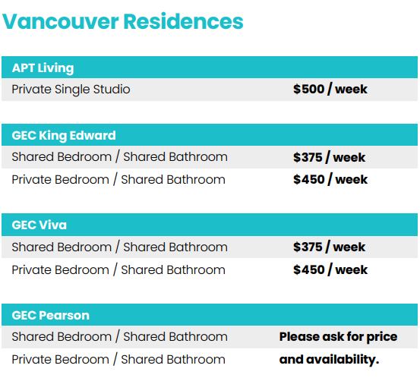
Accommodation Options
Options Available Near Pacific Link College:
https://www.universityliving.com/canada/surrey/u/pacific-link-college
Other Options Available Nearby

Slide 60


Slide 61
Location
2 Campuses
British Columbia
Langley
Richmond

Slide 62
Key Faculties
1. Faculty of Humanities and Social Science
2. Faculty of Arts, Media + Culture
3. Faculty of Natural and Applied Science
4. School of Business
5. School of Education
6. School of Human Kinetics
7. School of Nursing

Slide 63
Trinity Western University
Key Programmes for International Students:
Undergraduate (UG)/University First Year (U1)
Global Express Pathway (GXP Online)
Bachelor of Arts In Leadership
Bachelor of Arts in Leadership Professionals
Masters of Arts in Leadership
Masters of Business Administration (MBA)

Slide 64
UG/U1 :
Category | Length | Next Step Study | Intake | Tuition Fees | Advantages
UG ( Undergraduate) | 4 Years | - | January May September | $777 CAD/Credit | Scholarship for outstanding applications
U1 (University First Year) | 2 Semesters | Second Year | January May September | $777 CAD/Credit | Free English learning coaching, One year to decide major
Application Fee: 150 CAD (CURRECT FEE 50 CAD)
Application Checklist: Application Form
All documents in 1 PDF
Academic Documents
Passport
English Language Proficiency
Note: 10th and 12th Certificate is required, if not students should get enrolment letter issued from school.
Note: Conversion is allowed i.e. background education doesn’t matter to join any course
USPs:
48 Majors to choose from in Science, human Kinetics & Education.
Scholarship based on GPA and renewed every year. ($2000 to $10,000)
UG – Grouped along with the local students.
U1 - Grouped along with the international students.
UG : IELTS – 6.5 OVERALL, 6 in each.
TOFEL – 88 OVERALL , no less than 21 each band
U1 : IELTS – 6 OVERALL, No less than 5.5
TOFEL – 78 , 19 each band.

Slide 65
FACULTY OF HUMANITIES & SOCIAL SCIENCE :
English (BA),
Environmental Studies (BA)
General Studies (BA)
Political Studies (BA)
Psychology (BA)
Religious Studies (BA)
FACULTY OF ARTS, MEDIA + CULTURE :
Arts + Design (BA),
Acting (BFA)
Corporate Communication (BA)
Film Studies(BA)
Music (BA)
Theatre (BA)
FACULTY OF NATURAL & APPLIED SCIENCE :
Biotechnology (B.Sc.)
Biotechnology & Business Administration (B.Sc.)
Computer Science (B.Sc.)
Natural & Applied Science (B.Sc.)
Mathematics with Computing Science (B.Sc.)
Environmental Studies (B.Sc.)
SCHOOL OF BUSINESS :
Business Administration (B.Sc.)
Business Administration (BBA)
Economics (minor)
Information System (minor)
International Development Studies (minor)
Sports and Leisure Management (BHK)
SCHOOL OF EDUCATION :
Education (BA/B.Ed. or B.Sc.)
-Elementary and Secondary
Two-year post-degree program (B.Ed.)
-Elementary and Secondary
Special Education
SCHOOL OF HUMAN KINETICS :
Elementary School Physical Education (minor)
Human Kinetics (BA)
Human Kinetics (BHK)
Sports and Leisure Management (BA)

Slide 66
Masters of Business Administration (MBA)
Available in both campuses – Langley and Richmond
There are 9 intakes available – Sep, Oct, Nov, May, June, July, Jan, Feb, March.
Academic Requirement : 2.7 GPA i.e. 52%
Application Fee: 140 $
Note: If student has scored 46% can opt. for bridge courses (1 semester) Cost: $11655
MBA: Tuition Fee $36225 (2 years) (3 years work permit )
Academic Checklist : Resume
Academic Documents
Statement of Purpose
Letter of Recommendation (Letter Head only)
English Language Proficiency
Passport and Study Permit (If applicable)
Note: If LOR not available on Letter head, student can choose reference form.

Slide 67

Support from MetaApply
Quick and easy admissions process with an interactive agent portal.
View all of your applications + Daily updates regarding your application
Fast offers
Visa support, accommodation support.
Support to convert students from application to visa stage.
Holmes team: globe dedicated to student visa success
Checklist of documents to maximize chances to obtain student visa
Assist students to get admission in Bachelor's Degree Program with PDWP

Slide 68
MetaApply Resourses
MetaApply Drive
MetaApply WhatsApp Hub
Canada Recourses

Slide 69

UK

Slide 70
Points for Today’s Discussion
Why Study in UK
Key Facts UK
Type of Universities in UK
Level and Type of Courses in UK
Intakes/ Time Schedule for Intakes
Our University Tie ups
Academic Entry Criteria
Documents Requirement
Average Cost to Study in UK
Employment Rate by University/Course
Post Study Work Visa/Student Work Rights
Counselling Tips

Slide 71

United Kingdom of great Britain & Northern Ireland
Made of 4 Countries: England, Scotland, Wales &
Northern Ireland
Top Cities:
England: London, Birmingham, Liverpool, Leeds & Manchester
Scotland: Glasglow & Edinburgh
Wales: Cardiff
Norther Ireland: Belfast
Capital : London
Time Difference from India: 5 hours and 30 minutes
Currency: Pound Sterling ‘£’

Slide 72
Why
Study in UK?
World-Class education and academic facilities.
Multi Diversity in Culture
Institutions consistently ranked amongst the best in the world.
Numerous options of specializations to study.
Admission possible without IELTS.
Affordable and value for money as course duration are short.
Scholarships and Bursaries available.
Master's courses with paid placements or internships.

Slide 73
Best Cities in UK for International Students
London
Edinburgh
Manchester
Glasgow
Coventry
New castle Upon Tyle
Birmingham
Bristol
Nottingham
Leeds

Slide 74
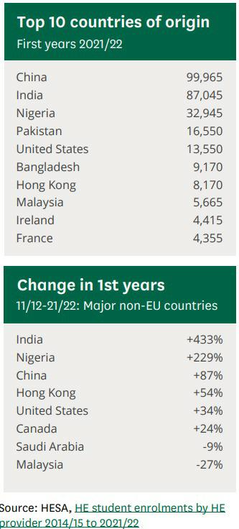
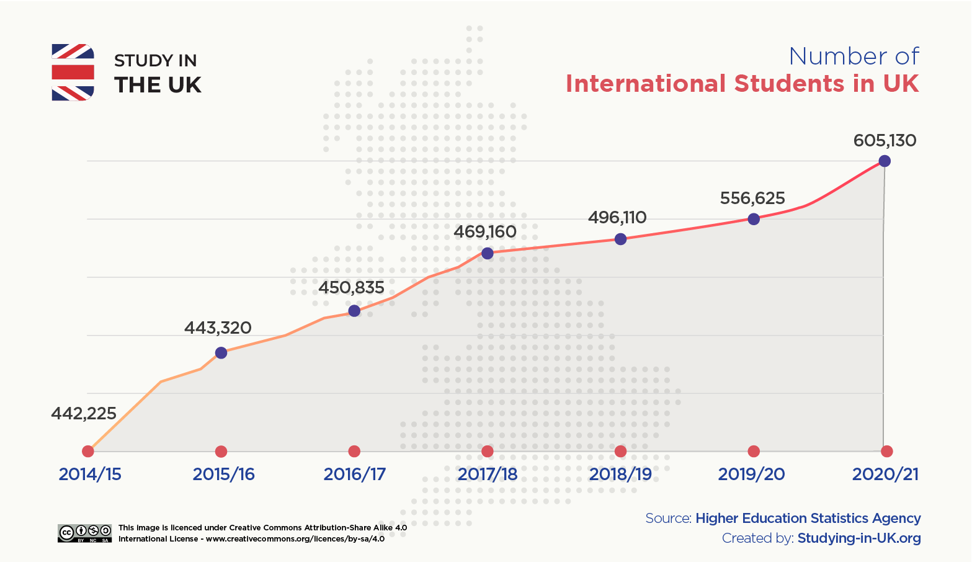
International Student Statistics in UK 2023

Slide 75
In total, 13 UK universities appear in the Global University Employability Ranking 2023-24, designed by HR consultancy Emerging and published exclusively by Times Higher Education. The ranking reveals the 250 universities that recruiters at top companies think are best at preparing students for the workplace.
Key UK Graduate Statistics
Five of these are London-based institutions; the remaining universities are spread across the UK.
In 2023, estimates show there will be 36.4 million graduates in the UK.
Undergraduate figures increased by 7% from 492,355 in 2020 to 527,070 in 2021.
Business studies graduates achieved the highest number of qualified degrees, totalling 175,670 graduates in 2022.
Women made up 57.6% of higher education graduates in 2022, with 530,170 women graduating.
Graduate job applications have increased by 41% in comparison to last year

Slide 76
A Foundation course is a one-year preparation course for international students who need additional English language and academic preparation for entry into the first year of a Bachelor’s degree at a UK university .
International Year 1 (IY1 Diploma): IY1 is a one-year program for students who are not eligible for direct entry to a Bachelor’s program, and it leads to 2nd year of a Bachelor's degree.
A Pre-Masters program is for international students who need to improve and develop their academics, research and seminar skills ahead of a Master's degree. This course varies in length from ten weeks to twelve weeks. It offers a route to a postgraduate degree in several disciplines and is suitable for students who: Do not meet the academic requirements for admission into a postgraduate course. Want to change the discipline from undergraduate degree to postgraduate degree
A Top-up degree is equivalent to the final year of a Bachelor’s degree. These one-year courses are aimed at students who have previously completed a related foundation level degree or an HND and provide a route for students to directly enter the final year of a Bachelor’s degree.
Level of Programs

Slide 77
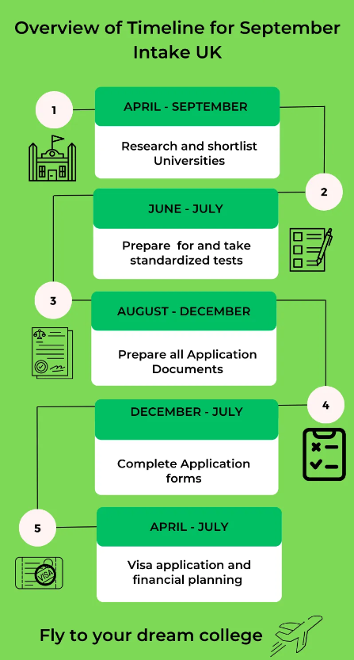
Intakes
UK Universities have two major intakes
September / October – Fall Intake
January / February – Spring Intake
However, many universities offer courses commencing in
April/ May/ June/ July – Mid Intake

Slide 78












Our Tie-ups with Universities

Slide 79

Universities In London
University of London
St. Mary University- Twickenham
London metropolitan University
University of West London
University of Greenwich
University of East London
Middlesex University London
London South Bank University
University of Roehampton London
Coventry University London
Royal Holloway University of London
Croydon University
University of Westminster
University of Creative Arts London
London College of Fashion
Brunel University London
St. George's University of London
Regent's University London
Anglia Ruskin University London
Queen Mary University of London
London Business School
Birkbeck University of London

Slide 80

University of Greenwich
We employ well-qualified, expert teaching staff, the majority with formal teaching qualifications. A large number of our academics have also previously worked in business or industry. This enables us to provide up-to-date and industry-relevant courses that are accredited by professional bodies.
IELTS - UG : Overall 6 with 5.5 in each PG: Overall 6.5 with 6 in each
Academics - UG: 70% ( Standard XII with a minimum of 50% For entry to our four-year extended degree programs)
PG : 65% in Final Year However, if graduating from one of the top universities, a minimum of 50% in final year is required)
https://www.gre.ac.uk/study/student-experience

Slide 81
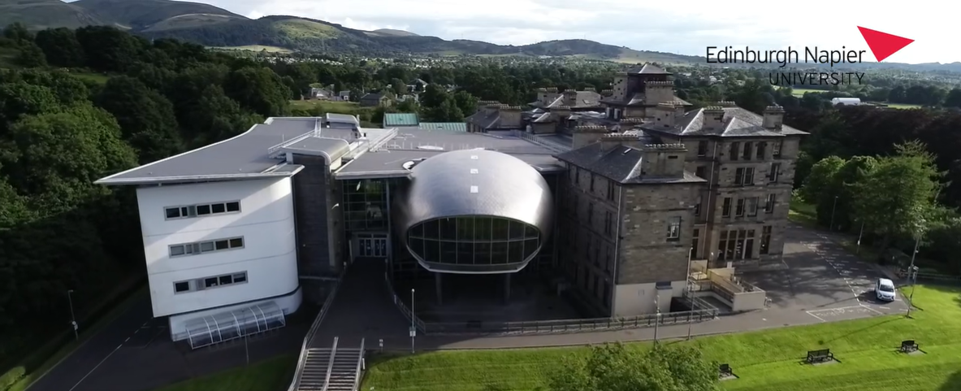
Edinburgh Napier University
Edinburgh Napier shapes global communities through research and education. With roots dating back to 1964, the university, initially Napier Technical College, now hosts over 19,500 students from 140+ countries. Renamed in 2009, it received prestigious awards for its work in building performance and timber engineering, reflecting its commitment to innovation and excellence.
IELTS - UG : Overall 5.5 with 5.5 in each PG: Overall 6 with 5.5 in each
Academics - UG: 70% ( (HSC) with overall 60% or above in the Intermediate (10+2) (XII Standard) exam)
PG : A bachelor general / pass (3 year) degree with 60% or above & bachelor degree (4 year) in a professional subject with 55% or above
https://www.napier.ac.uk/

Slide 82

De Montfort University
Type of University: Public , 150 year Old University
Location: London, Chelmsford, Cambridge
Intakes: Jan/Sep
Average Tuition Fees: GBP 14000 – 17000 (UG)/ PG : GBP 14000 - 19000
Entry Requirement: IELTS - Overall 6 with 5.5 in each (Some courses may require 6.5)
Academics - UG: Minimum 65% Required
PG : Between 50% - 60%
Scholarship: International merit scholarship/International excellence scholarship/Early Bird Scholarship
USP: In the heart of England. 1 hour from London. Affordable, Best career cells, Affordable and a lot of Indian Students.
100 years of education
Highest employability percentage - 97%
Nursing Program (Very popular, Need 2 years experience + Faculty Interview)
TEF GOLD Ranked
2021 Best Campus Career Cells& Employability (Based in Leicester - 40 mins from Birmingham and 1 hr from London)
Buddy scheme
Recruitment can happen from across India
Roughly 10-12 backlogs are accepted but no year back is accepted.
Top Courses: Sports Courses
Global MBA
MSc Global Health
https://www.dmu.ac.uk/international/en/international.aspx

Slide 83
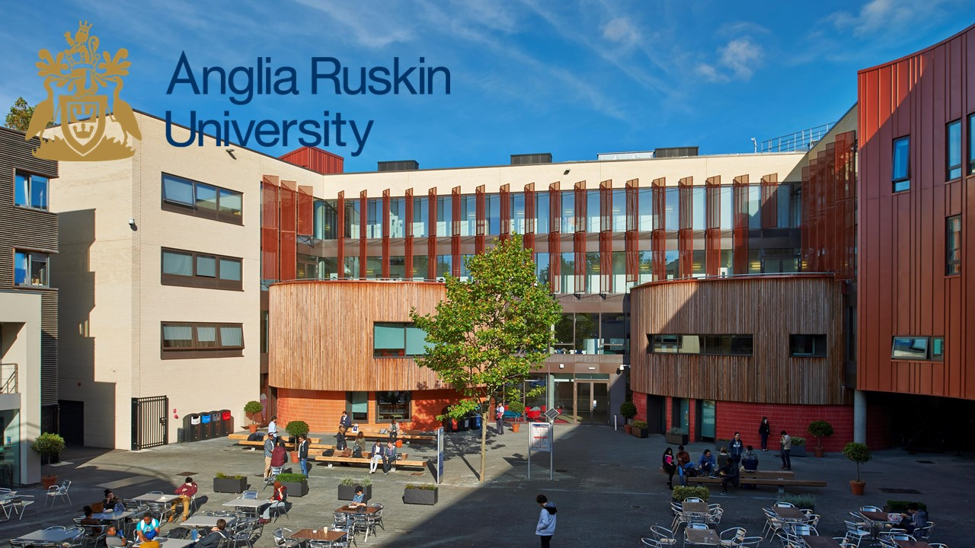
Anglia Ruskin University
ARU has been ranked in the UK's top 25% for graduate employment according to the figures compiled by the Higher Education Statistics Agency. The University is also among the top five universities in the UK for the number of UK part-time undergraduates in employment and/or further study within 15 months from graduation.
IELTS – UG : Overall 6 with 5.5 in each PG: Overall 6.5 with 5.5 in each
Academics - UG: Minimum 50% - 60% Depends on board
PG : Minimum 55% Required
https://www.aru.ac.uk/

Slide 84
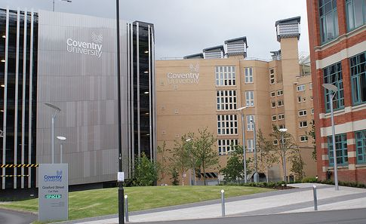
Coventry University
Coventry University has an excellent academic reputation. The university has been ranked among the top 200 universities in the world by Times Higher Education. This ranking is based on several factors, including the quality of the faculty, the quality of the labs, and the quality of the facilities..
IELTS – UG : Overall 6 with 5.5 in each PG: Overall 6.5 with 6 in each
Academics - UG: Min 60%
PG : Min 55%
https://www.coventry.ac.uk/

Slide 85
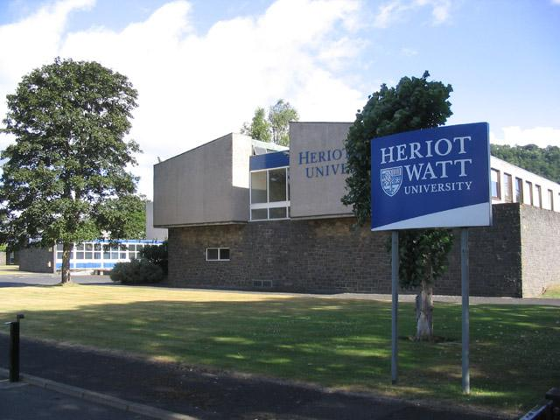
Heriot-Watt University
Heriot-Watt University is the eighth oldest higher institution in the UK, The world’s first mechanics institute, in 1821. In 1966 it became a university by Royal Charter. More than a third of Heriot-Watt’s 7,000 Edinburgh campus students are from outside the UK. The University boasts multiple campuses, with 3 in Scotland, and 1 each in Malaysia and Dubai. Heriot-Watt won an award from the Scottish Council of Development and Industry because of its international focus and it also performs well in physical sciences, math, business and management, engi. and the built environment. It won the 'International University of the Year' 2018 award from Times Higher Education.
IELTS – UG : Overall 6 with 5.5 in each PG: Overall 6.5 with 6 in each
Academics - UG: Min 70%
PG : Min 55%
https://www.hw.ac.uk/

Slide 86

University of Bolton
Bolton University, situated in Greater Manchester, boasts a rich history dating back over 190 years. With around 10,000 students and a welcoming community, it's a hub for education. Its prime location near Manchester offers students easy access to city life within a short train ride. The university provides diverse courses, reflecting varied interests. Beyond academics, Bolton thrives with multiculturalism and vibrant entertainment options like the AO Arena, hosting live shows and events, making it an enticing educational destination.
IELTS – UG : Overall 6 with 5.5 in each PG: Overall 6.5 with 6 in each ( Punjab and Haryana - 6.5/6.0)
Academics - UG: Min 60% / Punjab and Haryana - 70%
PG : Min 55% / Punjab and Haryana - 70%
https://www.bolton.ac.uk/

Slide 87
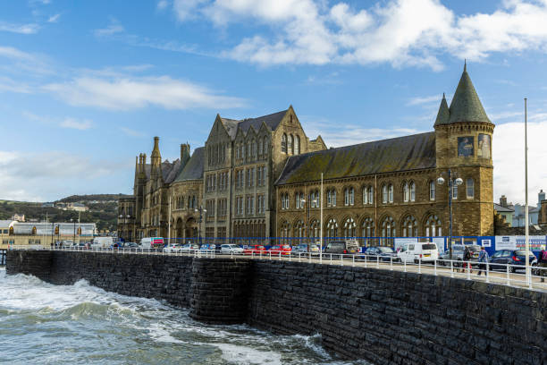
Aberystwyth University
This institution tops the charts for teaching quality and student satisfaction, earning TEF Gold and accolades for employability. Situated amidst breathtaking landscapes, it offers a unique experience, surrounded by sea and mountains. Renowned for specific disciplines like Accounting & Finance (4th), Business & Management (13th), and International Politics (6th), it provides an exceptional academic environment. With a remarkable student satisfaction rating and an awe-inspiring location nestled between the Cambrian Mountains and Cardigan Bay, this university promises an unforgettable educational journey.
IELTS – UG : Overall 6 with 6.5 in each PG: Overall 6 with 5.5 in each (Depends on Course)
Academics - UG: 70%
PG : 50-55%
https://www.aber.ac.uk/en/

Slide 88
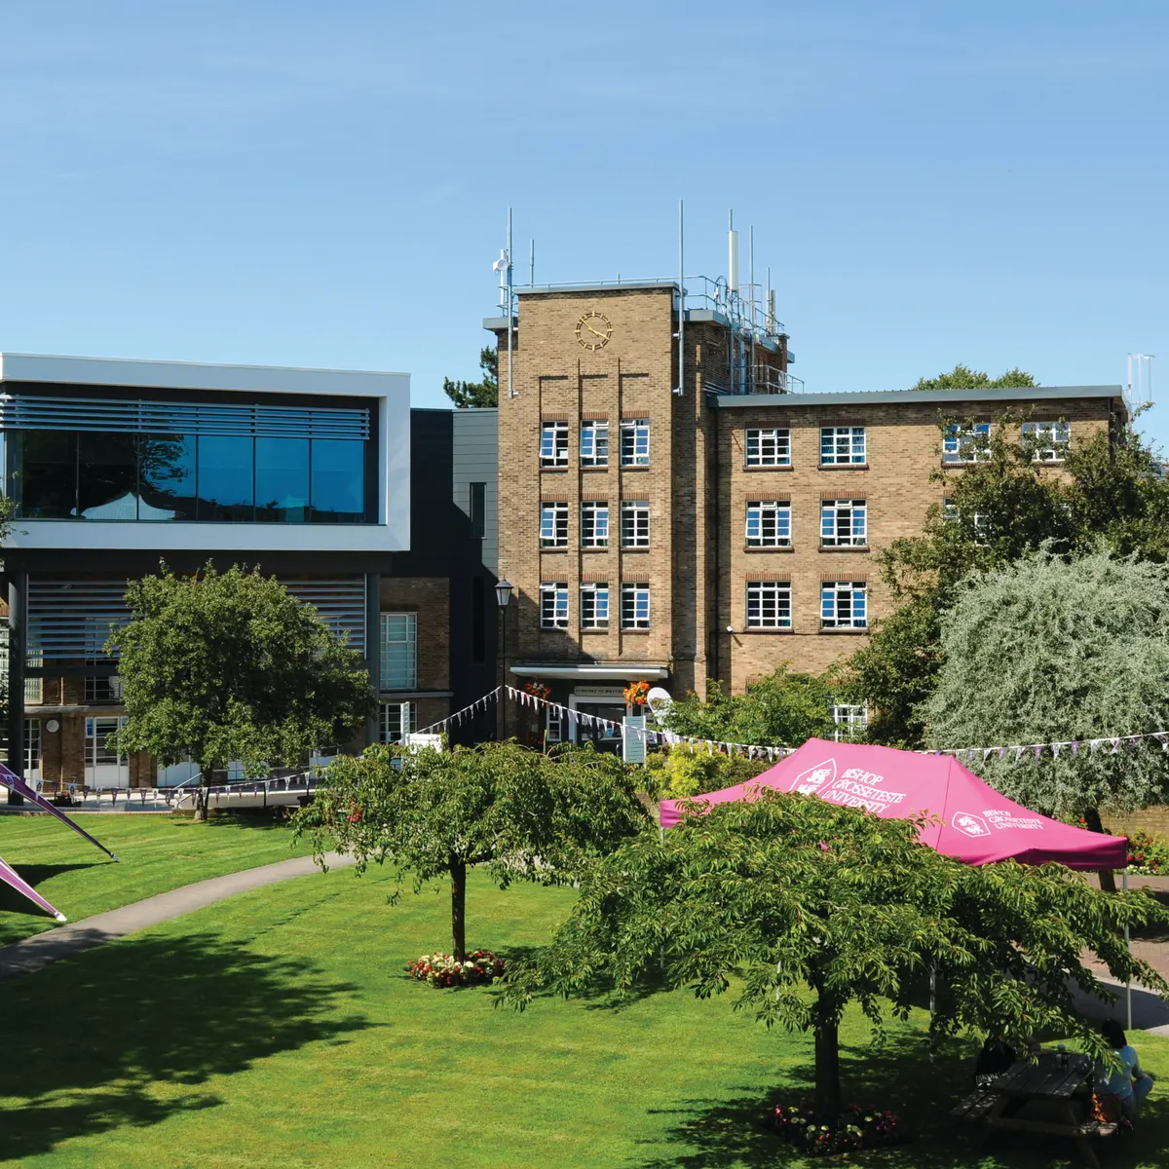
Bishop Grosseteste University
Located in the historic city of Lincoln for over 160 years, this institution, named after 13th-century figure Robert Grosseteste, accommodates thousands of students across diverse subjects. Notably, it's recognized as the most improved university in the Times and Sunday Times Good University Guide 2020 and ranks 64th in the UK. Renowned for teaching quality, it holds the 4th position in the country and offers an intimate setting for international students, fostering an authentic cultural exchange. With an impressive graduate employability rate of 91%, it stands as the second-highest among UK public universities and ranks among the top 3 for student satisfaction, ensuring a fulfilling educational journey..
IELTS – UG : Overall 6 with 5.5 in each PG: Overall 6.5 with 6 in each
Academics - UG: Min 65%
PG : Min 50%
https://www.bgu.ac.uk/apply-now/international

Slide 89
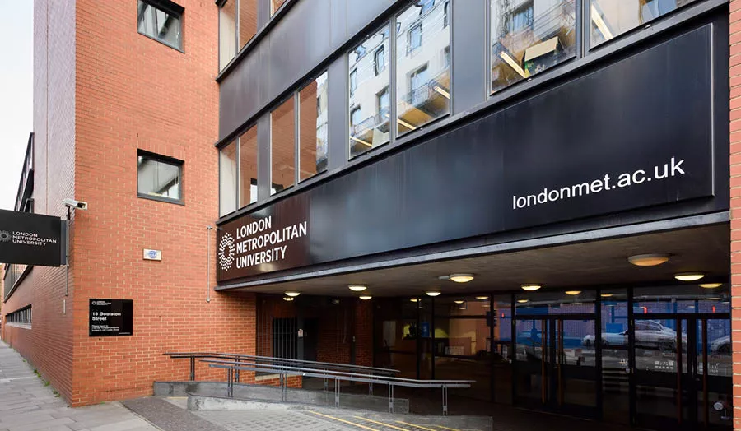
London Metropolitan University
LMU, steeped in England's historic capital, boasts a legacy in education tracing back to 1848. Renowned for its exceptional specialized tuition, the university offers a diverse array of high-quality courses across various disciplines. With accolades such as fourth place for student satisfaction in London and sixth for teaching quality in the UK, it upholds its commitment to excellence. Holding prestigious accreditations from ACCA, CIPS, CIPD, The Law Society, and The Bar Council ensures industry recognition. Noteworthy achievements include top-ranking business and management courses for teaching quality and being the sixth producer of CEOs and managing directors nationwide, showcasing its prowess in nurturing future leaders. The university serves as a gateway to promising career opportunities with world-renowned organizations, solidifying its stature as a launchpad for professional success
Pre Masters:
Academic IELTS 5.5 overall (minimum 5.5 in each component)
PTE - 59/59
Academic: 40%
https://www.londonmet.ac.uk/

Slide 90
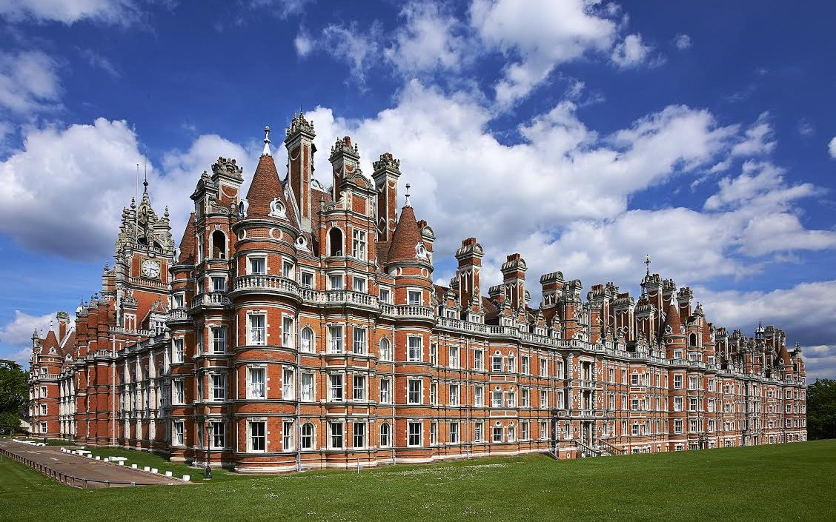
Royal Holloway, University of London
Royal Holloway, University of London stands as a beacon of academic excellence and innovation. The institution has earned a well-deserved reputation for its strong academic programmes and impactful research output, consistently ranking among the top universities in the UK and worldwide. Tin the most recent Research Excellence Framework, it was confirmed that Royal Holloway sits within the top 25% of universities in the UK for research which is rated world-leading or internationally excellent. 30% of research was rated, the highest category and several departments are in the top five highest scoring for their subject in the UK
IELTS – 6.5 Overall / 5.5 each (Note: required scores vary depending on the language demands of the subject you wish to study
Academics - 80% to 85%, (depends on course)
PG :55% to 65% (depends on Course)
https://www.royalholloway.ac.uk/

Slide 91
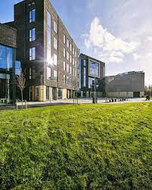
Holmes Institute Dublin
With a rich history spanning over 30 years, Holmes Institute has been instrumental in shaping exceptional business graduates who make global impacts. Their new campus in Dublin embodies their commitment, offering top-tier educators and dynamic programs at the pulse of modern business. Boasting 85,000+ successful graduates, spread across 19 centres globally and representing over 80 nationalities concurrently, the institute stands as a beacon of diverse and acclaimed education. Moreover, their courses, accredited by QQI (Quality and Qualifications Ireland) and listed on the ILEP, ensure recognized and quality education for aspiring professionals.
IELTS – UG : 6.0 Overall (No minimum in any module)
PG:95 Overall (No minimum in any module)
Academics - UG: 60% average (5 best), (depends on profile)
PG : 55% / 70% * (depends on Bords)
https://www.hid.ie/

Slide 92
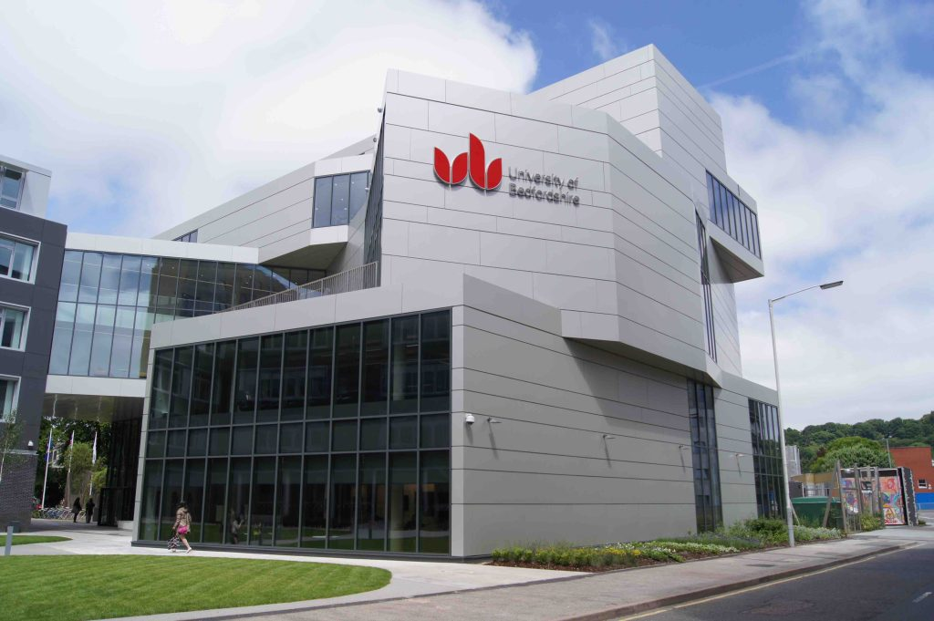
University of Bedfordshire
The advantages of studying at the University of Bedfordshire have never been greater: Courses taught by leading experts in their fields, with many lecturers presenting their work at international and national conferences. The university is also an internationally recognized and award-winning institution with a heritage of quality education that goes back more than 100 years.
IELTS – 6 Overall / 5.5 each element (Note: some courses may require higher levels of English)
Academics - UG 60%, (depends on course)
PG :55% (depends on Course)
https://www.beds.ac.uk/

Slide 93
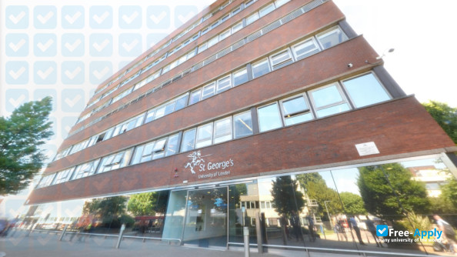
St. George's, University of London
We are the only UK university to share a campus with a teaching hospital, St George's University Hospitals NHS Foundation Trust, so you are immersed in a professional environment from day one. You can walk from lecture theatre to laboratory to hospital ward or clinic with ease.
IELTS – 6.5 Overall / 5 each element (Note: some courses may require higher levels of English)
Academics - Depends on course
https://www.sgul.ac.uk/

Slide 94
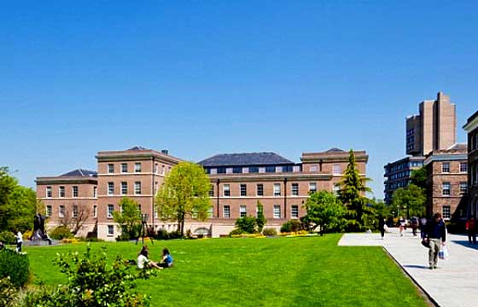
University of Leicester
Leicester offers more than 150 different degrees across 30 subjects. Most courses include an optional year abroad in one of 27 other countries. Leicester is also a top 25 university in the UK and is ranked 170th in the world out of more than 1,500 universities across 93 countries*.
IELTS – 6 Overall / 5.5 each element (Note: some courses may require higher levels of English)
Academics - UG 65%, (depends on course)
PG 605% (depends on Course)
https://le.ac.uk/

Slide 95
Documents Requirements
10th Marksheet & Certificate & 12th Marksheet & Certificate
SOP Course Specific and LOR
Graduation Marksheet & Certificate ( Applicable For PG Application)
English Proficiency Test
SOP Course Specific
Visa Refusal Letter if Applicable
Gap Justification if Applicabe

Slide 96
Average Cost of Studying in UK
Estimated cost to be incurred by a student for a year of study | 1 £ = INR 100/- (Approx. The amount is subject to be changed as per Currency Rate)
Particulars | Amount in £ | Amount in Rs
Exam Fees (IELTS- General/ Academic) |  | 16,250 (For UKVI IELTS 16,500)
Tuition Fees | 14,000 | 14,00,000
Living Cost | 9207 | 9,20,700
Visa Fees | 490 | 49000
NHS Health Surcharge (£470 per year + £235) | 705 | 70,500
Total |  | 24,40,200
Less Part Time Earnings | 9880 | 9,80,800
Net Cost |  | 14,39,400
Assistantships/Scholarships | Yes
Nature of Part Time Jobs | Off campus 20 hrs. per week During Vacation 40 hrs. per week

Slide 97
Employment rates by university
Place | Students | Population used for research * | Number employed or studying | % | Bench- mark (%)
Anglia Ruskin University | 1490 | 1115 | 970 | 86.8 | 88.8
Bishop Grosseteste University College Lincoln | 355 | 300 | 285 | 96 | 94.7
Aberystwyth University | 1435 | 1045 | 930 | 89 | 89.8
The University of Bolton | 500 | 330 | 265 | 80.5 | 86
Edinburgh Napier University | 1230 | 800 | 750 | 93.7 | 89.4
University of Bedfordshire | 1185 | 870 | 780 | 89.4 | 88.6
Royal Holloway | 1235 | 945 | 840 | 89.1 | 89.6
The University of Greenwich | 2340 | 1665 | 1330 | 79.8 | 84.7
De Montfort University | 2770 | 2285 | 1970 | 86.3 | 86.4
The University of Leicester | 1620 | 1305 | 1190 | 91 | 91.1
Coventry University | 1975 | 1485 | 1310 | 88.2 | 87.9

Slide 98
Employment Rate by course of study
Data summary
Subjects | Population studied, first degree | %
SOURCE: HESA
Medicine & dentistry and veterinary science | 7,330 | 99.3
Subjects allied to medicine | 15,905 | 95
Biological sciences | 19,680 | 90.6
Agriculture & related subjects | 1,335 | 89.3
Physical sciences | 9,195 | 88.8
Mathematical sciences | 3,630 | 88.9
Computer sciences | 7,330 | 81.8
Engineering & technology | 9,360 | 85.9
Architecture, building, and planning | 4,280 | 86.3
Social studies | 17,970 | 89.8
Law | 8,505 | 93.3
Business & administrative studies | 20,200 | 88.4
Mass communications & documentation | 5,795 | 85.3
Languages | 13,225 | 90.4
Historical & philosophical studies | 10,290 | 89.3
Creative arts & design | 21,485 | 86.8
Education | 9,265 | 95.2
Combined subjects | 535 | 90
All subjects | 1,85,310 | 89.9

Slide 99

Student Part time Work Rights
How long you can work while Studying in UK
20 Hours Per Week As a Student
Post Study Work Rights
How long you can stay
A Graduate visa lasts for 2 years. If you have a PHD or other doctoral qualification, it will last for 3 years.

Slide 100
Counselling Tips- UK 1
The student is looking for a one-year Masters course from a world class university.
The student is having a net budget of around INR 18 -19 lakhs.
The student is having good marks in English in 12th standard or has studied in English Medium and does not want to take up an English proficiency test and wants to apply based on MOI*/English Sub Score in class 12th (Valid for Specific boards only)
Acceptance for gaps during or after completion of studies.
If a student is looking for high ranked Universities but does not meet the Entry Criteria then, we can suggest admission through Foundation and Pre-Masters courses offered by Pathway providers which offer progression into Bachelor’s degree after Foundation and Master’s degree after successfully completing the Pre-masters at high ranked Universities.
If the student is marginally missing the entry requirements of highly ranked universities, then the above-mentioned pathway providers also offer a Year One entry called: International Diploma at undergraduate level for few courses leading to direct progression into the second year of a Bachelor’s degree in some of their respective universities.

Slide 101
Counselling Tips - UK
We should suggest the student, once in the UK, to Register with the Career Placement department of the University for assistance for full time and part time jobs. The student should start searching for Graduate level jobs in UK from the beginning so that he/she will find a suitable job by the end of the course.
The focus of the search should only be for UKVI registered Employers having a license to sponsor international candidates. UKVI maintains a Register of Tier 2 sponsors and currently there are 30,834 employers registered with UKVI who need skilled people for their work and are ready to recruit candidates.
• Link for Register of Sponsors : https://assets.publishing.service.gov.uk/government/uploads/system/uploads/attachment_data/file/859226/2020- 01-20_Tier_2_5_Register_of_Sponsors.pd
The student should also search for jobs online at Live Graduate Level Jobs. Engineers are in the shortage occupation list and UK need good skilled engineers who can contribute to the growth of the economy. Overall if the student is given proper guidance and is proactive, the chances of getting a good job after completion of studies are very bright.

Slide 102


Slide 103

Points for today’s discussion
The Education System
Types of Institutions
Intakes and Deadlines
Entry Requirements
Work Rights
Total Cost
Admission Process and Documentation
Visa Process and Documentation
Acceptable Funds & Finances
Why New Zealand

Slide 104

Why Choose New Zealand?
All the New Zealand Universities are ranked in the Top 500 as per the QS world ranking 2024
New Zealand is the second-most peaceful country worldwide, a rank it has enjoyed since 2014 (Global Peace Index 2022)
Official languages of New Zealand are English and Māori
Students can work 20 hours/week part time during classes and 40 hours/week during holidays. The min. wage rate is NZD 21.20 per hour
Post study work visa of up to 36 months
Popular Programs offered in the fields of – Business,
Management, Tourism and Hospitality, Civil and
Construction, Engineering, Finance, Supply Chain &
Logistics, Health Science and Nursing

Slide 105

Types of Educational Institutions

Slide 106



Top Universities Represented in New Zealand

Slide 107






Top Institutes of Technology and Polytechnics
Represented in New Zealand

Slide 108





Top Institutes of Technology and Polytechnics
Represented by MetaApply in New Zealand

Slide 109
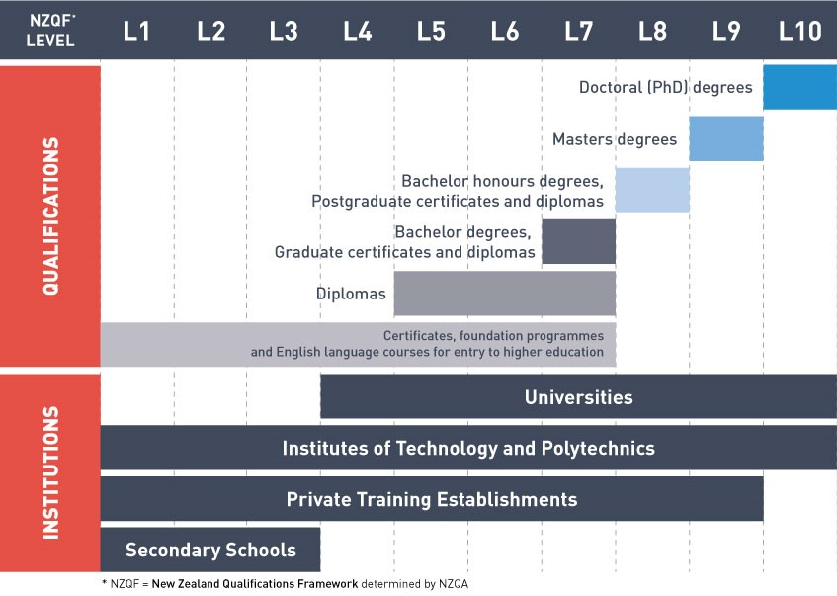
Education

Slide 110

Intakes and Deadlines
There are generally two Intakes in New Zealand: February and July
However, ITPs and Private Institutes have multiple Intakes for different courses
Hence, practically there is an intake almost every month in some or the other institution resulting in recruitment throughout the year
There is no deadline as such in New Zealand, but it is recommended to make applications at least 6 months prior to the start date to avoid last moment hassles

Slide 111

Entry Requirements
Academics
For UG Diploma & Bachelors Class 12 pass out with a range of 50% to 70%
For PG Diploma & Masters Bachelor's Degree with 60% and above
English Requirements
For UG Diploma & Bachelors IELTS- 6.0 overall with no band less than 5.5
For PG Diploma & Masters IELTS- 6.5 overall with no band less than 6.0
*However, IELTS requirement may vary on course-to-course basis.

Slide 112
Post Study Work Visa
Qualification | Post study work visa duration
Undergraduate Diploma – Level 5 & 6 Graduate Diploma – Level 7 | 1 Year (Only if the qualification is linked to occupation on the Green List)
Bachelors – Level 7 | 3 Years
Postgraduate Diploma – Level 8 | 1 Year
Masters – Level 9 | 3 Years
PhD – Level 10 | 3 Years

Slide 113
Cost of Education
Particulars | For Diploma in INR | For Masters in INR
IELTS Coaching | 5,050 | 5,050
IELTS Exam Fees | 15,500 | 15,500
Tuition Fees per year | 10,40,000 | 15,50,000
Living Costs per year | 10,00,000 | 10,00,000
Airfare from India to New Zealand | 50,000 | 50,000
Visa Fees (Including VFS Fees) | 16,500 | 16,500
Total Expenses | 21,27,050 | 26,37,050
Less Part Time Earning (Approx.) | 9,80,000 | 9,80,000
Net Cost | 11,47,050 | 16,57,050
Duration of Part Time Jobs | 20 hrs. per week during study time and 40 hrs. per week during vacations | 20 hrs. per week during study time and40 hrs. per weekduring vacations
Total expenses to be incurred approx. | 11.5 lacs | 16.5 lacs

Slide 114

Average Range of Fees per Annum
University | NZD | INR
Diplomas | $25,000 - $33,000 | 12.50 lacs to 16.50 lacs
Bachelors | $25,000 - $40,000 | 12.50 lacs to 20 lacs
Bachelors of Engineering in University | $40,000 | 20 lacs
Graduate Diplomas | $25,000 - $30,000 | 12.50 lacs to 15 lacs
Masters | $30,000 - $55,000 | 15 lacs to 27.50 lacs
Institutes of Technology and Polytechnics (ITPs) | NZD | INR
Diplomas | $17,000 - $20,000 | 8.50 lacs to 10 lacs
Bachelors | $18,000 - $22,000 | 9 lacs to 11 lacs
Masters | $19,000 - $25,000 | 9.5 lacs to 12.50 lacs

Slide 115

Popular Scholarships in New Zealand
New Zealand Commonwealth Scholarships
Scholarship Amount: Full tuition fee and living expenses allowance.
New Zealand Excellence Awards (NZEA)
NZD 5,000 towards the first-year tuition fee.
Wellington International Excellence Scholarship
NZD 20,000 over three years paid towards tuition fees.
Victoria Tongarewa Scholarship
NZD 5,000 or 10,000
University of Waikato Tauranga Bursary
NZ$10,000 only applicable for Tauranga campus
University of Waikato International Excellence Scholarship
Up to NZ$10,000 towards tuition fees.

Slide 116

Student Work Rights
Eligible students can work up to 20 hours in any given week during study time and 40 hours during holidays.
Students undertaking a course of 12 months or more may work full-time during the holidays
The spouse of a student is eligible to work full time for the duration of the study course, only if the student is studying a full-time course of Level 7 or 8 in areas as specified in the Long-Term Skill Shortage List/Green List. However, partners of students on study course of Level 9 and above can work full time without any such condition

Slide 117

Documents Required for Application
Resume
Duly attested Passing Certificates & Mark sheets of 12th Std or Intermediate & 10th Std. If the 10th or
12th Mark sheet contains only
The subject codes, the subject key should be mentioned.
Duly attested Degree/Provisional/Completion Certificate and all the Mark sheets of Bachelor
IELTS, PTE or TOEFL Score Card.
A Statement of purpose.
2 Letters of Recommendation (for Masters & PG Diploma only) and Work Experience if any.
Copy of Passport (1st & last page)

Slide 118
Documents Required for Visa
Good academic record - over 60% aggregate in Class 10th and 12th and over 50% aggregate in subsequent tertiary qualification with minimal backlogs if any.
IELTS score or equivalent score of TOEFL or PTE as per NZQA requirement.
The subject codes, the subject key should be mentioned.
Student’s immediate family’s verifiable evidence of funds to meet the educational and living expenses in NZ - including the paper trail to explain any recent high-value deposits in accounts.
No more than one immediate family member as a financial sponsor/guarantor.
Verifiable evidence of regular source of sufficient income of financial sponsors/guarantors.
The intended course of study is relevant to qualifications and/or work experience and shows education progression. Meet the health & character requirements

Slide 119
Documents Required for Visa (AIP)
Completed Application Forms and Supplementary
Information Forms.
Visa Application Fee (430 NZD)
Original Passport.
Offer of place
Covering Letter / SOP
Financial Documents
Affidavit of Support from Sponsor
Academic Documents
Evidence of English language ability - IELTS/TOEFL or PTE Result.
Employment documents, if applicable.
Original Police Clearance Certificate(must be less than 6 months old at the time of visa filing).
E- Medical acknowledgment of medical test from an impanelled doctor.

Slide 120
How much funds are required to be shown for NZ student visa
If the course duration is less than or equal to one academic year, then provide documentary evidence of funds for tuition fee for the entire course duration + NZ$ 20,000 towards living expenses in New Zealand.
If the duration of course is longer than one academic year then provide documentary evidence of funds for tuition fee for 1 academic year + NZ$ 20,000 per annum towards living expenses in New Zealand +
Payment plan to show the student has access to funds and has ability to meet the rest of the course cost and living expenses in New Zealand.

Slide 121
How much funds are required to be shown for NZ student visa
Course Duration | Funds | Example
1 year | 1 year tuition Fee + 1 year living expenses (20,000 NZD) | Tuition fee – NZD 22,500 Living – NZD – 20,000 Total – NZD - 42500
More than 1 year | 1 year tuition Fee + 1 year living expenses (20,000 NZD) + Payment plan to show the student has access to funds and has ability to meet the rest of the course cost and living expenses in New Zealand. | Tuition fee – NZD - 22,500 Living – NZD - 20,000 Payment Plan – NZD- 42,500 Total – NZD - 85,000

Slide 122
About Sponsors
Father
Mother
Brother
Sister
Grandfather
Grandmother
Eligible Sponsors
Only 1 Sponsor is Acceptable

Slide 123
Acceptable Evidence of Funds
Education Loan sanction letter from nationalized or multi nationalized bank
Latest bank account statements for the past 6 months. It should not be more than 1 week old at the time of lodgment of application
Fixed deposits copy and balance certificate from bank
PPF/ PF/ GPF withdrawable amount
** Parents and only immediate relatives (blood relations) should ideally sponsor the student.
** The funds should be at least six months old. If recent funds are to be shown then documentary evidence in support of every instance of recent deposits should be provided.
** Evidence of source of income of the student’s financial sponsors to be provided. The sponsors must provide documentary evidence of their identity including date of birth, proof of relationship with student and full contact details including telephone numbers.

Slide 124
What can an Acceptable Payment Plan
can include?
NSC is due for maturity in the following year
LIC is due for maturity in the following year
Land documents are required
Form 16 of the Sponsor shows the income and saving patterns.
EPF or GPF accumulated over a period of 1 year
Fixed Deposits.
Immovable Property evidence
* Please note that Immigration New Zealand (INZ) do not accept movable property as the acceptable payment plan

Slide 125
Job Search Work Visa
Students who have successfully completed in New Zealand a qualification that would qualify for Graduate Job Search Work Visa have to apply within 3 months after the end date of the student visa for that qualification.
Students will be granted a work visa on following conditions:
Applicants must provide a completed work visa application form and fee
Evidence that they have successfully completed a qualification in New Zealand that meets the study to work qualification requirements.
Evidence that they have a minimum of $5000 in funds available to maintain themselves during their stay in New Zealand.
Evidence of an offer of employment is not required.

Slide 126
Thank you !
Contact Details
Naduni Basnayake
University Representative – QIB Campus

