Slide 1
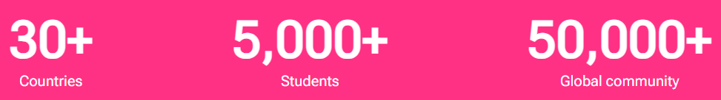

Why Us?
One contract for multiple destinations
Hassle free application process
Get the application submitted to University within 24 hours
Quick offer letters
Multiple scholarships
Free SOP writings and CV review
End-to-End Process

Slide 2

Our University Partnerships
nbasanayake@metaapply.io

Slide 3
















Application Process
Visa Counselling & Documentation Review
Student Application Submission
Eligibility Check
Quality Check
Application Submission to University
LOA/CAS/i20
/COE
Offer Letter
Deposit
Pre- Departure Orientation
University Registration
/ Enrolment
Visa Approval
Visa Application
/Submission
nbasanayake@metaapply.io

Slide 4
The European Union
Countries that are part of both the EU and the Schengen area ( As at June, 2024)
Counties in the EU, not in the Schengen, but Schengen visa is still valid:
France
Germany
Austria
Belgium
Croatia
Czech Republic
Denmark
Estonia
Finland
Greece
Hungary
Italy
Latvia
Lithuania
Luxembourg
Netherlands
Poland
Portugal
Slovakia
Slovenia
Spain
Sweden
Bulgaria
Romania
Cyprus
Ireland
Malta
Part of Schengen, but not in the EU:
Iceland
Liechtenstein
Norway
Switzerland

Slide 5
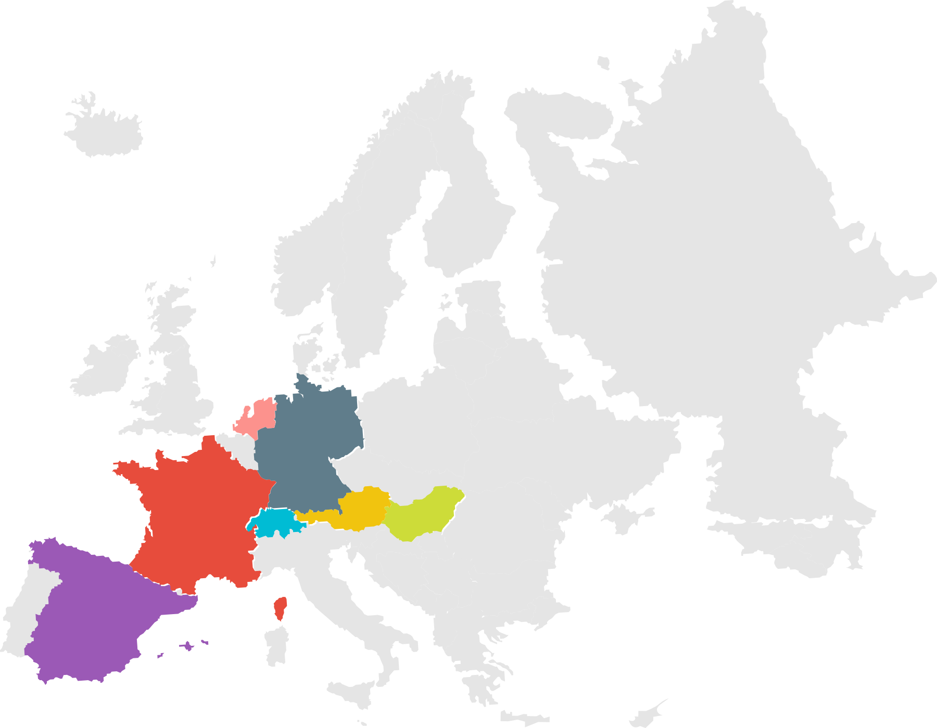








Countries in Our Portfolio
Germany
France
Hungry
Austria
Spain
Switzerland
Netherlands
Germany
France
Hungary
Austria
Spain
Switzerland
Netherlands
Malta

Slide 6

About Germany
Land Size - 357,022 square kilometers (137,847 square miles)
Human Density - 240-250 people per square kilometer (620-650 people per square mile)
Economy - USD 4.5 trillion
Purchasing Power Parity (PPP) - USD 4.6 trillion.
Per Capita - USD 55,000
Language - German
Global Peace Index 2023 - #15
Blocked Account - 11, 208 Euro
PSW - 18 months
Part time – 24hr/Week (120 full days or 240 half days)
Job Opportunities - Health Care, engineering, technology, Human resources, and renewable energy, Automobile

Slide 7







University Partners in Germany
Macromedia University of Applied Science
Media Design School (MDH)
IU- International University of Applied Science
GISMA University of Applied Science
SRH
Schiller International University, Berlin Campus
International School of Management
Cologne Business School
University of Europe for Applied Science

Slide 9
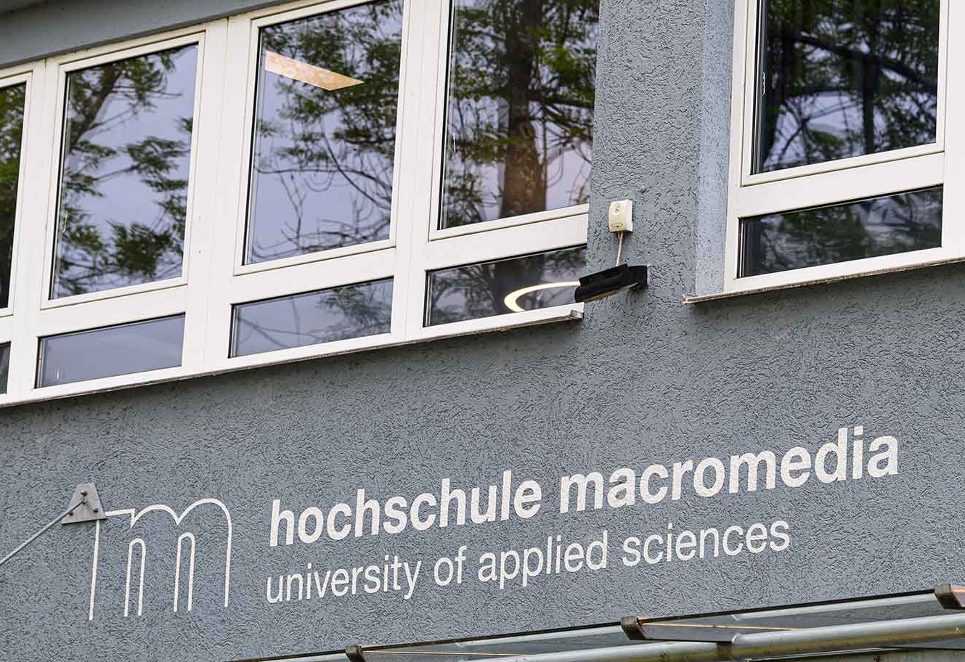
Why Macromedia University
Part of Galileo Global Education – Europe’s largest & the world’s second largest Higher Education Group with a focus on innovation, management, creativity, design and culture.
Globally recognized, state-approved degrees, accredited by FIBAA
Strong career prospects in Germany after graduation
Digitalization, industry collaboration and internationalization lay at the core of its research & teaching.
More than 70 percent of the students have an international background

Slide 10
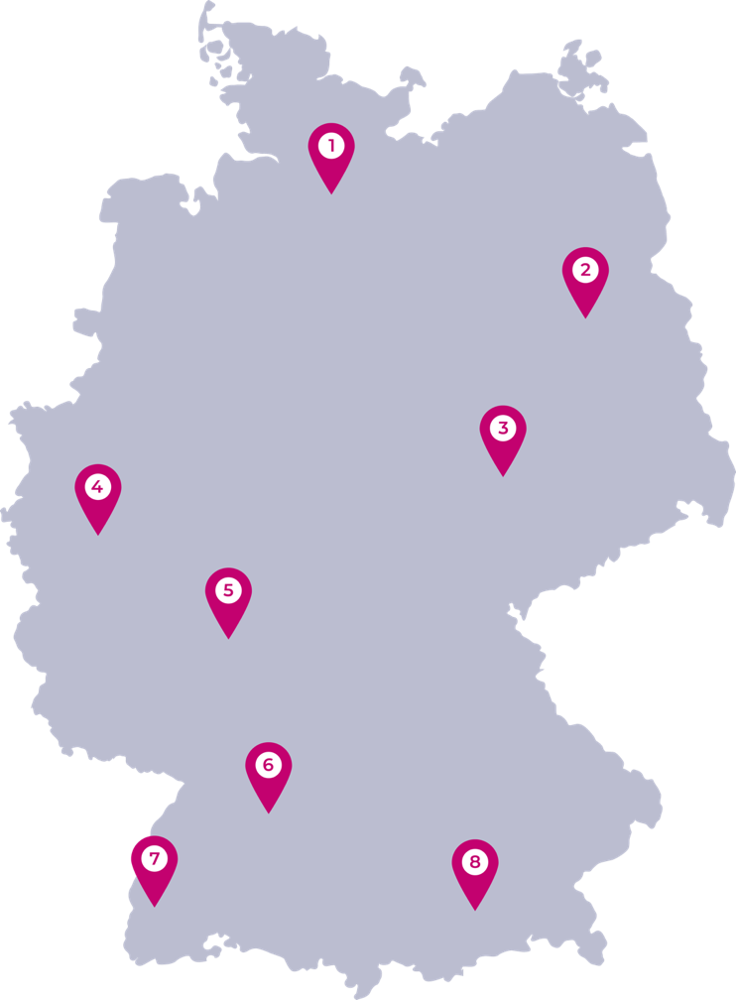
Campus Location
Hamburg
Berlin
Leipzig
Cologne
Hamburg
Berlin
Leipzig
Cologne
Airport close to Campus
Berlin Brandenburg (BER) Airport
Munich (MUC) Airport
Distance from Airport to Campus
Berlin Campus: 30 Mins by road
Munich Campus: 30 Mins by Road

Slide 11
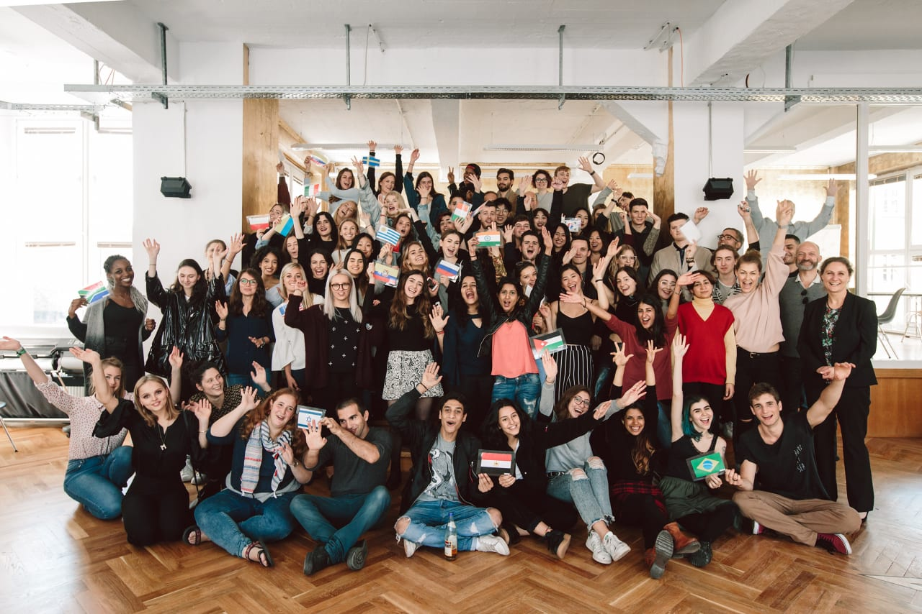
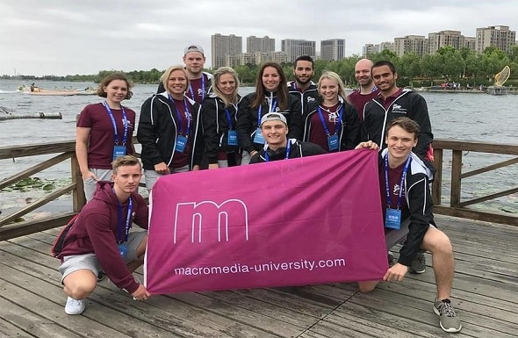
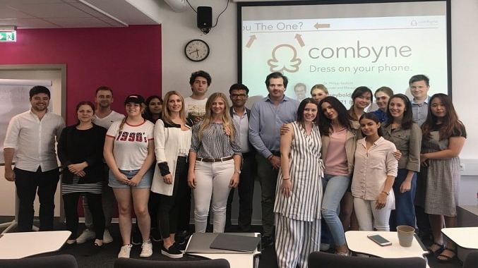
Campus life in Macromedia

Slide 12
Courses offered by Macromedia
Bachelor' s of Arts ( Specialization) - Acting, Design, Fashion Design, Film Making, Interior Design, Media & Communication Design.
Bachelor' s of Science ( Specialization) - Artificial Intelligence, Software Engineering, UI/UX Design.
Bachelor' s of Fashion - Fashion Design , Fashion Management, Management.
Bachelor' s of Film& Acting - Acting, Film Making.
Bachelor' s of Management - Brand Management, Business Management, Fashion Management, Media Management, Media & Communication Management, Music Management.
Bachelor' s of Media - Brand Management, Design, Interior Design, Media Management, Media and Communication Design, Media & Communication Management.
Music Management - M.A Brand Management, Business Management, Design Management, Digital Media Business, Media and Communication Management, Music Management, Strategic Marketing, Data Analytics, International Business, MBA in Marketing , General MBA.

Slide 13
Overview (courses, Fee and Entry requirements)
Programs | Duration | Campus | Tuition Fees
Masters of Arts in Brand Management | 2 Years | Berlin, Munich, Germany | € 6,500 per semester € 950 Registration Fees
Master of Arts in Business Management | 2 Years | Berlin, Munich, Germany | € 6,500 per semester € 950 Registration Fees
Masters of Arts in Design Management | 2 Years | Munich, Germany | € 6,500 per semester € 950 Registration Fees
Masters of Arts in Digital Media Business | 2 Years | Berlin, Munich, Germany | € 6,500 per semester € 950 Registration Fees
Masters of Arts in Media and Communication Management | 2 Years | Berlin, Munich, Germany | € 6,500 per semester € 950 Registration Fees
Masters of Arts in Music Management | 2 Years | Berlin, Germany | € 6,500 per semester € 950 Registration Fees

Slide 14
Cont.
Master of Arts in Strategic Marketing | 2 Years | Berlin, Munich, Germany | € 6,500 per semester € 950 Registration Fees
MBA in Data Analytics | 2 Years | Berlin, Munich, Germany | € 6,500 per semester € 950 Registration Fees
MBA in International Business | 2 Years | Berlin, Munich, Germany | € 6,500 per semester € 950 Registration Fees
MBA in Marketing | 2 Years | Berlin, Munich, Germany | € 6,500 per semester € 950 Registration Fees
MBA General | 2 Years | Berlin, Munich, Germany | € 6,500 per semester € 950 Registration Fees

Slide 15
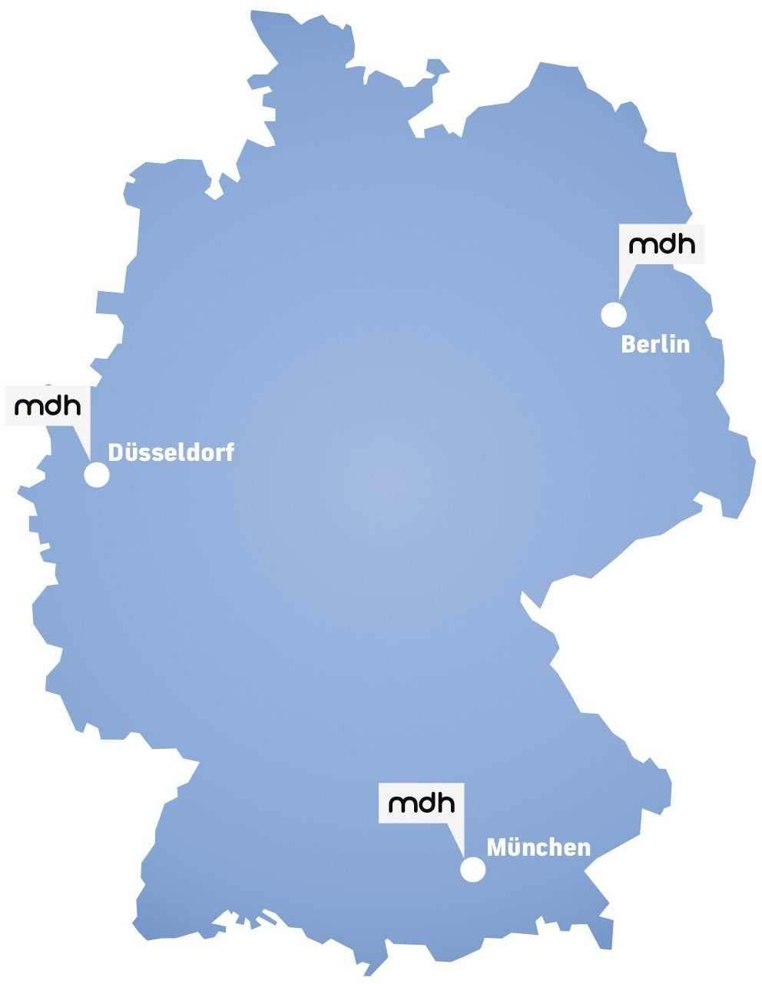

Slide 16

Why Media Design University of Applied Sciences?
State-recognized private university
Since 2004, MDH has been a State-Recognized University, with the power to award it‘s own degrees in Germany.
This means that all students that graduate from MDH will receive a state-recognized degree and will be eligible for the 18 month Post-Study Work Visa after graduation.
Top University specializing in Media, Arts and Design
Our outstanding quality of education was awarded the title of Top Media University in Germany by the magazine FOCUS in the Deutschland Test (30,000 respondents, 256 providers)
Over 25 Years in media and creative industries – We have valuable contacts in the working world. We know important players who are literally waiting for recommendations from us
Berlin Campus
Our campus is right in the heart of Ernst-Reuter-Platz in Berlin, where there are many other universities as well, creating a University Town
We have 7 English programmed in our Berlin campus, specializing in Media, Design, Management and Fashion
Our campus also has various facilities for students to use such as a printing workshop, photo studio, VR room etc.

Slide 17
MDH – Overview (courses, Fee and Entry requirements)
MDH Programme Portfolio -> Non-EU Applicants
Programme | Duration of Programme | Next Intake | Academic Qualifications* | English Level | Tuition Fees/Year | Scholarships | Price after scholarships | Total Price
B.A Digital Film Design | 3.5 Years - 7 Semesters | Oct 2024 | High School Certificate (50%) (50%), Portfolio (Min. 3 Samples) | IELTS 6.0 | €12,600, Year | 20% for all years | €10,080/Year | €35,280
B.A. Media Design | 3.5 Years - 7 Semesters | Oct 2024 | High School Certificate (50%), Portfolio (Min. 3 Samples) | IELTS 6.0 | €12,600, Year | 20% for all years | €10,080/Year | €35,280
BSc Game Design | 3.5 Years - 7 Semesters | Oct 2024 | High School Certificate (50%), Motivation Letter (1 Page) | IELTS 6.0 | €12,600, Year | 20% for all years | €10,080/Year | €35,280
B.A. Fashion Management | 3.5 Years - 7 Semesters | Oct 2024 | High School Certificate (50%), Motivation Letter (1 Page) | IELTS 6.0 | €12,600, Year | 20% for all years | €10,080/Year | €35,280

Slide 18
MDH – Overview (courses, Fee and Entry requirements)
B.A. Media Management | 3.5 Years - 7 Semesters | Oct 2024 | High School Certificate (50%) Motivation Letter (1 Page) | IELTS 6.0 | €12,600/Year | 20% for all years | €10,080/Year | €35,280
M.A. Design Management | 1.5 Years - 3 Semesters | Oct 2024 & Apr 2024 | 3.5 Year Bachelor's - 210 ECTS, Motivation Letter (1 Page) | IELTS 6.0 | €12,600/Year | 20% for all years | €10,080/Year | €15,120
M.A. Digital Leadership | 1.5 Years - 3 Semesters | Oct 2024 & Apr 2024 | 3.5 Year Bachelor's - 210 ECTS, Motivation Letter (1 Page) | IELTS 6.0 | €12,600/Year | 20% for all years | €10,080/Year | €15,120
M.A. Design Management | 2 Years - 4 Semesters | Oct 2024 & Apr 2024 | 3 Year Bachelor's - 180 ECTS, Motivation Letter (1 Page) | IELTS 6.0 | €12,600/Year | 20% for all years | €10,080/Year | €20,160
M.A. Digital Leadership | 2 Years - 4 Semesters | Oct 2024 & Apr 2024 | 3 Year Bachelor's - 180 ECTS, Motivation Letter (1 Page) | IELTS 6.0 | €12,600/Year | 20% for all years | €10,080/Year | €20,160

Slide 19


Slide 20
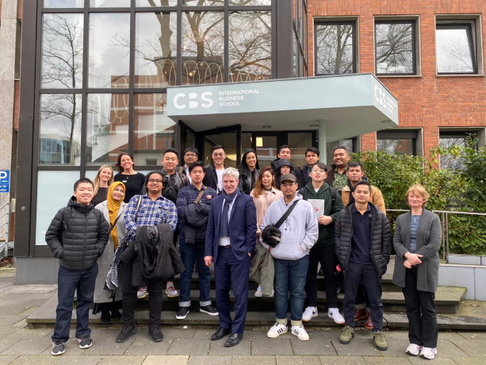
Why Choose CBS ?
Business partnerships: CBS has strong connections with world-leading companies
Work experience : Plenty of opportunities to secure outstanding internships
Global education links: The University has partnerships with 180 universities across the world
Great location: CBS campuses are situated in globally renowned German cities.
There’s a tight-knit student community at CBS, with over 4,000 students studying there.

Slide 21
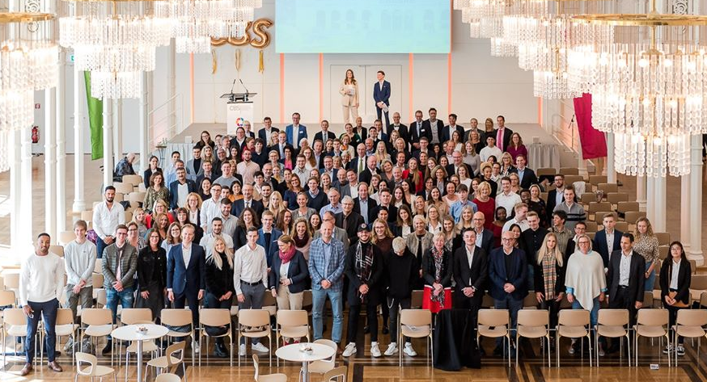
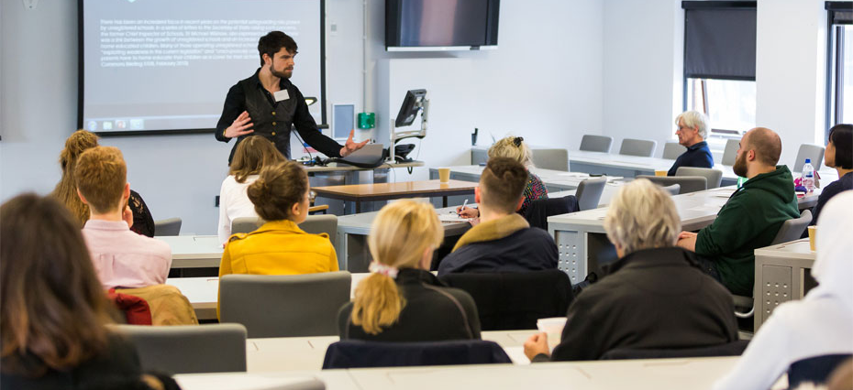
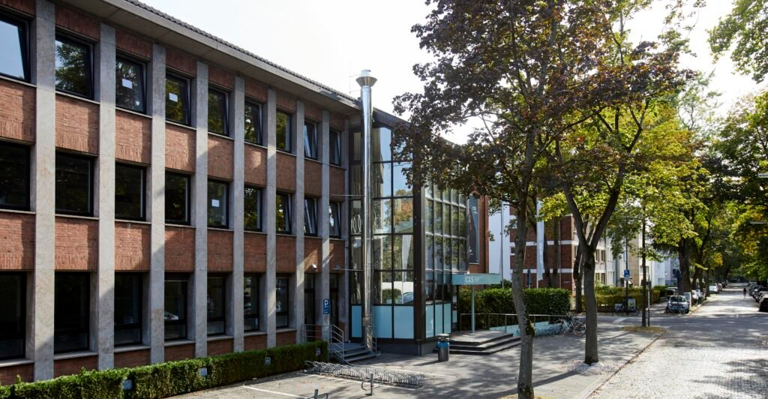
Campus Life in CBS

Slide 22
CBS –Overview (Course, Fee and Intake)
Programs | Duration | Tuition fee | Campus | Intake
Business Psychology (B.Sc.) | 3 Year | 5370 €/ semester | Cologne, Mainz, Germany | Mar-24
Finance & Management (B.Sc.) | 3 Year | 5370 €/ semester | Cologne, Mainz, Germany | Dec-23
International Business (I.B) | 3 Year | 5370 €/ semester | Cologne, Mainz, Germany | Mar-24
IB -Digital Management(B.A) | 3 Year | 5370 €/ semester | Cologne, Mainz, Germany | Mar-24
IB- Financial Management | 3 Year | 5370 €/ semester | Cologne, Mainz, Germany | Mar-24
IB- HRM & Leadership | 3 Year | 5370 €/ semester | Cologne,Mainz,Berlin,Aachen, Germany | Mar-24

Slide 23
CBS –Overview (Course, Fee and Intake)
IB- International Trade (B.A) | 3 Year | 5370 €/ semester | Cologne, Berlin, Aachen, Germany | Mar-24
IB- Management Consulting | 3 Year | 5370 €/ semester | Cologne, Berlin, Aachen, Germany | Mar-24
IB- Marketing Management | 3 Year | 5370 €/ semester | Cologne,Mainz,Berlin,Aachen, Germany | Mar-24
International Management Fast Track MBA | 1 year | 8250 €/ semester | Cologne, Germany | Dec-23
International Management MBA | 2 Year | 5850 €/ semester | Cologne, Germany | Dec-24

Slide 24
c

Slide 25

Why Choose GISMA Business School?
GISMA is partnered with awarded institutions to provide high-quality programs that are delivered entirely in English.
GISMA Business School is a German university located in Hannover, which secured the ranked #42 in the QS Global MBA Rankings 2022.
Students are supported in their search for internships and jobs in Germany. With our Career Centre, our students have access to numerous employers ranging from start-ups to SMEs, hidden champions to the world’s largest technology companies. Collaborations between GISMA and employers enable students to find exciting job opportunities and work on joint projects.

Slide 26
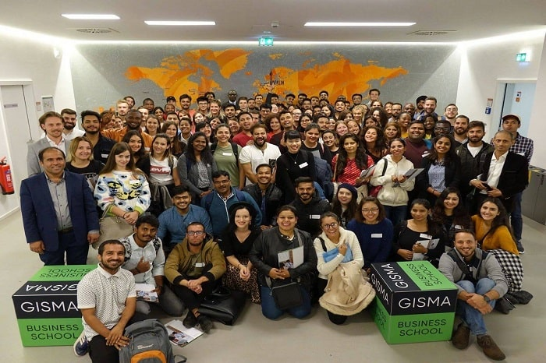
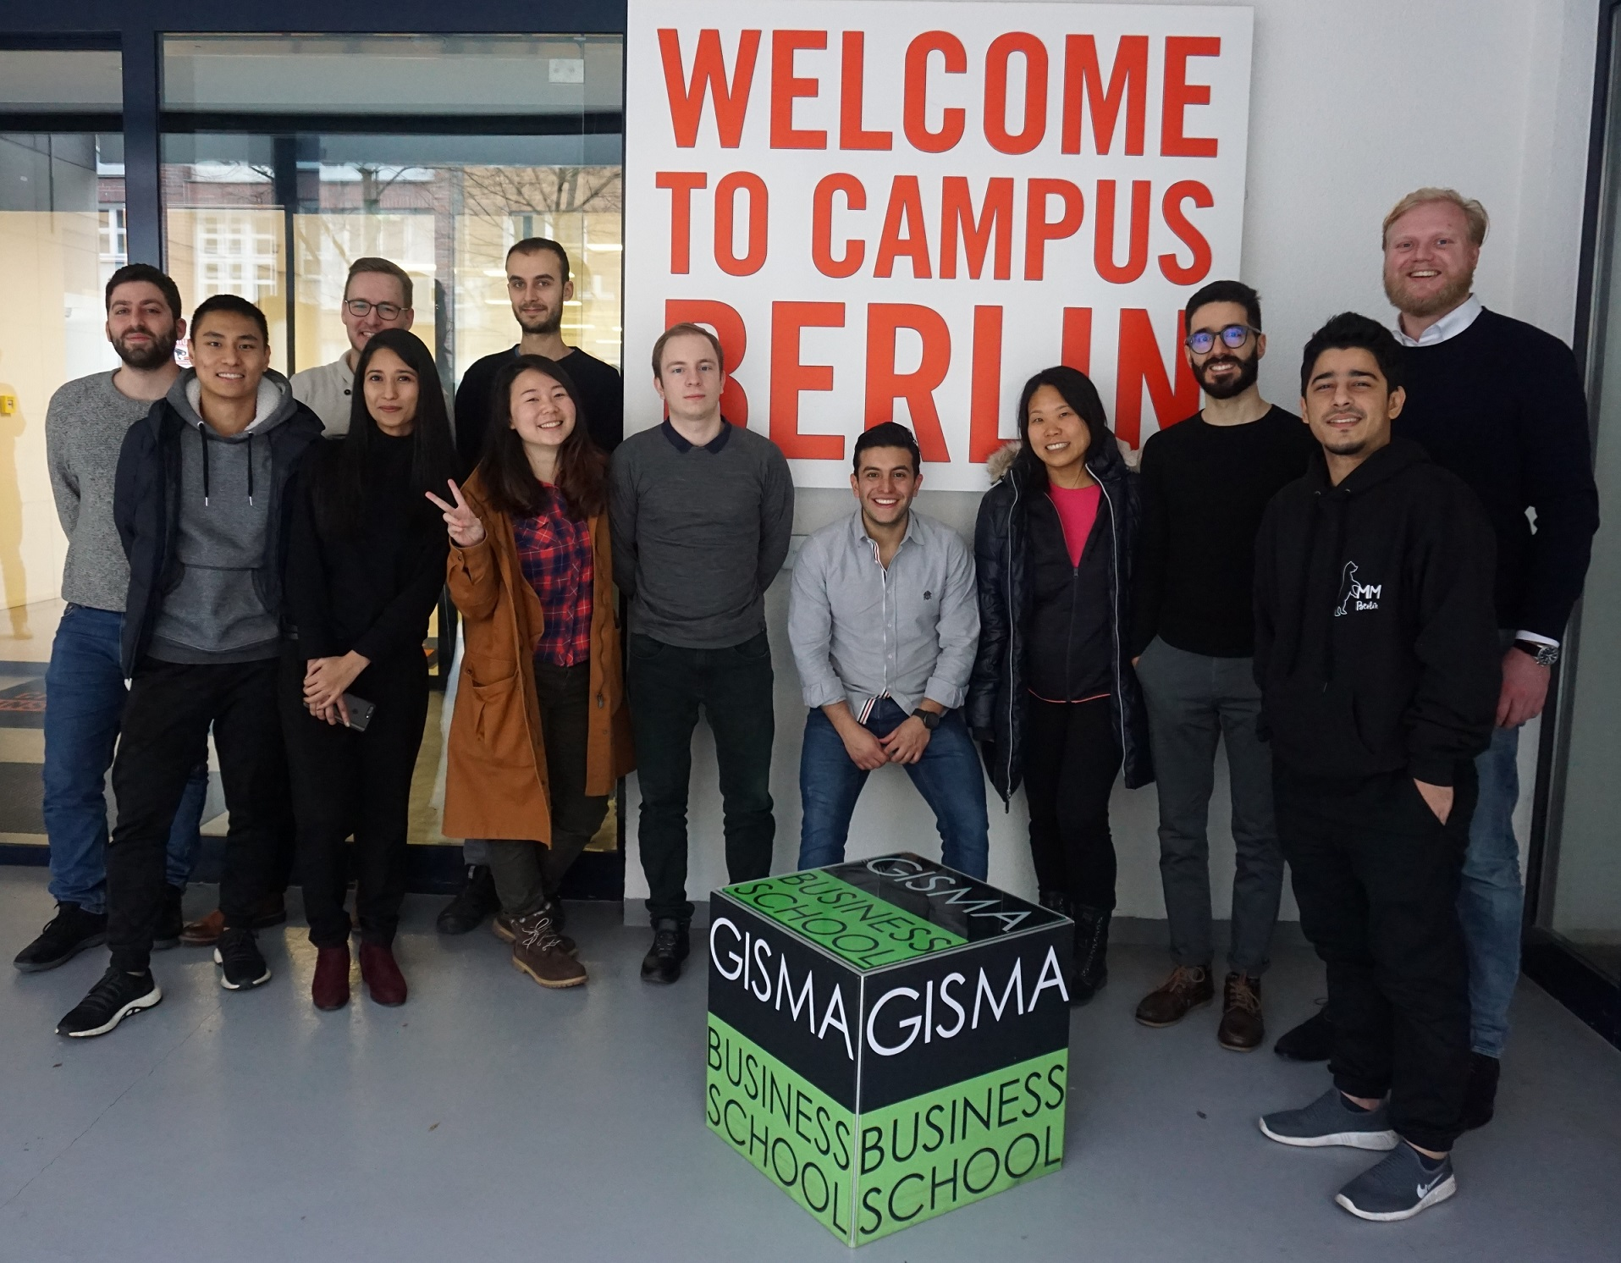
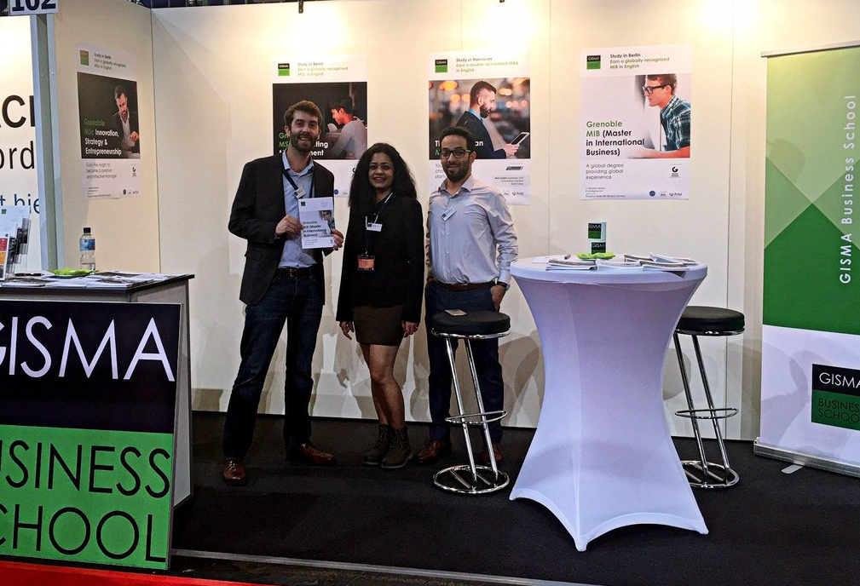
Campus life in GISMA Business School

Slide 27
GISMA Business School Overview
(Course, Fee and Intake)
Programs | Duration | Campus | Tuition fee
Bachelors :-
BSc Data Science , AI & Digital Business | 3 Years | Potsdam, Berlin | € from 9,600 per year
BSc International Business Management | 3 Years | Potsdam, Berlin | € from 9,600 per year
BENG Software Engineering | 3 Years | Potsdam, Berlin | € from 9,600 per year
BSc Computer Science | 3 Years | Potsdam, Berlin | € from 9,600 per year
BSc Business Management | 3 Years | Potsdam, Berlin | € from 9,600 per year

Slide 28
GISMA Business School Overview
(Course, Fee and Intake)
Programs | Duration | Campus | Tuition fee
Masters :-
MSc Business Management | 1Year-2Year | Potsdam, Berlin | € from 13,000 per year
MSc International Business Management | 1 Year | Hamburg | € from 16,500 per course
MSc Data Science , AI& Digital Business | 1Year-2Year | Potsdam, Berlin | € from 13,000 per course
Global MBA | 1Year-2Year | Potsdam, Berlin | € from 18,000 per course
Computer Science Masters of Engineering | 1Year-2Year | Potsdam, Berlin | € from 13,000 per year / 15500 for international students
MSc Leadership of Digital Transformation | 1Year-2Year | Potsdam, Berlin | € from 13,000 per year

Slide 29


Slide 30
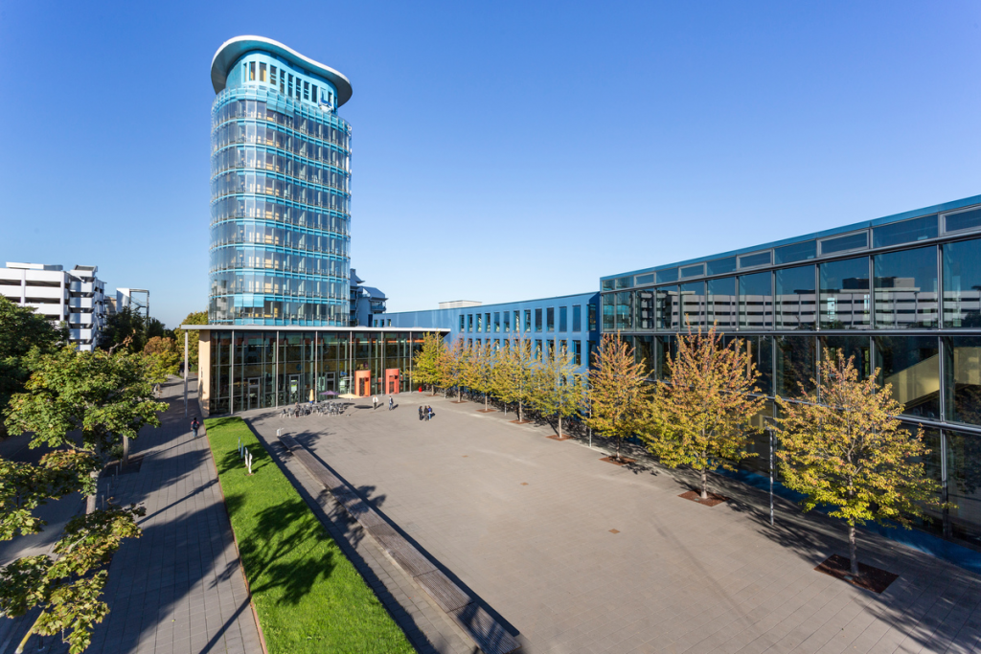
Why Choose SRH?
The schools of the SRH Berlin University of Applied Sciences offer a great variety of courses. We have designed unique programs under the slogan "our semesters are colorful" so that our students can benefit from this diversity.
SRH Hochschule Berlin is considered one of the world's most famous and renowned institutions for its excellent structure of knowledge system and friendly environment. SRH berlin ranking is 148 in the country.
Excellent study conditions - Teaching at SRH is characterized by innovative course contents, small groups and mutual exchange.

Slide 31
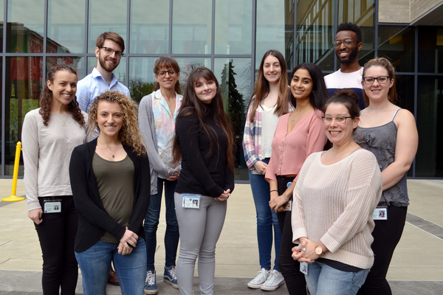

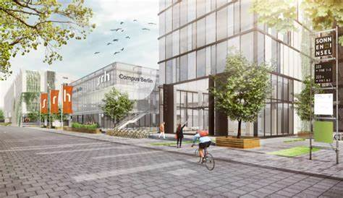
Campus life in SRH

Slide 32
Course Offered by SRH
Programs | Duration | Tuition fee | Campus
Business & Hotel Management
B.A. International Business Administration | 3.5 Years | 8280EUR/Year | Berlin, Germany
B.A. International Business Administration- Digital marketing | 3.5 Years | 8280EUR/Year | Berlin, Germany
B.A. International Business Administration- Business Psychology | 3.5 Years | 8280EUR/Year | Berlin, Germany
B.A. International Business Administration- Healthcare Management | 3.5 Years | 8280EUR/Year | Berlin, Germany
B.A. International Business Administration- Supply Chain Management | 3.5 Years | 8280EUR/Year | Berlin, Germany
B.A. Creative Industries Management | 3.5 Years | 8280EUR/Year | Berlin, Germany
B.A. Global Hospitality management | 3.5 years | 8280EUR/Year | Dresden, Germany
Health & Psychology | 3.5 Years | 8280EUR/Year
B.Sc. Computer Science- Healthcare Management | 3.5 Years | 8280EUR/Year | Berlin, Germany

Slide 33
Course Offered by SRH
Design, Communication & Media
B.A. Illustration | 3.5 Years | EUR 4,725 / semester | Berlin, Germany
B.A. Advertising and Brand Design | 3.5 Years | EUR 4,725 / semester | Berlin, Germany
B.A. User Experience Design and Content Creation | 3.5 Years | EUR 4,725 / semester | Berlin, Germany
Film & Photography
B.A. Film & Motion Design | 3.5 Years | EUR 4,725 / semester | Berlin, Germany
B.A. Photography | 3.5 Years | EUR 4,725 / semester | Berlin, Germany
Music & Sound
B.A. Audio Design | 3.5 Years | EUR 4,740 / semester | Berlin, Germany
B.A. Music Production | 3.5 Years | EUR 4,740 / semester | Berlin, Germany
B. Music- Popular Music | 3.5 Years | EUR 4,740 / semester | Berlin, Germany

Slide 34
Course Offered by SRH
Programs | Duration | Tuition fee | Campus
Technology, Computer Science & UX Design
B.Eng. Applied Mechatronic Systems | 3.5 Years | EUR 4800 / semester | Berlin, Germany
B.Sc. Computer Science | 3.5 Years | EUR 4800 / semester | Berlin, Germany
B.Sc. Computer Science- Healthcare Management | 3.5 Years | EUR 4800 / semester | Berlin, Germany
B.Sc. Web Development | 3.5 Years | EUR 4800 / semester | Berlin, Germany
B.A. User Experience Design and Content Creation | 3.5 Years | EUR 4800 / semester | Berlin, Germany
Design
M.A. Strategic Design | 2 Years | EUR 5700 / semester | Berlin, Germany
M.A. Social Design and Sustainable Innovation | 2 Years | EUR 5700 / semester | Berlin, Germany
Film & Photography

Slide 35
Course Offered by SRH
M.A. Film, Television and Digital Narratives | 2 Years | EUR 5700 / semester | Berlin, Germany
M.A. Photography | 2 Years | EUR 5700 / semester | Berlin, Germany
Management
M.A. International Management | 2 Years | EUR 6800 / semester | Berlin, Germany
M.A. International Management- Creative Leadership | 2 Years | EUR 6800 / semester | Berlin, Germany
M.A. International Management - Entreprenurship and Intrapreneurship | 2 Years | : EUR 6800 / semester | Berlin, Germany
MSc. Digital Transformation Management | 2 Years | EUR 6,450 / semester | Hamburg, Germany
M.A. International Business and Leadership | 2 Years | EUR 6850 / semester | Hamburg, Germany
M.A. International Business- Sustainability Management | 2 Years | EUR 6450 / semester | Hamburg, Germany

Slide 36
Course Offered by SRH
Programs | Duration | Tuition fee | Campus
Supply Chain Management
M.Sc. Supply Chain Management | 2 Years | EUR 6800 / semester | Berlin/Hamburg, Germany
M.Sc. Digital Supply Chain Management | 2 Years | EUR 6800 / semester | Berlin, Germany
M.Sc. Sustainable Supply Chain Management | 2 Years | EUR 6800 / semester | Berlin, Germany
Engineering
M.Eng. Sustainable Battery Production Engineering | 2 Years | EUR 6800 / semester | Berlin, Germany
M.Eng. Engineering and International Business- Renewable Energy, Water and Waste Management | 2 Years | EUR 6800 / semester | Berlin, Germany
M. Eng. Engineering and Sustainable Technology Management- Mobility and Automative Industry | 2 Years | EUR 6800 / semester | Berlin, Germany
M. Eng. Engineering and Sustainable Technology Management- Industry 4.0: Automation, Robotics & 3D Manufacturing | 2 Years | EUR 6800 / semester | Berlin, Germany

Slide 37
Course Offered by SRH
M. Eng. Engineering and Sustainable Technology Management - Smart Building and Technologies | 2 Years | EUR 6800 / semester | Berlin, Germany
Computer Science
M.Sc. Computer Science- Cyber Security | 2 Years | EUR 6800 / semester | Berlin, Germany
M.Sc. Computer Science- Big Data and AI | 2 Years | EUR 6800 / semester | Berlin, Germany
MBA
General Management | 1.5 Years | EUR 7560 / semester | Berlin, Germany
Healthcare Management | 2 Years | EUR 7560 / semester | Berlin, Germany
International Human Resource Management | 2 Years | EUR 7560 / semester | Berlin, Germany
Executive MBA General Management | 1 Years | EUR 7875 / semester | Berlin, Germany
DBA |  | £13,100 / year | Berlin, Germany

Slide 38


Slide 39
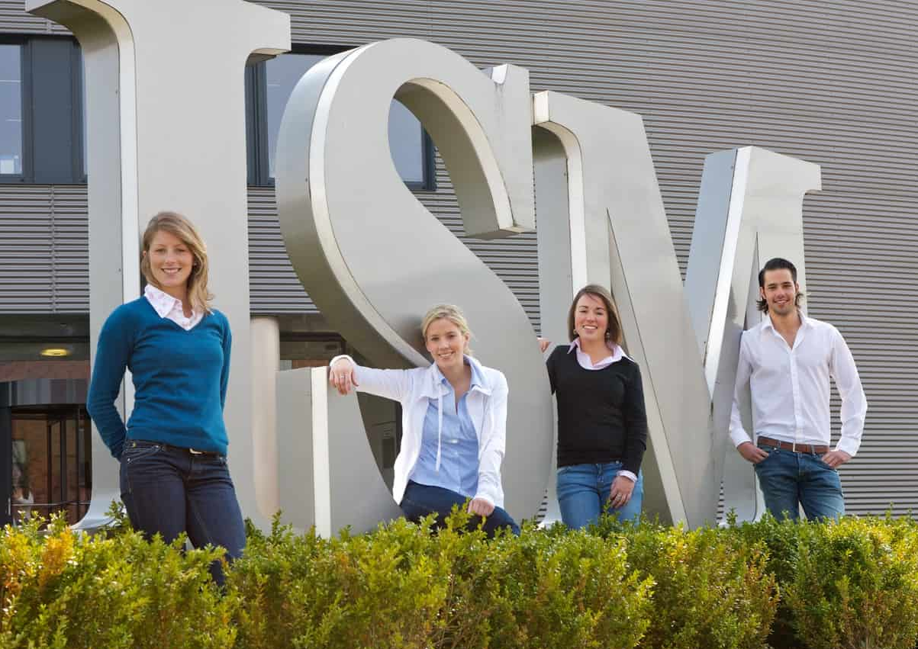
Why Choose ISM?
The quality of the education is confirmed by HR managers, ISM students and alumni and the presence in numerous rankings where ISM consistently occupies top positions for many years for areas such as internationality, student mobility, international academic staff, contact to professional practice, professional

Slide 40
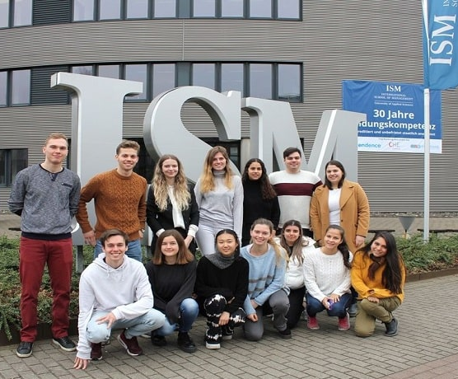
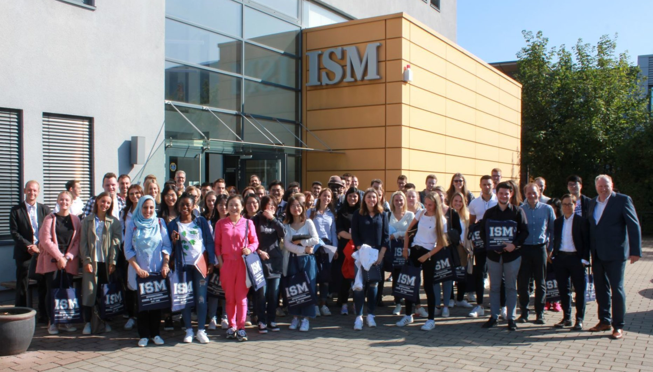
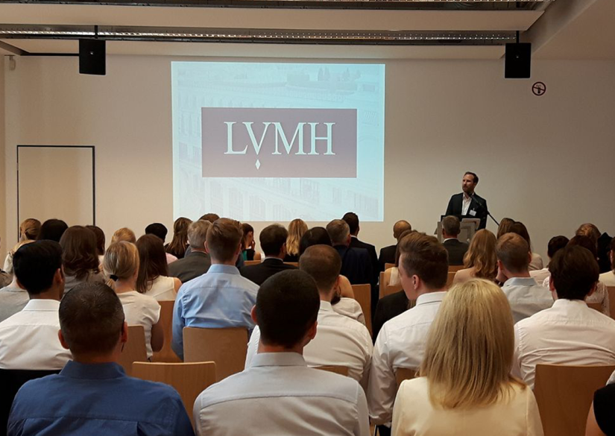
Campus life in ISM

Slide 41
Programs Offered by ISM
Programs | Duration | Campus | Tuition fee | Scholarship | Campus
Bachelor's of Business Management & Marketing | 3.5 YEARS |  | 2990 euro/sem |  | Berlin, Germany
Bachelor's of Finance | 3.5 YEARS |  | 2990 euro/sem |  | Berlin, Germany
Bachelor's of Economics & Politics | 3.5 YEARS |  | 2990 euro/sem |  | Berlin, Germany
Bachelor's of Economics & Data Analytics | 3.5 YEARS |  | 2990 euro/sem |  | Berlin, Germany
Bachelor's of Entrepreneurship & Innovation | 3.5 YEARS |  | 2990 euro/sem |  | Berlin, Germany
Bachelor's of International Business & Communication | 3.5 YEARS |  | 2990 euro/sem |  | Berlin, Germany
M.Sc. International management | 2 Years | Dortmund, Frankfurt(main campus), Munich, Hamburg, Cologne, Stuttgart, Berlin | 5700 euro/Sem | Early Bird discount and Last bird Discount) | Berlin, Germany
M.A. Strategic marketing management | 2 Years | Munich and Berlin | 5700 euro/Sem | Early Bird discount and Last bird Discount) | Berlin, Germany

Slide 42
Programs Offered by ISM
M.A. Digital Marketing | 2 years | Berlin | 5700 Euro/Sem | Early Bird discount and Last bird Discount) | Berlin, Germany
M.Sc. Finance | 2 Years | Dortmund, Frankfurt/Main, Munich, Berlin | 5700 Euro/Sem | Early Bird discount and Last bird Discount) | Berlin, Germany
M.Sc. Business Intelligence & Data Science | 2 Years | Dortmund, Munich, Hamburg, Stuttgart | 5700 Euro/Sem | Early Bird discount and Last bird Discount) | Berlin, Germany
M.Sc. International Logistics & Supply Chain management | 2 Years | Frankfurt/Main, Hamburg | 5700 Euro/Sem | Early Bird discount and Last bird Discount) | Berlin, Germany
M.A. Luxury, Fashion & Sales Management | 2 Years | Munich and Berlin | 5700 Euro/Sem | Early Bird discount and Last bird Discount) | Berlin, Germany
M.A. Strategic Sports Management | 2 Years | Berlin | 5700 Euro/Sem | Early Bird discount and Last bird Discount) | Berlin, Germany
M.Sc. International Business | 2 Years | Dortmund, Frankfurt/Main, Munich, Berlin | 5700 Euro/Sem | Early Bird discount and Last bird Discount) | Berlin, Germany
MBA in General management | 1.5 years |  | 5700 Euro/Sem |  | Berlin, Germany

Slide 43


Slide 44
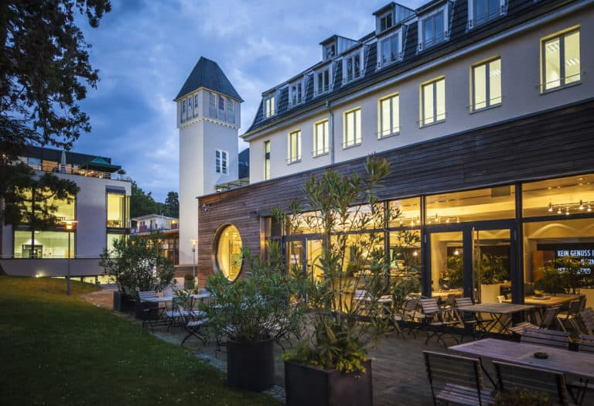
Why Choose IU International
14000+ Alumni Network
Highly Equipped Campus with Applied Science's Workshops
7:1 student to faculty ratio
Bad Honnef campus has in campus accommodation
ACBSP Accredited all courses accredited by ANABIN(H+ Accreditation).
IU International University of Applied Sciences is a legitimate and reputable institution that provides students with quality education and prepares them for successful careers.

Slide 45
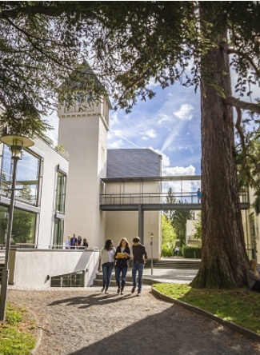
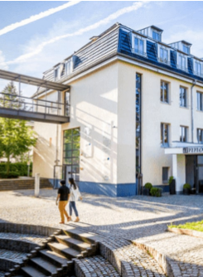
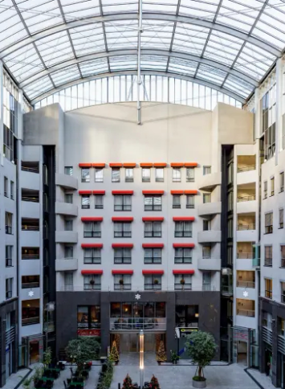
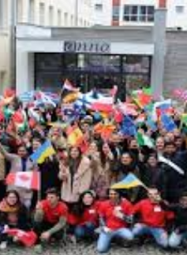
Campus Life In IU International

Slide 46
Course Offered in IU International
Programs | Duration | Tuition fee | Campus
B.Sc. Business and IT | 3 Years | 5,142.06 EUR/Year | Bad Honnef/ Berlin
B.A. Business Administration | 3 Years | 5,142.06 EUR/Year | Bad Honnef/ Berlin
B.Eng. Ind. Engineering & Management | 3 Years | 5,142.06 EUR/Year | Bad Honnef/ Berlin
B.A. International Management | 3 Years | 5,142.06 EUR/Year | Bad Honnef/ Berlin
B.Sc. Cyber Security | 3 Years | 5,142.06 EUR/Year | Bad Honnef/ Berlin
B.Sc. Data Science | 3 years | 5,142.06 EUR/Year | Bad Honnef/ Berlin
B.A. Entrepreneurship | 3 years | 5,142.06 EUR/Year | Bad Honnef/ Berlin
B.Eng. Robotics | 3 Years | 5,142.06 EUR/Year | Bad Honnef/ Berlin
M.Sc. Artificial Intelligence 120 ECTS | 2 Years | 7,320 EUR/Year | Berlin
M.Sc. Data Science 60 ECTS | 1 Year | 9,487 EUR | Berlin
M.Sc. Data Science 120 ECTS | 2 Years | 7,320 EUR/Year | Berlin
M.Sc. Computer Science 120 ECTS | 2 Years | 7,320 EUR/Year | Berlin
M.Eng. Engineering Management 60 ECTS | 1 Year | 9,487 EUR | Berlin

Slide 47
Course Offered in IU International
Programs | Duration | Tuition fee | Campus
MBA with Specialization (90 ECTS)
Big Data Management | 1.5 Years | 9,816 EUR/Year | Berlin
Engineering Management | 1.5 Years | 9,816 EUR/Year | Berlin
Finance & Accounting | 1.5 Years | 9,816 EUR/Year | Berlin
International Marketing | 1.5 Years | 9,816 EUR/Year | Berlin
IT Management | 1.5 Years | 9,816 EUR/Year | Berlin
Artificial Intelligence | 1.5 Years | 9,816 EUR/Year | Berlin
E-Sports Management | 1.5 Years | 9,816 EUR/Year | Berlin
Healthcare Management | 1.5 Years | 9,816 EUR/Year | Berlin
Human Resource Management | 1.5 Years | 9,816 EUR/Year | Berlin
Innovation & Entrepreneurship | 1.5 Years | 9,816 EUR/Year | Berlin

Slide 48
Course Offered in IU International
Salesforce | 1.5 Years | 9,816 EUR/Year | Berlin
Supply Chain Management | 1.5 Years | 9,816 EUR/Year | Berlin
M.A. Management with Specialisation (60 ECTS)
Big Data Management | 1 Year | 9,487 EUR | Berlin
Engineering Management | 1 Year | 9,487 EUR | Berlin
Finance & Accounting | 1 Year | 9,487 EUR | Berlin
International Marketing | 1 year | 9,487 EUR | Berlin
IT Management | 1 Year | 9,487 EUR | Berlin
M.A Marketing Management (60 ECTS) | 1 Year | 9,487 EUR | Berlin
M.A Marketing Management (120 ECTS) | 2 Year | 7,320 EUR/Year | Berlin

Slide 49
Course Offered in IU International
Programs | Duration | Tuition fee | Campus
M.A. International Management with Specialization (60 ECTS)
Big Data Management | 1 Year | 9,487 EUR | Berlin
Engineering Management | 1 Year | 9,487 EUR | Berlin
Finance & Accounting | 1 year | 9,487 EUR | Berlin
International Marketing | 1 Year | 9,487 EUR | Berlin
IT Management | 1 Year | 9,487 EUR | Berlin
M.A. International Management with Specialization (120 ECTS)
Big Data Management | 2 Years | 7,320 EUR/Year | Berlin
Engineering Management | 2 Years | 7,320 EUR/Year | Berlin
Finance & Accounting | 2 Years | 7,320 EUR/Year | Berlin
International Marketing | 2 Years | 7,320 EUR/Year | Berlin
IT Management | 2 Years | 7,320 EUR/Year | Berlin
AI & Robotics | 2 Years | 7,320 EUR/Year | Berlin

Slide 50


Slide 51
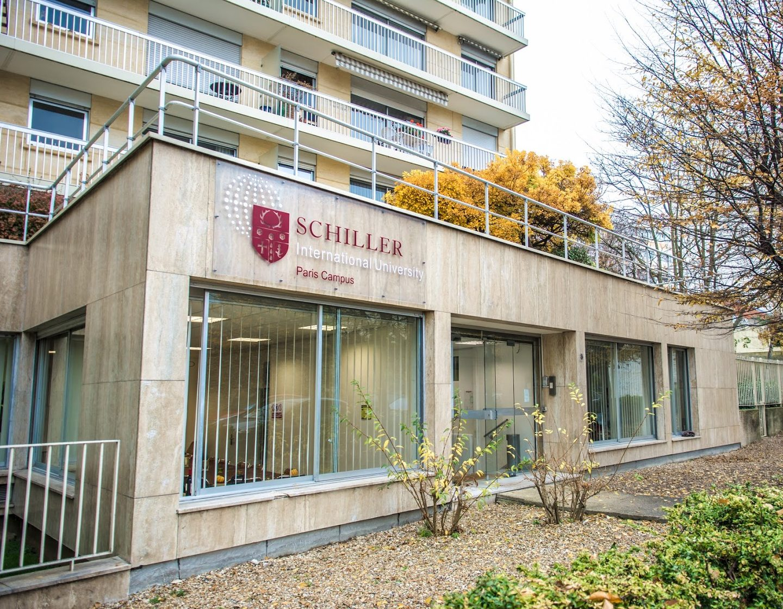
Why Choose Shiller International University ?
Schiller is the new education concept aimed at people who understand that running in a global world needs smart global performance. The university for those who can’t settle. Through our four international campuses, we provide students with a global transformative education. A learning by living experience that allows them to obtain an accredited dual degree (US and European), master global diversity by living immersed in up to four different countries and increase their international employability by building a flexible path. Success starts with transformation, and transformation happens after a smart decision.

Slide 52
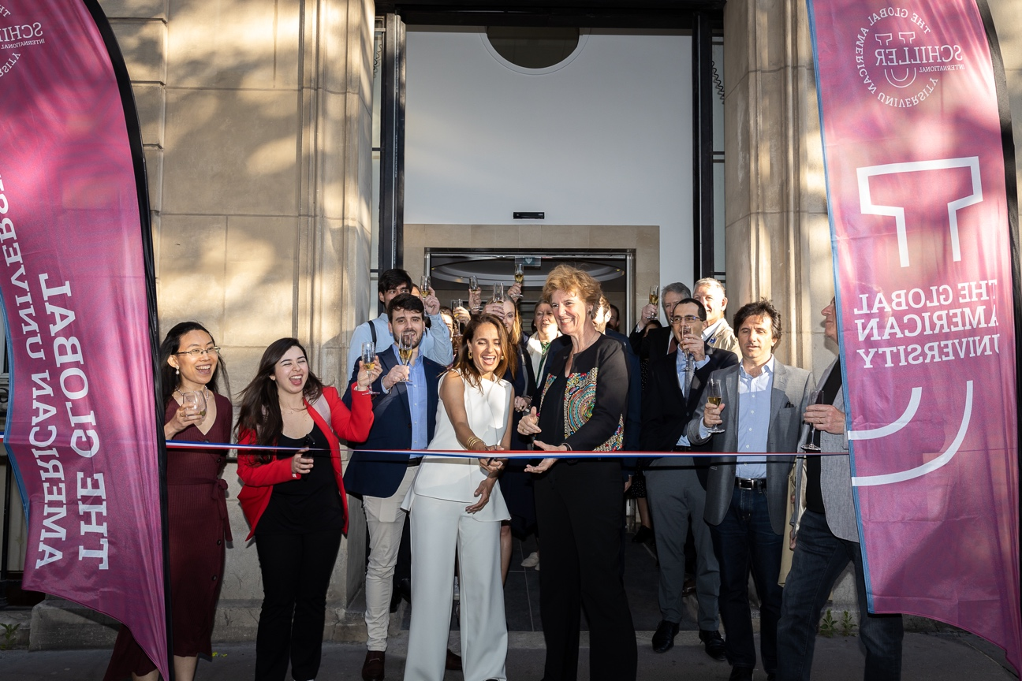
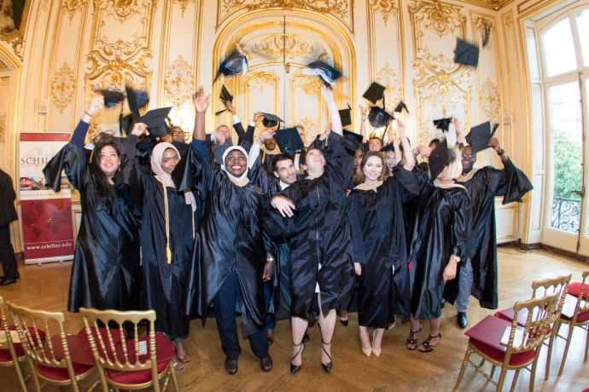
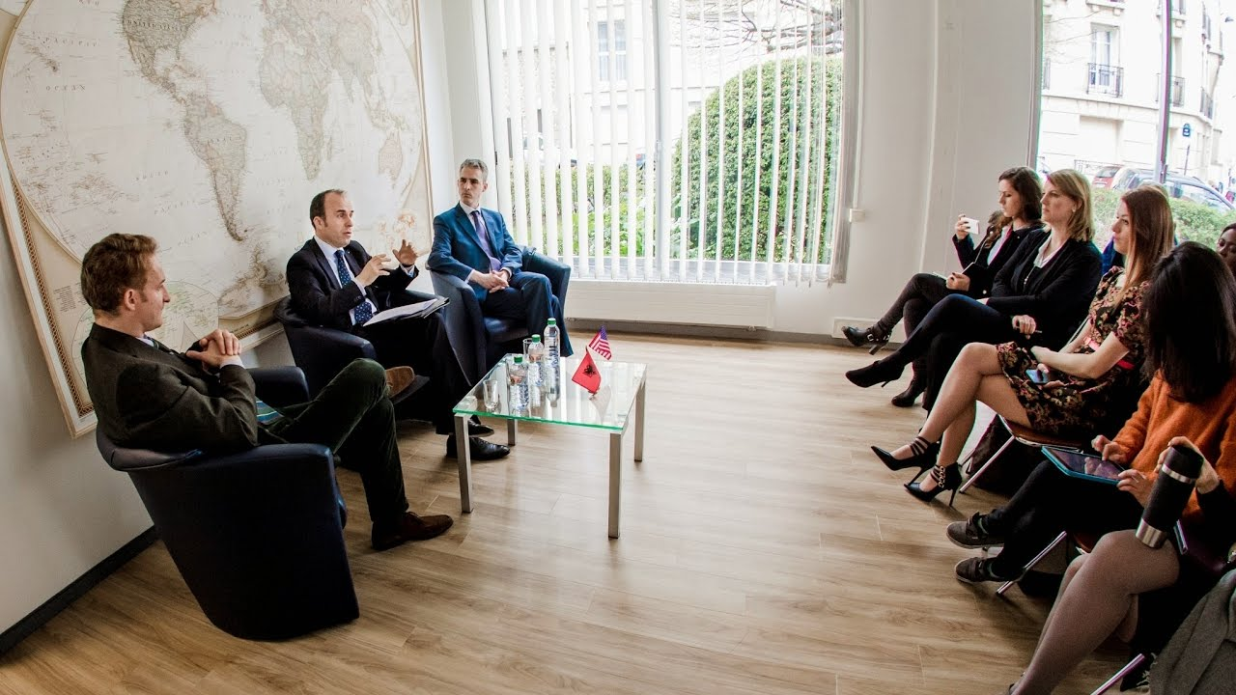
Campus life in Shiller International University

Slide 53
University Overview (Course, Fee and Intake)
Programs | Duration | Tuition fee | Campus | Intake
MA- International Relations and Diplomacy | 2 Years | $21600 | Florida
MBA-Business Administration | 2 Years | $21600 | Florida | June-24/Sep-24
MS - Digital Marketing and E-commerce | 2 Years | 19,560 | Florida | Sep-24
MA - International Relations and Diplomacy | 2 Years | 19,560 | Heildelberg | Sep-24
MBA-Business Administration | 2 Years | 19,560 | Heidelberg | June-24/Sep-24
MBA-International Business | 2 Years | 24,450 | Heildelberg | June-24/Sep-24
MA - International Relations and Diplomacy | 2 Years | 19,560 | Madrid | Sep-24
MBA-Business Administration | 2 Years | 19,560 | Madrid | June-24/Sep-24
MBA-Business Administration Spanish | 2 Years | 19,560 | Madrid | June-24/Sep-24
MBA-International Business | 2 Years | 24,450 | Madrid | June-24/Sep-24
MA - Sustainability | 2 Years | 19,560 | Madrid | Sep-24

Slide 54
University Overview (Course, Fee and Intake)
MS- Data Science | 2 Years | 19,560 | Madrid | Sep-24
MS- Digital Marketing and E-commerce | 2 Years | 19,560 | Madrid | Sep-24
MS - Global Finance | 2 Years | 19,560 | Madrid | Sep-24
MA- International Relations and Diplomacy | 2 Years | 19,560 | Paris | June-24/Sep-24
MBA-Business Administration | 2 Years | 19,560 | Paris | June-24/Sep-24
MBA-International Business | 2 Years | 24,450 | Paris | June-24/Sep-24
MS- Data Science | 2 Years | 19560 | Paris | Sep-24
MS- Global Finance | 2 Years | 19,560 | Paris | Sep-24
MS - Sustainability | 2 Years | 19,560 | Paris | Sep-24

Slide 55

About France
Land Size- 549,087 km² (212,004 mi²)
Population- 64,756,584
Economy- USD 4.5 trillion
Purchasing Power Parity (PPP)- USD 4.6 trillion.
Per Capita- USD 55,000
Language- French
Global Happiness Index 2023- #20
Living Cost/Finances- 1000EUR per month
PSW- Bachelors: 02 years (Extendable up to 5 years)
  Masters: 03 years
Part time- 20hr/Week (120 full days or 240 half days)
Job Opportunities- Health Care, engineering, technology, Human resources, and renewable energy, Automobile

Slide 56





University Partners -France
ESC Clermont Business School
ESDES Business School (UCLY)
College De Paris
ESSCA Business School
Aivancity School of Business, Society and Technology
Schiller International University, Paris Campus
EMA
Kedge Business School (Bordeaux Campus), France

Slide 57


+91 8802807641
uniopseurope@metaapply.io
metaapply.io

Slide 58
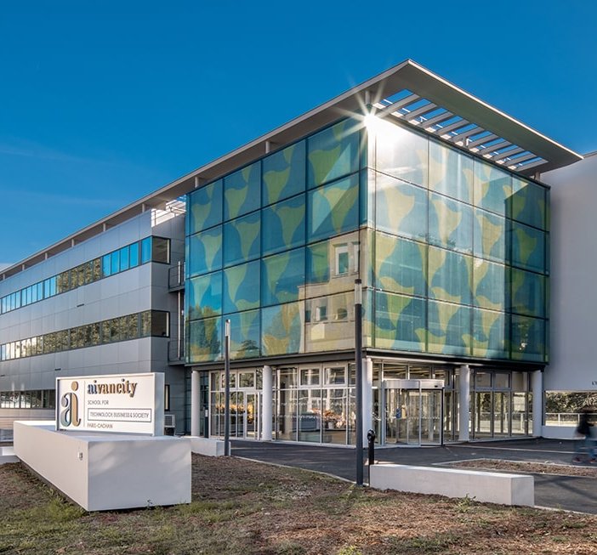
Why Aivancity?
Aivancity is a unique school in France due to its hybrid positioning: Technology / Business / Ethics.
Aivancity is a specialized French higher education Institution (“Grande Ecole”) whose mission is to prepare students and professionals to these new challenges.
The only AI school with all French State recognitions.
The recognition from the Ministry of Higher Education, Research and Innovation.
The visa for its 5-year Grande Ecole Program from the Ministry of Higher Education, Research and Innovation
2 RNCP recognitions by the Ministry of Labour (Bachelor - RNCP level 6 - Masters -> RNCP level 7).
The life-guarantee of updating the diploma®, guaranteeing all its graduates the possibility of updating their skills even years after graduating.

Slide 59
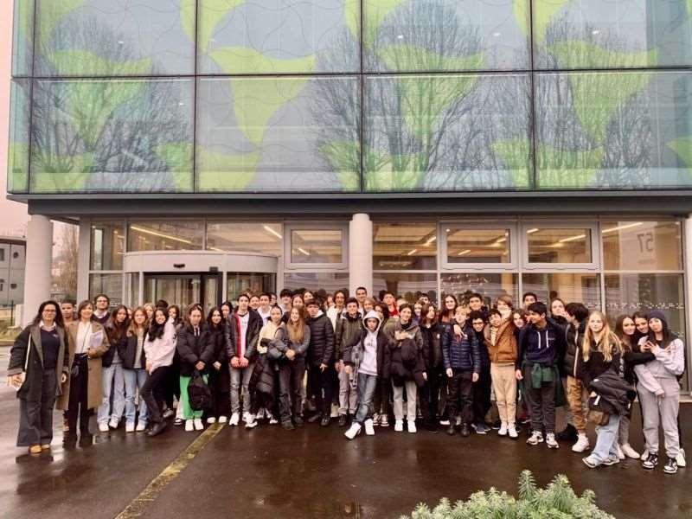
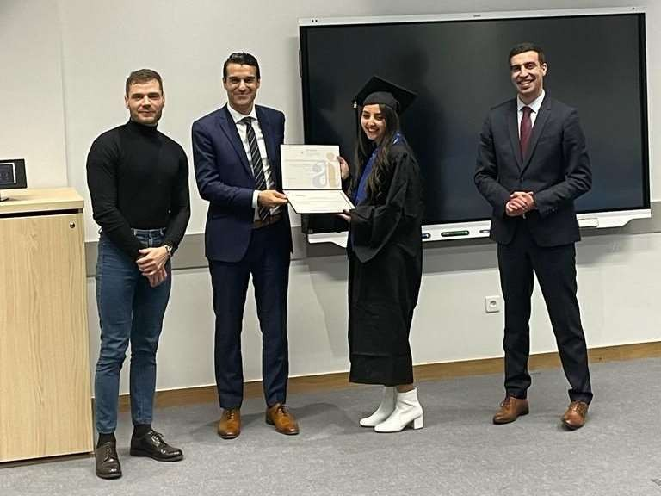
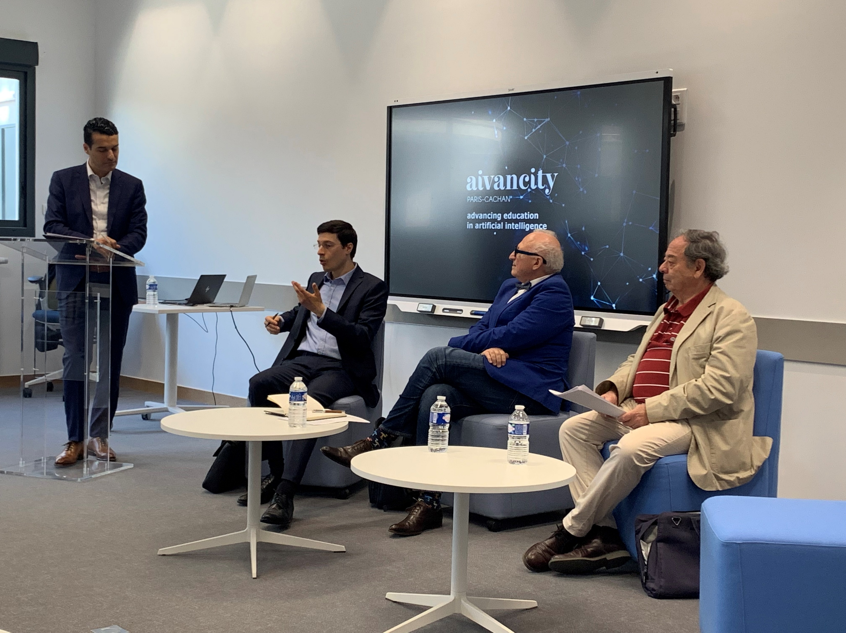
About Aivancity: Life on Campus

Slide 60
Course Snapshot
Course Title | Duration (years) | Yr1 fees | Yr2 fees | Yr3 fees | Yr4 fees | Yr5 fees | Total Credits(ECTS)
Masters in Data Engineering | 1 | €12,500 |  |  |  |  | 60
Masters in Data Management | 2 | €12,500 | €12,500 |  |  |  | 120
Masters in Machine Learning for Business Intelligence | 1 | €17,000 |  |  |  |  | 90
Masters in AI/ML & Smart Data( 2 years Grande Ecole | 2 | €12,500 | €12,500 |  |  |  | 120
Grande Ecole (Integrated Masters) | 5 | €9,500 | €10,900 | €12,900 | €14,900 | €14,900 | 300
Bachelor in AI/ML (First 3 years from Grande Ecole) | 3 | €9,500 | €10,900 | €12,900 |  |  | 180
BSc in IoT and Data Science | 3 | €7,500 | €7,500 | €7,500 |  |  | 180

Slide 62
Why ESC Clermont Business School?
The ESC Clermont Business School is a Leading French ‘Grande Ecole’ of Management committed to its surrounding region and connected to the international market. Together with its network of graduates and partners, the ESC Clermont Business School is devoted to accompanying change in an evolving world.
Mindfulness- We believe that to be mindful of the world, everyone must cultivate empathy, mutual aid and benevolence, towards themselves and others
The recognition from the Ministry of Higher Education, Research and Innovation
The visa for its 5-year Grande Ecole Program from the Ministry of Higher Education, Research and Innovation
Agility- We believe that to be mindful of the world, everyone must cultivate empathy, mutual aid and benevolence, towards themselves and others
Commitment-We act with conviction to serve learners and all stakeholders placing involvement, high standards and respect for our commitments at the heart of our priorities

Slide 63
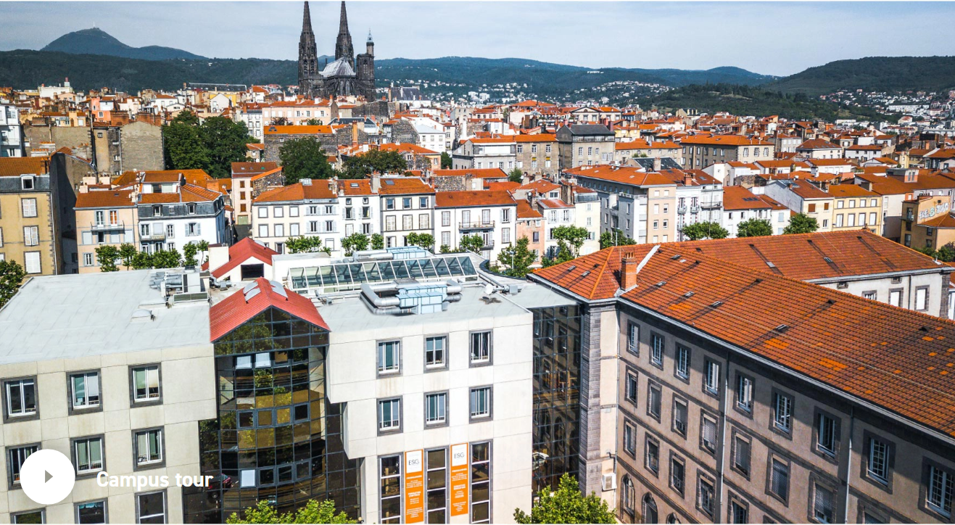
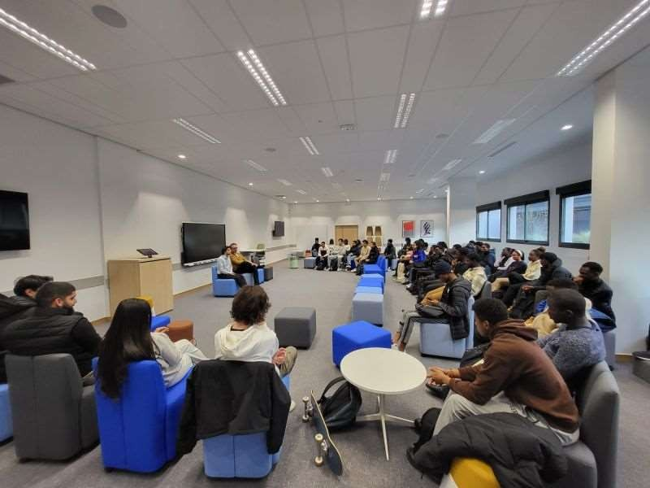
The Campus

Slide 65
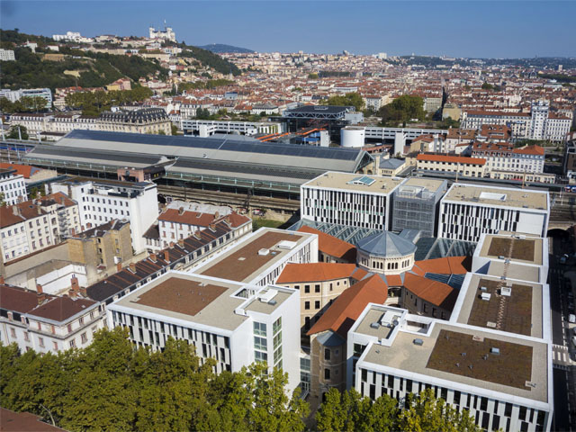
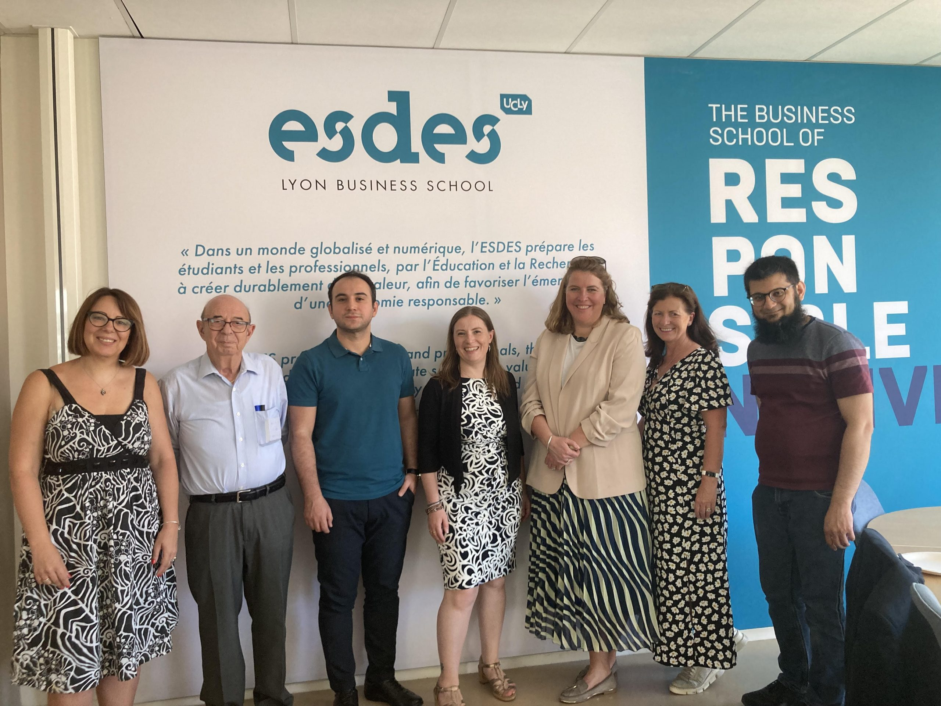
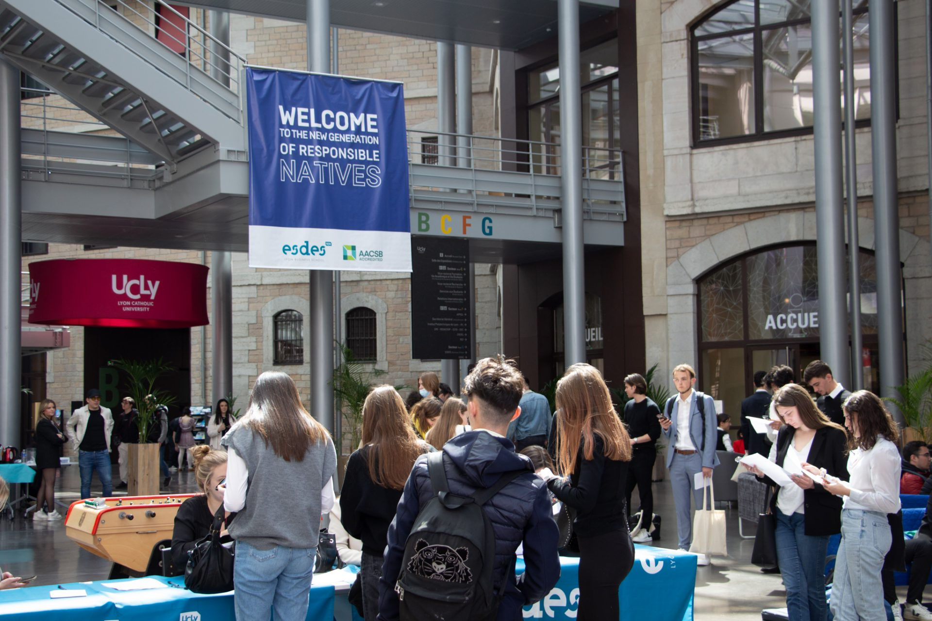
The Campus

Slide 66
Why ESDES Business School?
ESDES is a Business school in a multidisciplinary University
ESDES currently has around 100 partner universities across the globe.
35 different nationalities are represented on Campus.
ESDES has 1400 students, including 300 international students
About UcLy (Catholica University of Lyon)
The Catholic University of Lyon was founded in 1875 and has 147 years of academic history.
It combines academic knowledge, respect for human-centered values and openness to the rest of society.
Has 3 modern campuses 2 in the heart of Lyon and 1 in Annecy.
11,400 students and auditors, including 1,800 international students
200 permanent lecturers
750 administrative and technical staff

Slide 67
ESDES Programs
Masters Programs:
Master in Management
2 years program fully taught in English
It prepares students to become an international business leaders. 1 semester/1 year abroad.
8-12-months of internship. (Paid Internship)
It also has a double degree program from a partner University.
Duration - 2 years
Intakes: September - December
Specialization (in Year 2)
Business Administration
Marketing and Digital Business
Supply Chain Management
Language proficiency Test Required
MOI Accepted
IELTS- 6.0+
Tuition Fee: 12,750€ /year

Slide 68
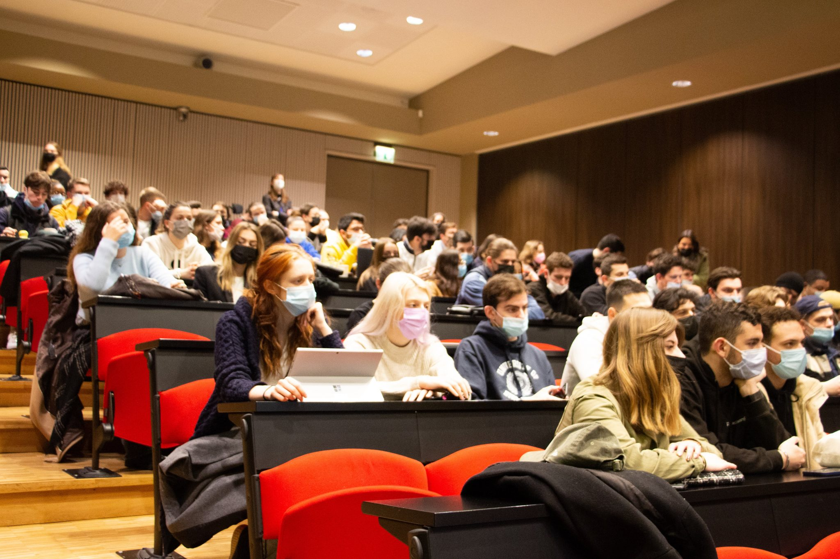
ESDES Programs
Other Masters Programs:
MSC CIRCULAR ECONOMY & SUSTAINABLE INNOVATION
MSC IMPACT FINANCE & FINTECH MANAGEMENT
MSC SUSTAINABLE TOURISM & EVENT MANAGEMENT
Duration: 13 months
Tuition Fee: 13 900 € (CESI & IFFM)
Tuition Fee: 15400€ (STEM)
Internship Duration: 4 months
Credit Points: 90 ECTS

Slide 69

About Hungary
Land Size- 93,000 Sq Km.
Human Density- 107 people per Sq Km. (278 people per sq mi)
Economy- $170-180 billion USD
Per Capita- USD 18,000
Language- Hungarian and English
Student Safety Index 2023- #18
Living Expenses- 7,000 Euros/Year
PSW- 9 months
Part time- 30hr/Week
Job Opportunities- IT Sector, Engineering and Manufacturing, Finance and Business Services, Tourism and Hospitality, Language Teaching and Translation

Slide 70



University Partners Hungary and Austria
IBS Hungary and Austria
University of Debrecen
Avicenna International College

Slide 72
Why Choose IBS?
British universities are widely recognized for their research and teaching excellence.
An independent body, the Quality Assurance Agency is responsible for maintaining the high standards of British university education. A British degree guarantees you a good quality education.
1,000 years of extraordinary academic innovation - currently the UK ranks third in the world for innovation.
Three of the ten top universities in the world are in the UK, including the university ranked first in the world.
British degrees are important to employers because they have a strong emphasis on gaining practical experience in the relevant field and they equip you with all the skills and knowledge necessary for a successful international business career.
The student-centered approach to learning in British education means that you will develop the independence, self-discipline and analytical skills sought after by employers.
English is the language of global business so studying a British degree enables you to improve your English language skills.
Class sizes are generally small enough to ensure that students have access to equipment and enough time to talk to their lecturers.
+91-9999388615

Slide 73
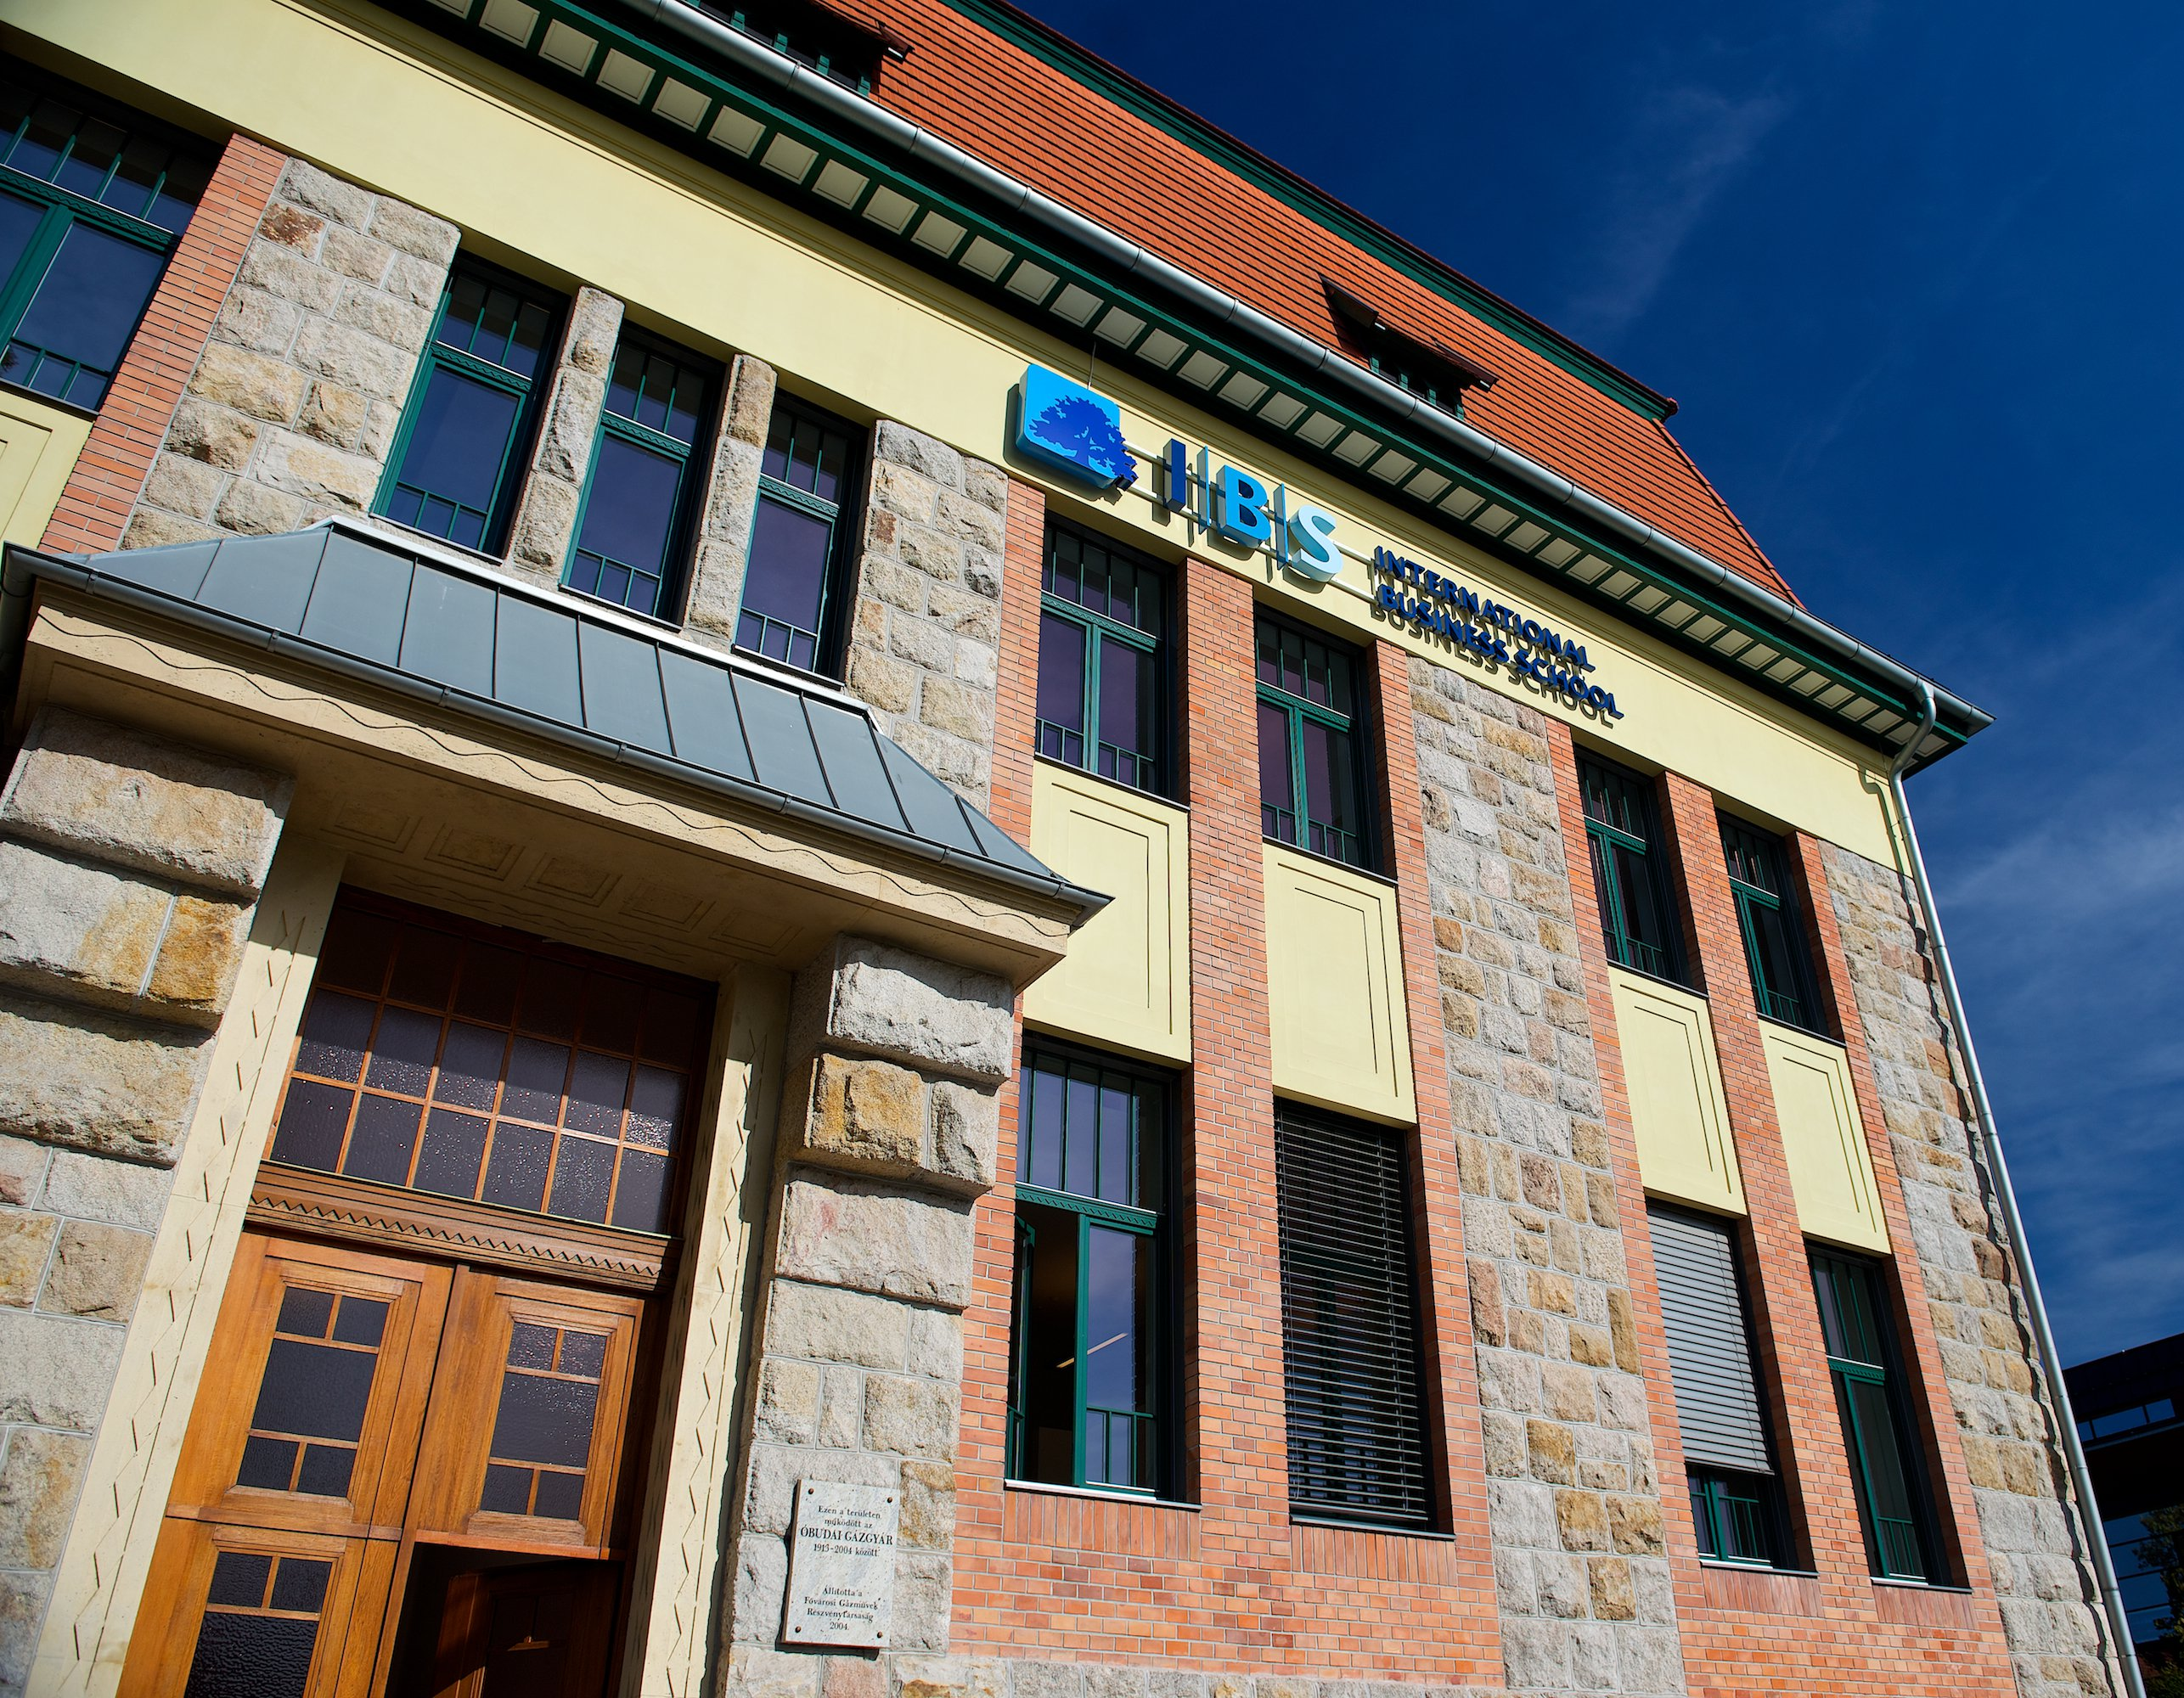
Why Choose IBS?
We give considerable importance to increasing students' employability skills. IBS has set up its Up Skill programme, which enhances and develops the skills which are most demandable in the job arena and lets our graduates have an advantage over others in job applications.
British programmes are shorter, saving you time and money. Our Bachelor’s programs are 3-year full-time courses and our Master's programs take 1 year.
38 per cent of Nobel prize winners who studied abroad did so for a British degree.

Slide 74
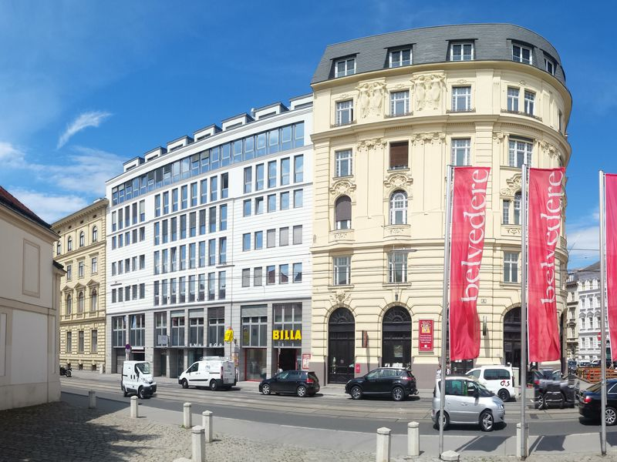
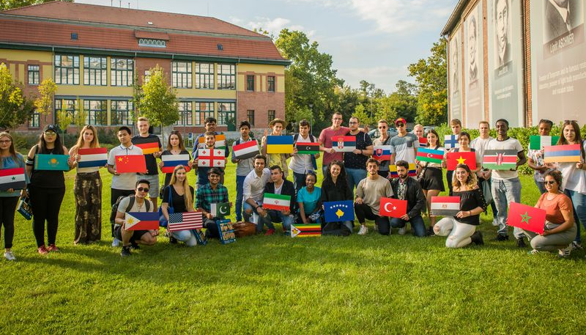
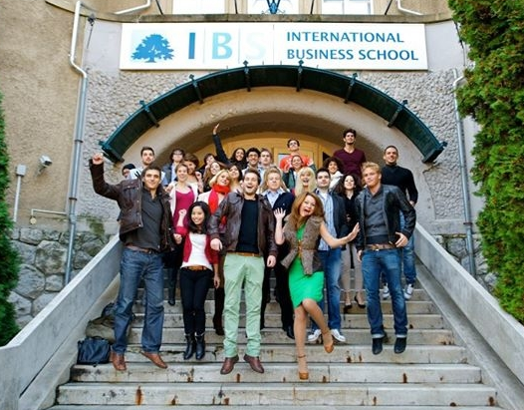
The Campus
+91-9999388615

Slide 75
Courses Offered
Programs | Duration | Campus | Tuition fee | Scholarship | Intake | Stay Back
BSc in Corporate Finance | 3 years | Budapest, Hungary | 22200EUR 3 Years | Merit Based up to 50% | February and September | 9 Months
BSc in Business and Diplomatic Studies | 3 years | Budapest, Hungary | 22200EUR 3 Years | Merit Based upto 50% | February and September | 9 Months
BSc in Business Management | 3 years | Budapest, Hungary | 22200EUR 3 Years | Merit Based up to 50% | February and September | 9 Months
BSc in Business Management with Arts | 3 Years | Budapest, Hungary | 22200EUR 3 Years | Merit Based upto 50% | February and September | 9 Months
BSc in Business Management with Tourism | 3 years | Budapest, Hungary | 22200EUR 3 Years | Merit Based up to 50% | February and September | 9 Months
MSc in Strategic Human Resource Management | 1.5 Years | Budapest, Hungary | € 11,800 | Merit based 10-35% off | February and September | 9 Months
MSc in Strategic International Management | 1.5 Years | Budapest, Hungary | € 11,800 | Merit based 10-35% off | February and September | 9 Months
MSc in Strategic Marketing | 1.5 Years | Budapest, Hungary | € 11,800 | Merit based 10-35% off | February and September | 9 Months
MSc in IT for Business Data Analytics | 1.5 Years | Budapest, Hungary | € 11,800 | Merit based 10-35% off | February and September | 09 Months
MSc in International Management (Vienna Campus) | 1.5 Years | Vienna, Austria | € 11,800 | Merit based 10-35% off | February and September | 12 Months
MBA in Strategic Data-Driven Management | 1.5 Years | Budapest, Hungary | € 12,400 | Merit based 10-35% off | February and September | 9 Months
+91-9999388615

Slide 76
+91-9999388615

Slide 77
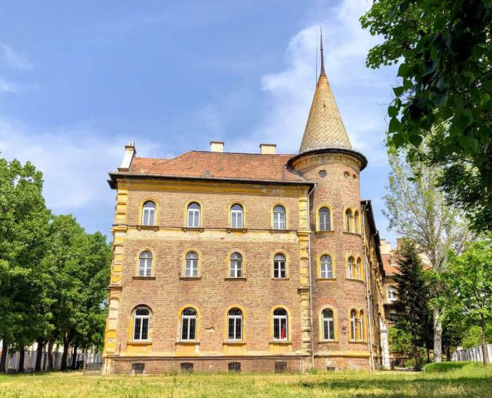
Why Avicenna International College?
The passion for knowledge and lifelong learning is an integral part of our education.
Avicenna is a caring, safe and highly academic community with a focus on “holistic approach”, “problem-solving” and “interactive learning”.
Many of our past students are now among successful medical doctors, engineers or businessmen in Europe, United States or other countries.
AIC has proven to be the leading institution in Europe to prepare non-European students for medical schools.
At AIC, we target a 100% success rate, no student is neglected or left behind.
+91-9999388615

Slide 78
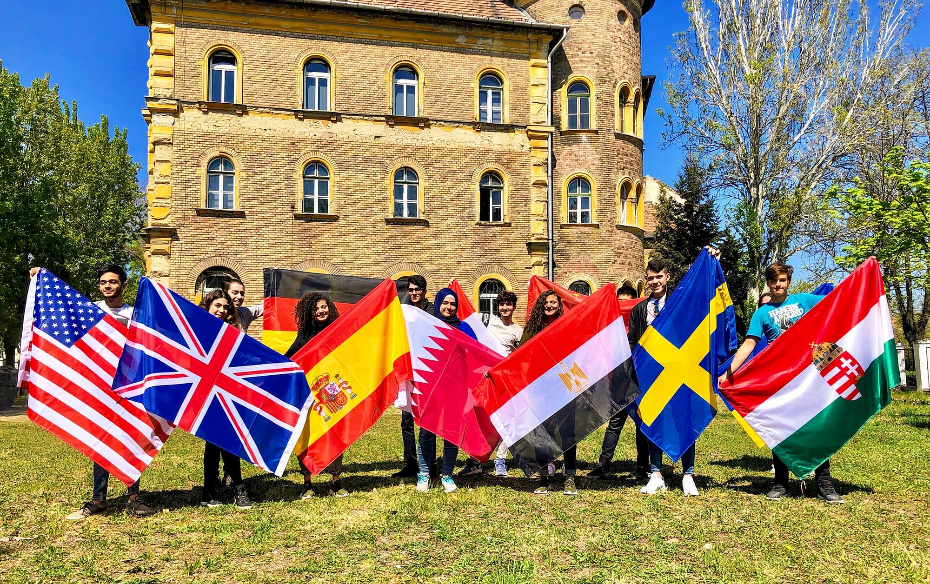
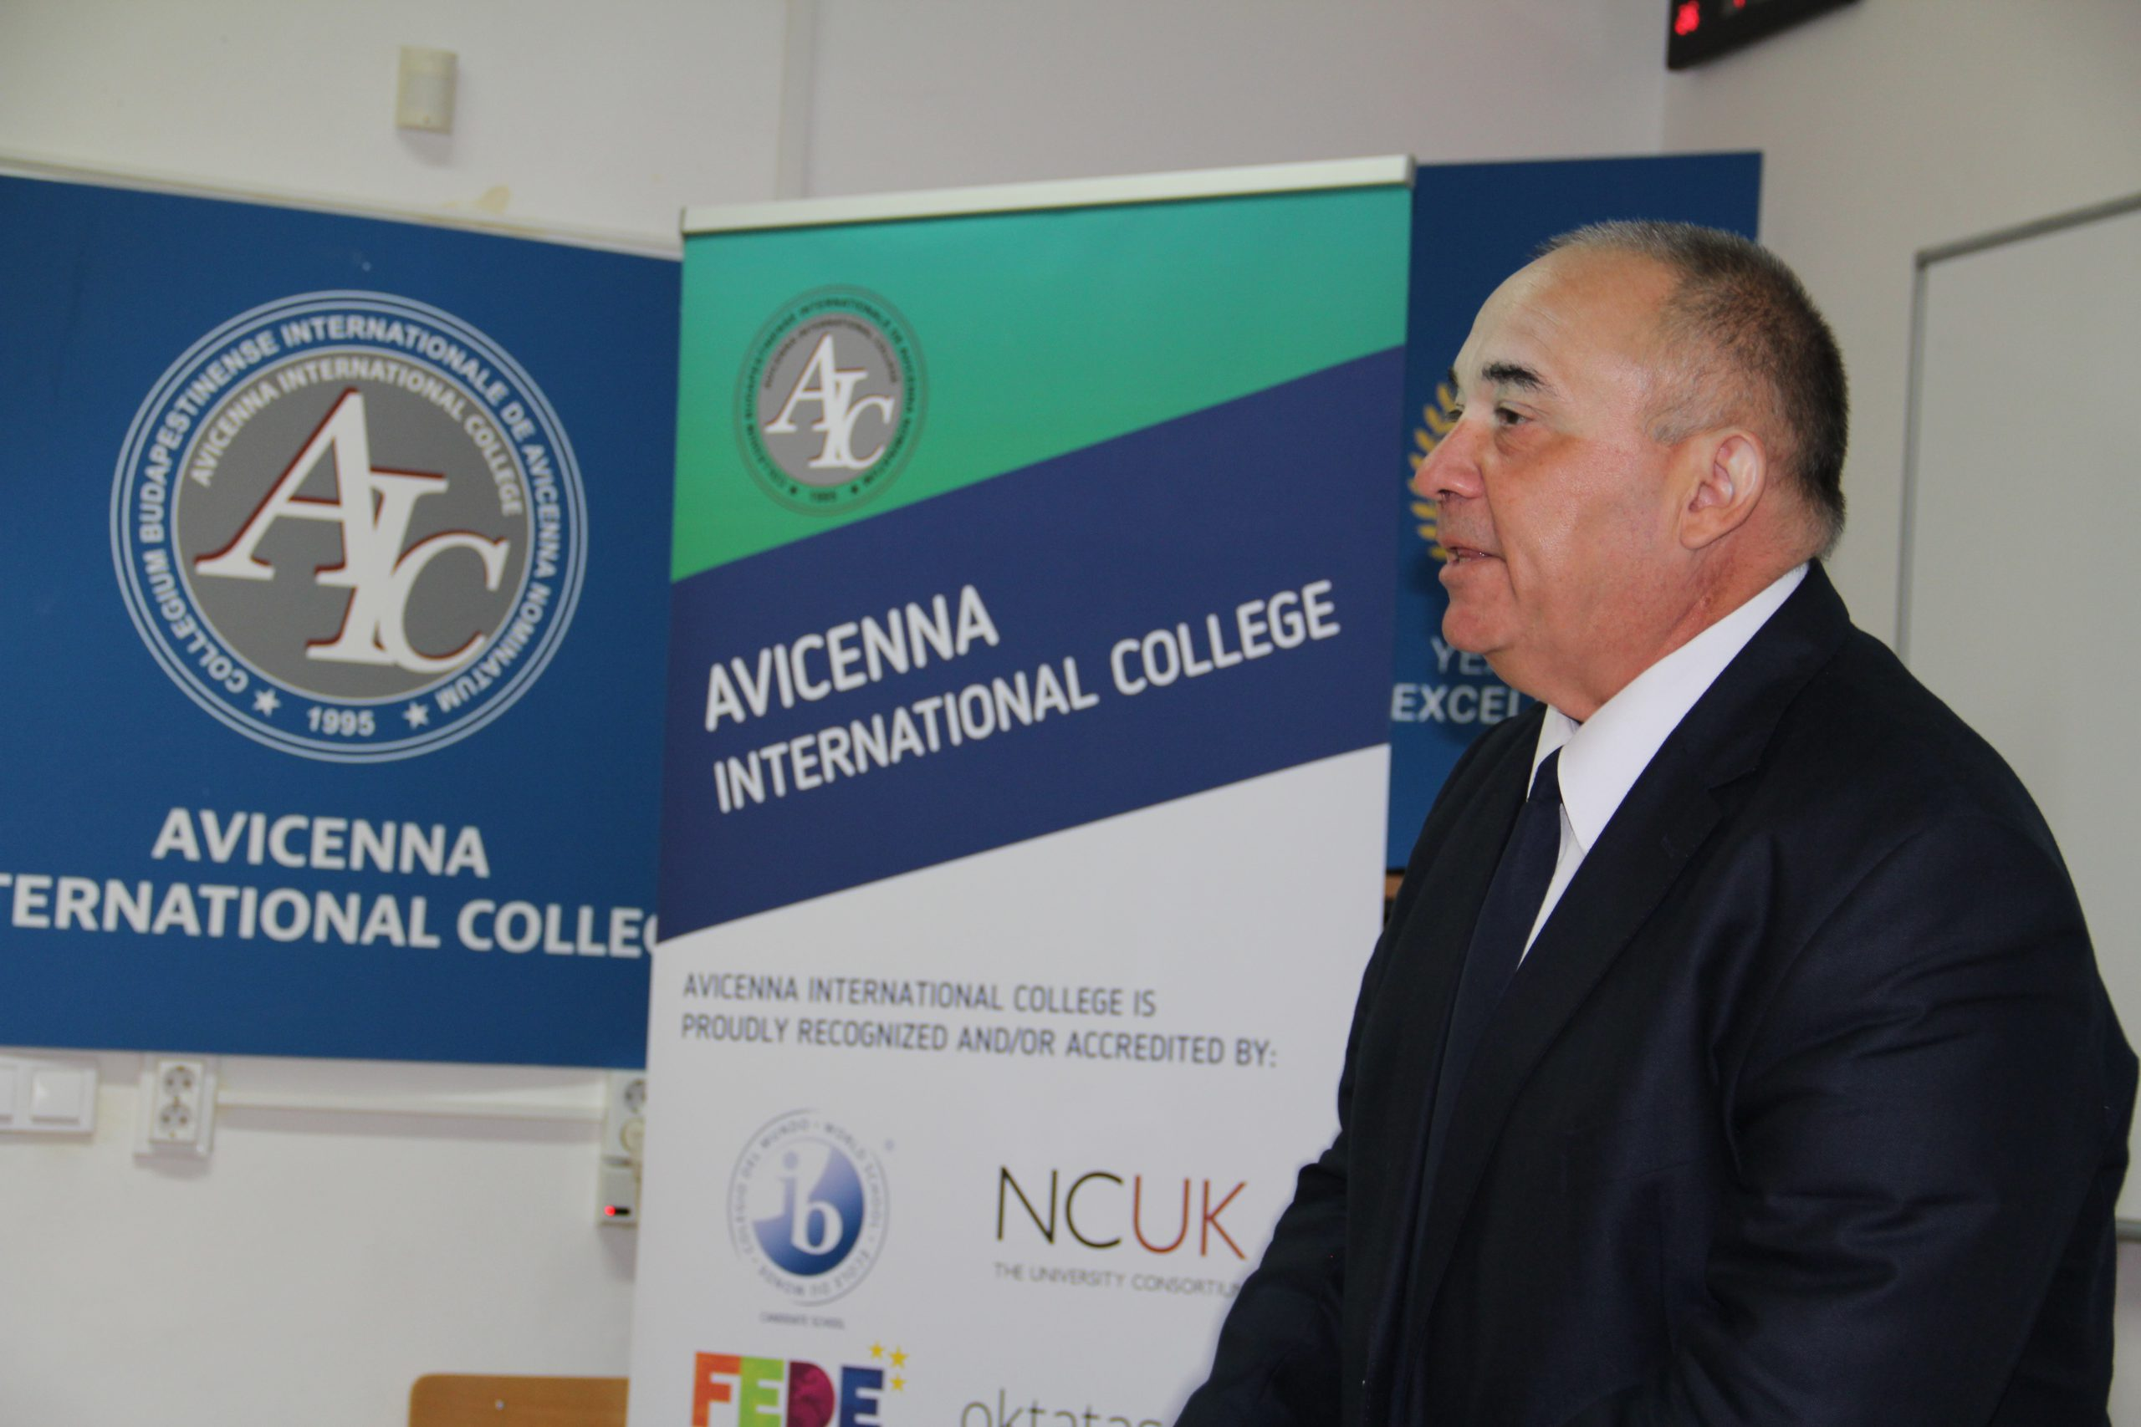
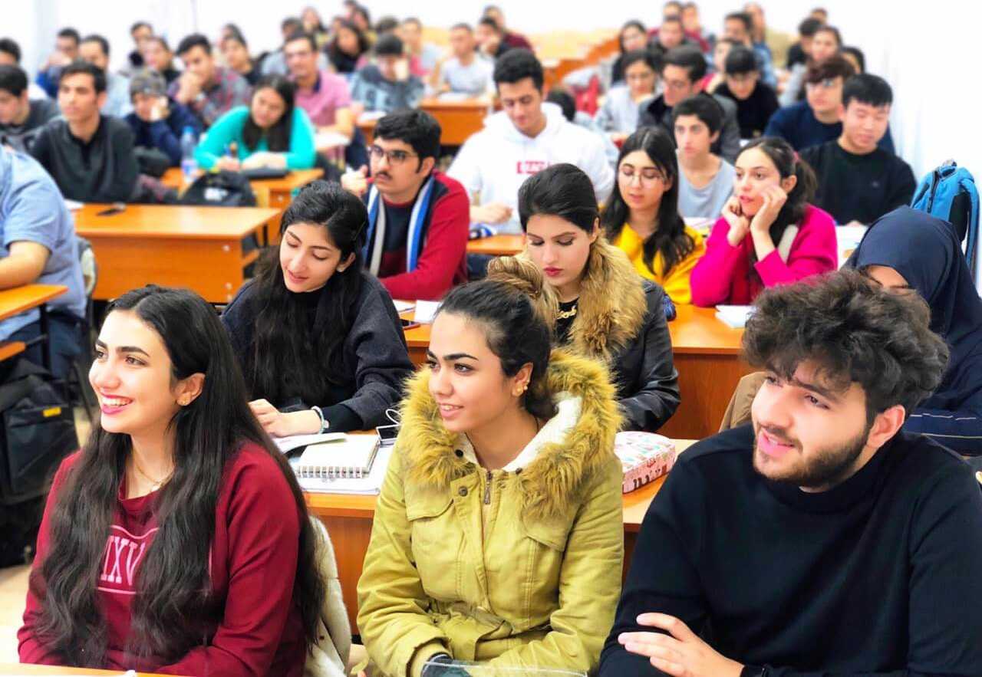
The Campus
+91-9999388615

Slide 79
Courses Offered
Programs | Duration | Tuition fee | Campus | Intake | Scholarship | Stay Back
Bachelor's Degree- IT, Networks & Security | 3 Years | 4900 Euro | Hungary | Sep-24 | N.A | 9 Months
Bachelor's Degree- Web Developer | 3 Years | 4900 Euro | Hungary | Sep-24 | N.A | 9 Months
Bachelor's Degree- Digital Marketing | 3 Years | 4900 Euro | Hungary | Sep-24 | N.A | 9 Months
Bachelor's in Tourism & Hotel Management | 3 Years | 4900 Euro | Hungary | Sep-24 | N.A | 9 Months
Master's Degree- Intelligent Applications & Big Data | 2 Years | 5900 Euro | Hungary | Jan/Sep-24 | N.A | 9 Months
Master's Degree- IT Experts(Cyber Security & High Availability | 2 Years | 5900 Euro | Hungary | Jan/Sep-24 | N.A | 9 Months
Master's in Tourism & Hotel Management | 2 Years | 5900 Euro | Hungary | Jan/Sep-24 | N.A | 9 Months
+91-9999388615

Slide 80
+91-9999388615

Slide 81
Why University of Debrecen?
With a student body of about 28,000 the University of Debrecen is one of the largest institutions of higher education in Hungary today.
Debrecen is the largest city outside Budapest and has over 200,000 inhabitants. At a convenient distance of 250 km to the East from the capital, Debrecen is a cultural, economic and scientific center of the region and a renowned university town.
The cooperation of fourteen faculties ensures the multidisciplinary background guaranteeing the University a leading role as a research and education institution, and the intellectual center of Eastern Hungary.
In 2007 our institution was the first to receive the highest degree of the Higher Education Qualification Prize awarded to the most reputable Hungarian higher education institutions.
The University conducts its programs according to the European Qualifications Framework of the Bologna Process.
Thus diplomas attained at the University of Debrecen are generally accepted in the countries of the European Union. Moreover, all our programs are accredited by the Hungarian Accreditation Board which is part of the European Accreditation Board.
Medical programs are accredited by the World Health Organization (WHO), the State Education Department (NY, USA), Medical Board of California, Medical Councils of India (a qualifying exam is compulsory), Israel, Ireland, Iran, Norway and the United Arab Emirates.
+91-9999388615

Slide 82
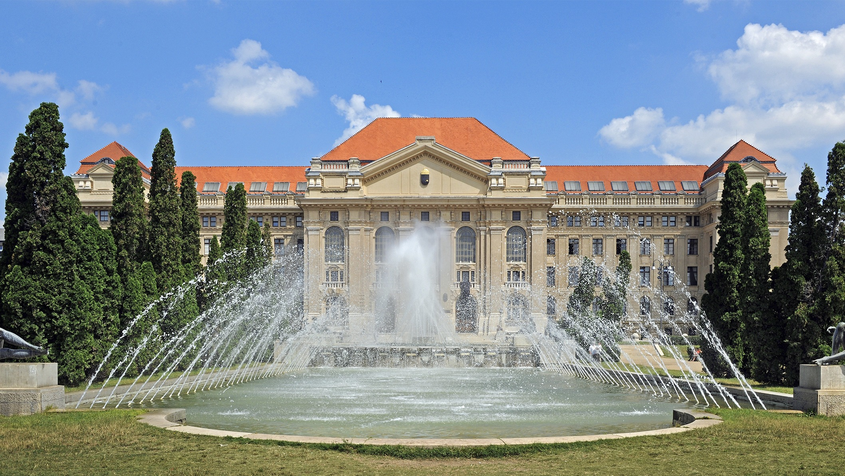


The Campus
+91-9999388615

Slide 83
Courses Offered
Programs | Duration | Tuition fee | Campus | Intake | Scholarship | Stay Back
BSC - Agricultural Engineering | 3.5 Years | 6,500 USD/year | Debrecen, Hungary | Sep-24 | Merit Basis 30% up to 90% | 9 Months
BSC - Biochemical Engineering | 3.5 Years | 7,000 USD/year | Debrecen, Hungary | Sep-24 | Merit Basis 30% up to 90% | 9 Months
BSC - Business Administration and Management | 3.5 Years | 7,000 USD/year | Debrecen, Hungary | Sep-24 | Merit Basis 30% up to 90% | 9 Months
BSC - Business Informatics | 3.5 Years | 7,000 USD/year | Debrecen, Hungary | Sep-24 | Merit Basis 30% up to 90% | 9 Months
BSC- Chemical Engineering | 3.5 Years | 7,000 USD/year | Debrecen, Hungary | Sep-24 | Merit Basis 30% up to 90% | 9 Months
BSC - Chemistry | 3.5 Years | 6,500 USD/year | Debrecen, Hungary | Sep-24 | Merit Basis 30% up to 90% | 9 Months
BSC - Civil Engineering | 3.5 Years | 7,500 USD/year | Debrecen, Hungary | Sep-24 | Merit Basis 30% up to 90% | 9 Months
BA - Classical Performing Arts (Music) | 3 Years | 10,000 USD/year | Debrecen, Hungary | Sep-24 | Merit Basis 30% up to 90% | 9 Months

Slide 84
Courses Offered
BSC- Commerce and Marketing | 3.5 Years | 7,000 USD/year | Debrecen, Hungary | Sep-24 | Merit Basis 30% up to 90% | 9 Months
BSC - Computer Science | 3 Years | 7,000 USD/year | Debrecen, Hungary | Sep-24 | Merit Basis 30% up to 90% | 9 Months
BSC - Computer Science Engineering | 3.5 Years | 7,000 USD/year | Debrecen, Hungary | Sep-24 | Merit Basis 30% up to 90% | 9 Months
BA- Contemporary Music | 3 Years | 10,000 USD/year | Debrecen, Hungary | Sep-24 | Merit Basis 30% up to 90% | 9 Months
BSC - Nursing and Patient Care (Dietetics) | 4 Years | 6,000 USD/year | Debrecen, Hungary | Sep-24 | Merit Basis 30% up to 90% | 9 Months
BSC - Earth Sciences | 3 Years | 6,500 USD/year | Debrecen, Hungary | Sep-24 | Merit Basis 30% up to 90% | 9 Months
BSC - Electrical Engineering | 3.5 Years | 7,000 USD/year | Debrecen, Hungary | Sep-24 | Merit Basis 30% up to 90% | 9 Months
+91-9999388615

Slide 85
Courses Offered
Programs | Duration | Tuition fee | Campus | Intake | Scholarship | Stay Back
BA - English and American Studies | 3 Years | 6,000 USD/year | Debrecen, Hungary | Sep-24 | Merit Basis 30% up to 90% | 9 Months
BSC- Food Engineering | 3.5 Years | 6,500 USD/year | Debrecen, Hungary | Sep-24 | Merit Basis 30% up to 90% | 9 Months
BSC - Geography | 3 Years | 6,500 USD/year | Debrecen, Hungary | Sep-24 | Merit Basis 30% up to 90% | 9 Months
BSC - Kindergarten Education | 3 Years | 6,000 USD/year | Debrecen, Hungary | Sep-24 | Merit Basis 30% up to 90% | 9 Months
BSC - Mathematics | 3 Years | 6,500 USD/year | Debrecen, Hungary | Sep-24 | Merit Basis 30% up to 90% | 9 Months
BSC- Mechanical Engineering | 3.5 Years | 7,500 USD/year | Debrecen, Hungary | Sep-24 | Merit Basis 30% upto 90% | 9 Months
BSC- Mechatronics Engineering | 3.5 Years | 7,500 USD/year | Debrecen, Hungary | Sep-24 | Merit Basis 30% up to 90% | 9 Months
BA - Musical Creative Art and Musicology | 3 Years | 10,000 USD/year | Debrecen, Hungary | Sep-24 | Merit Basis 30% up to 90% | 9 Months
BSC - Nursing and Patient Care (Physiotherapy) | 4 Years | 6,000 USD/year | Debrecen, Hungary | Sep-24 | Merit Basis 30% up to 90% | 9 Months
BSC - Nursing and Patient Care (Nurse) | 4 Years | 6,500 USD/year | Debrecen, Hungary | Sep-24 | Merit Basis 30% up to 90% | 9 Months
+91-9999388615

Slide 86
Courses Offered
BSC - Physics | 3 Years | 6,500 USD/year | Debrecen, Hungary | Sep-24 | Merit Basis 30% up to 90% | 9 Months
BSC - Precision Agricultural Engineering | 3 Years | 6,500 USD/year | Debrecen, Hungary | Sep-24 | Merit Basis 30% up to 90% | 9 Months
BSC - Professional Pilot | 3.5 Years | 35,000 USD/year | Debrecen, Hungary | Sep-24 | Merit Basis 30% up to 90% | 9 Months
BA - Psychology | 3 Years | 6,000 USD/year | Debrecen, Hungary | Sep-24 | Merit Basis 30% up to 90% | 9 Months
BSC - Health Care and Disease Prevention (Public Health) | 4 Years | 6,000 USD/year | Debrecen, Hungary | Sep-24 | Merit Basis 30% up to 90% | 9 Months
BSC - Rural Development Engineering | 3.5 Years | 7,000 USD/year | Debrecen, Hungary | Sep-24 | Merit Basis 30% up to 90% | 9 Months
BSC - Vehicle Engineering | 3.5 Years | 7,000 USD/year | Debrecen, Hungary | Sep-24 | Merit Basis 30% up to 90% | 9 Months
+91-9999388615

Slide 87

About Spain
Land Size- 505,990 sq km (195,360 sq mi)
Human Density- 92-94 people per sq km (239-244 people per sq mi)
Economy- €1.24 trillion to €1.26 trillion
Per Capita- USD 28,276
Language- Espanol Catalan, Galician, Basque and Valencian Student Safety Index 2023- #22
Living Expenses- 11, 208 Euro one year
PSW- 12 months
Part time- 40hr/Week
Job Opportunities- Health Care, engineering, technology, Human resources, and renewable energy, Automobile

Slide 88


University Partners - Spain
Catholic University of Murcia UCAM
University of West London, Marbella
Schiller International University, Madrid Campus
+94717882255

Slide 90

Why UCAM Catholic University of Murcia
The university follows an internal process of continuous renovation and accreditation to preserve the highest quality standards in our educative system.
In this new ranking, UCAM is positioned among the best European universities. It was ranked in the 122 position in the European University Ranking - Southern Europe 2024.
UCAM is expanding worldwide to promote a high-quality university education.
UCAM has around 200 renowned international strategic partners, including leading colleges and universities in the world, such as UC Berkeley, Stanford, NTU, NUS or Università degli Studi di Bologna. With these partners, UCAM develops student, staff and professor exchange programs, dual degrees and other collaborations.

Slide 91



The Campus
+91-9999388615

Slide 92
Courses Offered
Courses Offered
Programs | Duration | Campus | Tuition fee | Scholarship | Intake | Stay Back
Business Administration and Management | 4 Years | Murcia, Spain | 7100EUR/Year | Case Based | September | 12 Months
Bachelors in Fundamental of Architecture | 3 years | Murcia, Spain |  | Case Based | September | 12 Months
Bachelors of Business Administration | 4 Years | Murcia, Spain | 7100EUR/Year | Case Based | September | 12 Months
Bachelors in Dentistry | 5 Years | Murcia, Spain | 14650 EUR/Year | Case Based | September | 12 Months
Bachelor's in Psychology | 4 Years | Murcia, Spain | 7500EUR/Year | Case Based | September | 12 Months
Bachelor's in Physical Activity and Sports Science | 5 Years | Murcia, Spain | 7450EUR/Year | Case Based | September | 12 Months
MBA | 2 Years | Murcia, Spain |  | Case Based | November | 12 Months
Master in Management of Sports Entities + MBA | 1 Year | Murcia, Spain | 11400EUR/Year | Case Based | November | 12 Months
Master's in Innovation an Tourism Marketing | 1 Year | Murcia, Spain | 6500EUR/Year | Case Based | November | 12 Months
Master's in Hospitality Management | 1 Year | Murcia, Spain | 7290EUR/Year | Case Based | November | 12 Months
Master's in High Performance Sports: Strength and Conditioning | 1 Year | Murcia, Spain | 8750EUR/Year | Case Based | January and November | 12 Months
Master's in Bilingual Education | 1 Year | Murcia, Spain | 5150EUR/Year | Case Based | October | 12 Months
Master's in European Union Studies and Human Rights | 1 year | Murcia, Spain | 6300EUR/Year | Case Based | October | 12 Months
Master's in Sports Management | 1 Year | Murcia, Spain | 11,400EUR/Year | Case Based | November | 12 Months

Slide 93
+91-9999388615

Slide 94

Why Schiller International University?
Schiller is the new education concept aimed at people who understand that running in a global world needs smart global performance.
Through our four international campuses, we provide students with a global transformative education.
No matter what country you study in, courses are delivered in English and focused on learning from an international context.
Our faculty members are international and bring their expertise and professional experience to our classrooms.
We emphasize competencies such as teamwork to analyze case studies and prepare presentations with expert visiting lecturers from the field. Reality matters.
We are very focused on preparing students for professional life. To accomplish this, programs are designed to combine theory with practice.
+91-9999388615

Slide 95


The Campus
+91-9999388615

Slide 96
Courses Offered
Courses Offered
Programs | Duration | Tuition fee | Campus | Intake | Scholarship
BSC in International Business | 4 Years | 15400 Eur/year | Madrid, Paris, Heidelberg | Sep/Jan -24 | Merit Basis 30%- 50%
BSC -International Marketing | 4 Years | 15400 Eur/year | Madrid, Paris | Sep-24 | Merit Basis 30%- 50%
BA - International Relations & Diplomacy | 4 Years | 15400 Eur/year | Madrid, Paris | Sep/Jan -24 | Merit Basis 30%- 50%
BS- Computer Science | 4 Years | 15400 Eur/year | Madrid | Sep-24 | Merit Basis 30%- 50%
BS- International Business | 4 Years | 15400 Eur/year | Madrid | Jun-24 | Merit Basis 30%- 50%
BS- International Hospitality and Tourism Management | 4 Years | 15400 Eur/year | Madrid | Sep-24 | Merit Basis 30%- 50%
BS- International Marketing | 4 Years | 15400 Eur/year | Madrid | Sep-24 | Merit Basis 30%- 50%
BA- International Relations and Diplomacy | 3 Years | 15400 Eur/year | Madrid | Sep-24 | Merit Basis 30%- 50%
BS-Applied Mathematics and AI | 4 Years | 15400 Eur/year | Madrid | Sep-24 | Merit Basis 30%- 50%
BS- Business Analytics | 4 Years | 15400 Eur/year | Madrid | Sep-24 | Merit Basis 30%- 50%
MA - International Relations and Diplomacy | 2 Years | 19,560 | Madrid | Sep-24 | Merit Basis 30%- 50%
MBA-Business Administration | 2 Years | 19,560 | Madrid | June-24/Sep-24 | Merit Basis 30%- 50%
MBA-Business Administration Spanish | 2 Years | 19,560 | Madrid | June-24/Sep-24 | Merit Basis 30%- 50%
MBA-International Business | 2 Years | 24,450 | Madrid | June-24/Sep-24 | Merit Basis 30%- 50%
MA - Sustainability | 2 Years | 19,560 | Madrid | Sep-24 | Merit Basis 30%- 50%
MS- Data Science | 2 Years | 19,560 | Madrid | Sep-24 | Merit Basis 30%- 50%
MS- Digital Marketing and E-commerce | 2 Years | 19,560 | Madrid | Sep-24 | Merit Basis 30%- 50%
MS - Global Finance | 2 Years | 19,560 | Madrid | Sep-24 | Merit Basis 30%- 50%

Slide 97

About Netherlands
Land Size – 4,154,000 square kilometres
Population – 17,821,419 (240-250 people per square kilometre)
Economy -USD 1.1 trillion
Per Capita - USD 66,450
Language – Dutch, English and German
Global Peace Index 2023 - #16
PSW - 12 months
Part time - 16hr/Week
Job Opportunities - Health Care, engineering, technology, Human resources, and renewable energy, Automobile

Slide 98
Why Choose Netherlands for Higher Studies?
Higher education in the Netherlands is known for its high quality.
Dutch people are innovators, entrepreneurs and discoverers.
Dutch society is multicultural, religiously very diverse and is focused on international relations.
Life is not expensive when compared to English-speaking countries.
Students come from over 190 different countries to study in the Netherlands and you’ll be meeting all types of people. You’ll make international connections that will benefit you for years to come
Wide range of English-taught programmes.
The majority of Dutch people are open-minded, liberal, and accepting of other people and cultures. This makes the Netherlands attractive to people from all walks of life. You’ll hear many languages being spoken (especially in tourist-popular Amsterdam), but Dutch is the official language.
While you may have to find housing independently, it will most likely be affordable. You may also be living with other international students, which can be very exciting and rewarding. You could potentially get a housing subsidy which will go a long way. Maybe add those savings to your weekend travel budget?

Slide 99


Slide 100

Why Choose Wittenberg?
Wittenberg University of Applied Sciences is a dynamic, double accredited business school, with its headquarters in Apeldoorn. Wittenberg was established in 1987.
The school also has a vibrant study location in Amsterdam, with a focus on Entrepreneurship.
Wittenberg University of Applied Sciences is staffed by international team of academics, professional people dedicated to excellence in higher education focused on management, business and entrepreneurship.
Accreditation - Our MBA and BBA Programs are Double Accredited by NVAO and FIBAA

Slide 101



About Wittenberg – Life in campus

Slide 102
Wittenberg – Overview (Course, Fee and Intake)
Program Name | Tuition fee | Campus | Intake
BBA Entrepreneurial Business Administration | € 9800/Year | Apeldoorn/Amsterdam | Aug-24
BBA Pathway IBA- International Business Administration | € 9800/Year | Apeldoorn | Aug-24
BBA Pathway MCI- Marketing, Communication & Information | € 9800/Year | Apeldoorn | Aug-24
BBA Pathway HBA- Hospitality Business Administration | € 9800/Year | Apeldoorn | Aug-24
BBA Pathway EBA- Entrepreneurial Business Administration | € 9800/Year | Wittenberg | Aug-24
Master of Business Administration (MBA) | € 18,300 | Wittenberg | Aug-24
Master of Business Management (MBM) | € 18,300 | Wittenberg | Aug-24
Pre-Master + Master of Business Management (MBM) | € 22,300 | Wittenberg | Aug-24
MBA in Digital Transformation | € 18,300 | Wittenberg | Aug-24

Slide 103

About Switzerland
Land Size- 41,290 KM Sq
Population- 8,796,669
Economy- USD 815 billion
Per Capita- USD 98,800
Language- German, French, Italian and Romansh
Global Peace Index 2023- #10
Cost of Living- 19,000 Euros
PSW- NIL
Part time- 20hr/Week (120 full days or 240 half days)
Job Opportunities- Health Care, Finance, pharmaceuticals, manufacturing, and tourism
+91-9999388615

Slide 104



University Partners Switzerland
Business & Hotel Management School
Hotel Tourism & Management Institute
American University of Applied Science
+91-9999388615

Slide 105
+91-9999388615

Slide 106
Why Choose B.H.M.S?
B.H.M.S. is located in the heart of Luzern, one of the most beautiful and business-oriented City in Switzerland.
It is a member of the Bénédict Switzerland group of schools, founded in 1928.
Bénédict School is one of Switzerland's largest private educational organizations and is educating each year more than 15,000 full- and part time students.
At Bénédict Zürich campus, we have about 8'000 students per year
At B.H.M.S. Luzern campus we have about 900 students per year.
These students have the opportunity to prepare for their future management roles in the hotel and hospitality industry.
B.H.M.S. in collaboration with Robert Gordon University of Aberdeen, UK offers a Bachelor of Arts degree, an MBA/PG Diploma degree.
B.H.M.S. is partnered with York St. John University in granting the Master of Business Administration (MBA Dual) Degree.
+91-9999388615

Slide 107



The Campus
+91-9999388615

Slide 108
Courses Offered
Programs | Duration | Campus | Tuition fee | Scholarship | Intake | Stay Back
Bachelor Degree | 2 years | Luzern, Switzerland | 38,500 CHF | Up to 20% | Feb,Aug,Nov
MSC Degree | 1 year | Luzern, Switzerland | 38,500 CHF | Up to 20% | Feb,Aug,Nov
MBA Degree | 1 year | Luzern, Switzerland | 41,500 CHF | Up to 20% | Apr, Oct
PG Diploma Hospitality | 1 year | Luzern, Switzerland | 37,500 CHF | Up to 20% | Feb,May,Aug, Nov
+91-9999388615

Slide 109

Hotel Tourism & Management Institute

Slide 110

Why Choose HTMi?
In the field of student research, HTMi is a world leader. To promote student research at all levels, the institute has its own International Hospitality Research Centre. Two student online journals are linked to promote our students' research, and students can speak twice a year at HTMI's conferences.
HTMI consistently achieves very high student results with the current BSc results level at its highest ever.
HTMI Switzerland campus location is in the most beautiful UNESCO biosphere in Switzerland, which is a skiing destination in winter and a beautiful relaxation destination throughout the year.
+91-9999388615

Slide 111
The Campus
+91-9999388615

Slide 112
Courses Offered
Programs | Duration | Campus | Tuition fee | Scholarship | Intake | Stay Back
PG Diplomas in International Hotel and Tourism Management | 2 Years | Luzern, Switzerland | 31,350 CHF | Up to 20% | Jan, Apr, Aug, Oct | N/A
Bachelor Degree in International Hospitality Management | 3,4 Years | Luzern, Switzerland | 33,350 CHF | Upto 20% | Jan, Apr, Aug, Oct | N/A
MBA |  | Luzern, Switzerland | 35,350 CHF | Up to 20% | Jan, Aug | N/A
MSC/MBA/MBA PgD in Hospitality and Tourism Management | 1 Year | Luzern, Switzerland | 36,350 CHF | Upto 20% | Jan, Aug | N/A
+91-9999388615

Slide 113


Slide 114

Why GBS Malta?
Global Banking School Malta (GBS Malta) specializes in formative higher education experiences that help you take your career to the next level — with targeted personal and professional development.
GBS began in 2010 as a specialist training center for finance and investment banking, offering courses to students from around the world.
Global Banking School Malta (GBS Malta) specializes in formative higher education experiences that help you take your career to the next level — with targeted personal and professional development. Our campus is set in the heart of Valletta, a UNESCO World Heritage Site that is rich in character and culture in one of Europe’s safest countries.
Fast-forward to 2021 and we have almost 20,000 students studying at campuses in London, Birmingham, Manchester, Leeds, Dubai and Malta.
+94717882255

Slide 115



The Campus
+94717882255

Slide 116
Courses Offered
Programs | Duration | Tuition fee | Campus | Intake | Stay Back
MBA | 1 Year | 10,000 EUR | Giljan, Malta | Feb, April and Oct | 1 Year
MA in Marketing and Brand Management | 1 Year | 7,000 EUR | Giljan, Malta | Feb, April and Oct | 1 Year
MA in Business and Management | 1 Year | 7,000 EUR | Giljan, Malta | Feb, April and Oct | 1 Year
BA (Hons) Business and Management | 3 Years | 6,000EUR per year | Giljan, Malta | Feb, April and Oct | 1 Year
+94717882255

Slide 117
Visa and Immigration
Europe
+94717882255

Slide 118
Visa Documents
Academic Documents
Employment documents
Letter of Confirmation from University
Blocked Account- Germany Only
Health & Travel Insurance Certificate
Tuition fee payment receipt
English Proficiency Test Scores
APS Certificate- Germany Only
Covering Letter
Accommodation Booking Confirmation- France, Spain & Hungary only
Flight Itinerary- France, Spain & Hungary only
Police Clearance Certificate- Spain & Hungary Only
+94717882255

Slide 119

Our Visa Support Services
Mock Interview Preparation
Opening of Blocked Account
Visa Form Fill Up Assistance
Virtual Training- Country Specific Immigration policies
Assistance in preparing Statement of Purpose, Visa Covering Letters
Documentation Support as per Embassy requirements
+94717882255

Slide 120

nbasanayake@metaapply.io

Slide 121
Thank you !
Contact Details
Naduni Basnayake
University Representative – QIB Campus

